Slide 1
sec. 10.2
Organic Halides
Addition
Substitution

Slide 2
Organic Halides
Other than the hydrocarbons, the second classification for organic chemistry are hydrocarbon derivatives.
These are compounds which are made up of a hydrocarbon chains with a functional group taking place of one or more the hydrogens
Functional groups are characteristic arrangements of atoms that determine the important chemical and physical properties.

Slide 3
We will be looking at several of these functional groups
The first hydrocarbon derivative we will study are ORGANIC HALIDES
The functional group for these are the halogens (fluorine, chlorine, bromine and iodine)
These halogens take the place of one of the hydrogen in the chain

Slide 4
Organic halides have many uses
Refrigerants such as chlorofluorocarbons for air conditioners
Teflon (poly-tetra-fluoro-ethylene) for cookware
But many of them are toxic and/or carcinogenic
Example- DDT (dichloro-diphenyl-trichloro-ethane)
PCB- (polychlorinated biphenyls)

Slide 5
Naming Organic Halides
The naming of organic halides is very simple.
Name the original hydrocarbon chain, including an branches.
Indicate the halogens by using the prefixes fluoro (fluorine), chloro (chlorine), bromo (bromine) and iodo (iodine)
Indicate the carbon it comes off in the same manner as the branches

Slide 6
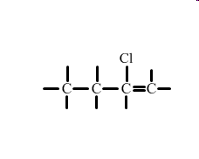
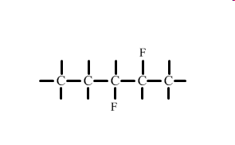
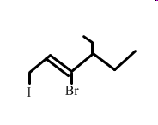
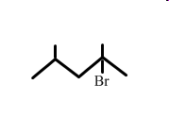

Slide 7
Draw the line structural diagram for the following organic halides
1,1 dichloro-propane
3-chloro-2-phenyloct-4-ene
3- ethyl -3-iodo-4-methyl hept-1-yne
1-3 dibromo-benzene

Slide 8
Addition reactions
An addition reaction is a organic reaction that takes place when a unsaturated hydrocarbon reacts with a small molecule to create a saturated hydrocarbon or an organic halide
But-1-ene + excess hydrogen
butane

Slide 9
but-1-yne + excess hydrogen
butane
Both of these are examples of a sub category of addition reactions
They are called hydrogenation reactions

Slide 10
Another addition reaction that is important to the Alberta chemical industry is the production of 1-2 dichloroethane, which is used to produce PVC
Ethene + excess chlorine
1-2 dichloro ethane

Slide 11
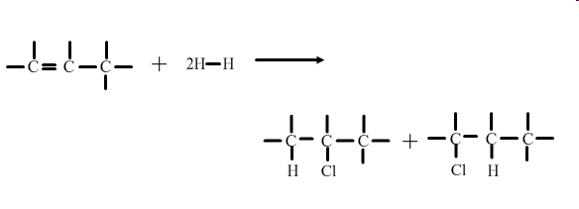
Draw the line structural diagram that represents the production of 2-chloropropane and 1-chlorpropane from propene and excess hydrogen chloride

Slide 12
Substitution reaction
A substitution reaction is a saturated hydrocarbon reacting with a small molecule to produce an hydrocarbon derivative
The small molecules atoms are going to replace the hydrogens to form the hydrocarbon derivative

Slide 13
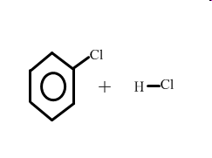
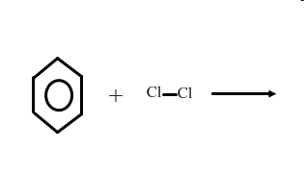
Draw and name the product of the reaction of benzene with chlorine gas
chlorobenzene

Slide 14
Homework
Organic Halides, Substitution and Addition reactions Assignment

