Slide 1
10.3
Alcohols and Elimination Reactions

Slide 2
Alcohols and Elimination Reactions
Alcohols are organic derivatives with the hydroxide ions replacing one or more hydrogens R-OH– R represents the hydrocarbon chain
Physical properties
Higher boiling point than hydrocarbons of similar size
Due to the hydrogen bonds in the alcohol
Smaller alcohols are very soluble with water but as they get larger, the solubility decreases

Slide 3
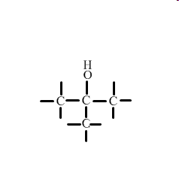
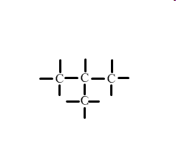
Naming Alcohols
Name the original hydrocarbon chain, including any branches.
Indicate the alcohol with the –ol- suffix
Indicate the carbon it comes off in the same manner as the branches without the OH function group
Example: 2-methyl-propane
With the functional group
2-methyl-propan-2-ol

Slide 4
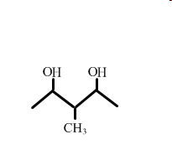
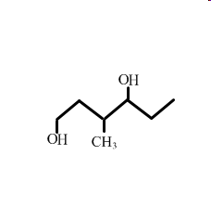
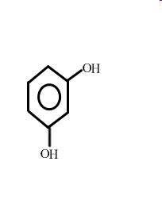
Name the following
3-methyl-pentan-1-2-diol
3-methyl-hexan-1-4-diol
Benzan-1-3-diol

Slide 5
Draw the following alcohols
3-ethyl-octan-2-ol
Decan-3-4-diol

Slide 6
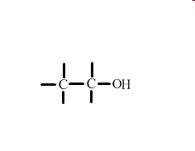
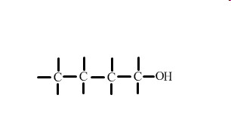
Primary, Secondary and Tertiary Alcohols
A primary alcohol has the hydroxyl group (OH) bonded onto a carbon that is bonded onto only one other carbon
Ex ethanol
butan-1-ol
Bonded onto only one
Carbon

Slide 7
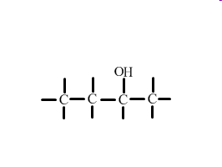
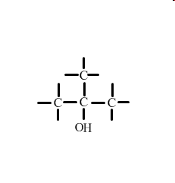
Secondary alcohols have the hydroxyl group bonded onto a carbon that has two carbon-carbon bonds
Butan-2-ol
A tertiary alcohol have the hydroxyl group attached to a carbon that has three carbon-carbon bonds
2-methyl-propan-2-ol
Bonded onto 2 carbon
Bonded onto 3 carbon

Slide 8
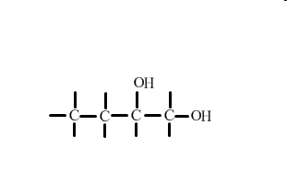
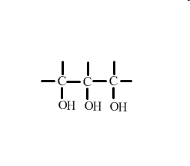
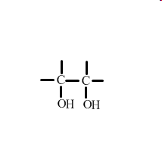
Poly alcohols are substances with two hydroxyl groups.
Ex
To name a poly alcohol, indicate the number of the carbon that the hydroxyl group is off of and use the prefix di or tri how many there are
Butan-1,2-diol
Ethan-1,2-diol
Propan-1,2,3-triol

Slide 9
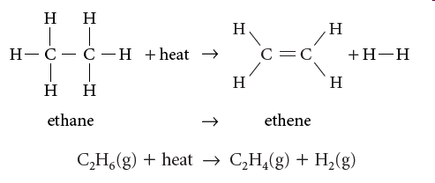
Elimination reactions
As we said before, because ethene is such a major component on many chemicals, not enough is produced naturally.
One way that ethene is produced is ethane cracking. This is actually an elimination reaction.
The hydrogen branches are being eliminated from the alkane

Slide 10
Elimination reactions
As we said before, because ethene is such a major component on many chemicals, not enough is produced naturally.
One way that ethene is produced is ethane cracking. This is actually an elimination reaction.
The hydrogen branches are being eliminated from the alkane

Slide 11
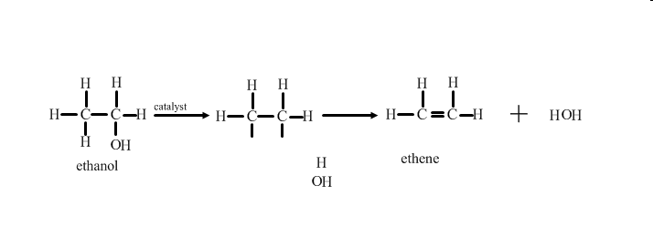
Alcohols can also undergo an elimination reaction to produce alkenes.
The ethanol is heated in the presence of a catalyst and the hydroxyl group and one hydrogen atom are removed.
Elimination reactions involve the eliminating/removing atoms or groups of atams from adjacent carbons.

Slide 12
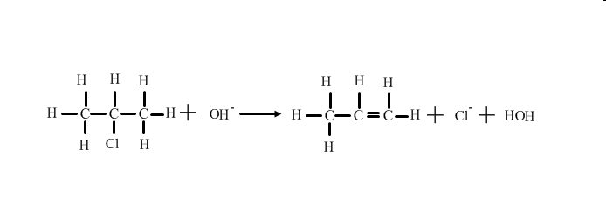
Another type of elimination reaction is a dehydrohalogenation, which is the removal of a hydrogen and halogen from a organic halide.
This type of elimination reaction requires a strong base to perform.

Slide 13
Write the structural formula equation for the preparation of but-2-ene from 2-chlorobutane, in the presence of a strong base.

Slide 14
Homework
Alcohols assignment

