Slide 1
Chapter 15
Section 15.2
Hormones that Affect Blood Sugar

Slide 2
15.1 questions?

Slide 3
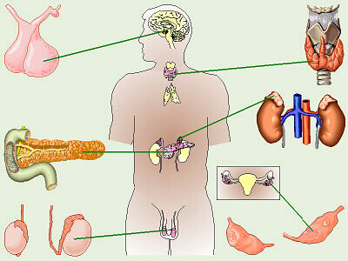
Endocrine Glands
Two glands of the endocrine system are responsible for maintaining blood sugar levels:
1. Pancreas
2. Adrenal Glands

Slide 5
Pancreas
The pancreas contains 2 types of cells:
Cells that produce digestive enzymes.
Cells that produce hormones.

Slide 6
The hormone producing cells in the pancreas are located in structures called islets of Langerhans.
200, 000 islets in pancreas.
Each islets contains thousands of beta and alpha cells.

Slide 7
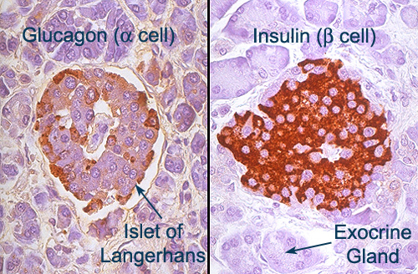

Slide 8
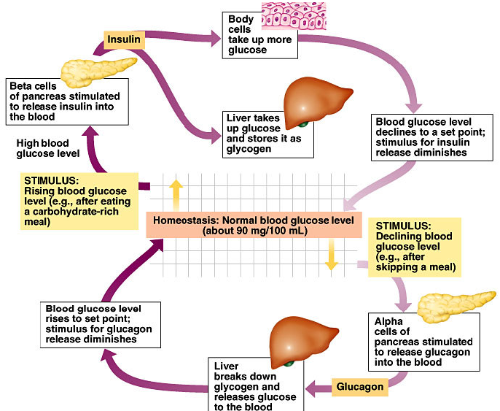

Slide 9
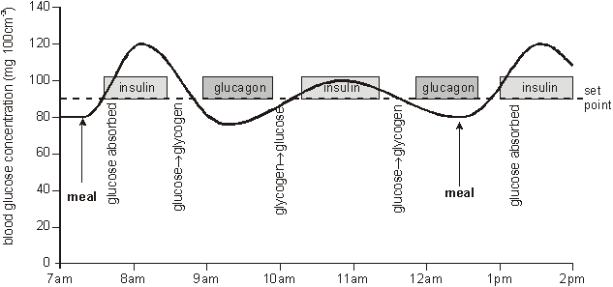

Slide 10
Two hormones are produced in the pancreas:
Insulin
produced by beta cells
released when blood sugar is high
lowers blood sugar back to normal by promoting the storage of it
causes cells of muscles, the liver and other organs to become permeable to glucose
in liver the glucose is converted to glycogen (storage form)
Feedback Loop!!!
NUMBER ONE!

Slide 11
2. Glucagon
produced by alpha cells
released when blood sugar is low
raises blood sugar by promoting the conversion of glycogen (storage form) into glucose
this adds glucose to the blood returning the level to normal
Feedback Loop!!!
NUMBER 2

Slide 12
Diabetes Mellitus
Diabetes – is a chronic disease in which the body cannot produce any insulin or enough insulin, or is unable to use the insulin it does make.
When left untreated diabetes can cause blindness, kidney failure, nerve damage and limb amputation.
Diabetes animation

Slide 13
As a result of no insulin or insulin not performing it’s job, blood sugar levels rise very sharply following meals.
High blood sugar is known as hyperglycemia.
Because all of the glucose is trapped in the blood and is unable to reach the cells and tissues, they must turn to other sources of energy (fats and proteins).

Slide 14
Switching to these other sources of energy creates problems.
Acetone is an immediate product of excessive fat metabolism.
Can be smelled on peoples breath.

Slide 15
Symptoms of Diabetes
Tiredness
Large amounts of urine
Presence of glucose in urine
Thirst

Slide 16
Testing for Diabetes
A simple urine test is used to diagnose diabetes.
Glucose is not normally found in urine, and if it is, it is a trace amount.
Normal glucose range in urine is 0 - 0.8 mmol/l or 0 - 15 mg/dL.
If blood glucose is extremely high due to lack of insulin, the kidneys will filter out the glucose in our urine as waste.
Therefore the presence of glucose in the urine is an indication of diabetes.

Slide 17
Types of Diabetes
3 main types:
Type 1 Diabetes (Juvenile Onset) – pancreas is unable to produce insulin because of degeneration of the beta cells in islets of Langerhans.
- Insulin must be taken for survival.
- 10% of people with diabetes have Type 1.

Slide 18
2. Type 2 Diabetes (Adult Onset) – decreases insulin production or ineffective use of insulin.
- Can be controlled with diet, exercise and oral drugs called sulfonamides.
- 90% of people with diabetes have Type 2.

Slide 19
3. Gestational Diabetes – is a temporary condition that occurs in 2-4% of pregnancies.
- Pregnancy hormones block insulin for doing it’s job.
- Increases the risk of Type 2 for mother and child later in life.

Slide 20
Islet Cell Transplants
Researchers are attempting to come up with a more permanent cure for diabetes.
Inserting new, fully functioning islets.

Slide 21
Adrenal Glands
Located above each kidney.
Each adrenal gland is made of 2 glands encased in one shell.
The inner gland, the adrenal medulla, is surrounded by the outer gland, the adrenal cortex.
Medulla regulated by the nervous system.
Cortex regulated by hormones.

Slide 22
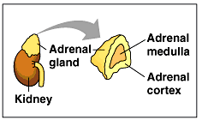

Slide 23
The adrenal medulla produces two hormones:
Norepinephrine AKA Noradrenaline
Initiates the fight or flight response by increasing heart rate and blood sugar levels
Epinephrine AKA Adrenaline
accelerates heart rate and body reactions further during a crisis
part of the ‘fight or flight’ response

Slide 24
In a stressful situation, the sympathetic nervous system causes epinephrine and norepinephrine to be released from the adrenal medulla into the blood.
Blood sugar levels rise because they promote glycogen (stored form) to be converted into glucose.
This ensures that more energy is available to muscles.
Heart rate increases, breathing rate, blood vessels and pupils dilate.

Slide 25
The adrenal cortex produces three steroid (fat soluble) hormones:
Glucocorticoids
increases blood glucose by converting other sources of energy into glucose
Ex. breaks down fats and proteins and converts to glucose
most important glucocorticoid is cortisol
cortisol increases the level of amino acids in blood so the amino acids can be converted to glucose by the liver
this helps the cells recover from stress because stress uses up our glucose stores

Slide 26
2. Mineralocorticoids
help maintain water and ion balance by increasing the amount of sodium and water reabsorbed into the blood by the kidneys
most important mineralocorticoid is aldosterone
aldosterone increases sodium and water reabsorption by the kidneys
this helps to maintain body fluids

Slide 27
3. Sex hormones
any hormone that affects the development and growth of the sex organs
we will discuss sex hormones in Unit B

Slide 28
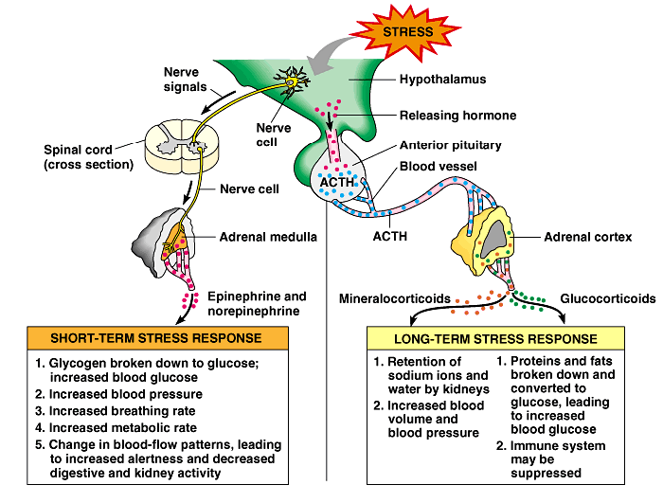

Slide 29
Short Term Response to Stress
Feedback Loop!!!
NUMBER 3
Brain identifies stressful situation.
Cells in hypothalamus send signals to nerve cells in spinal cord.
Spinal cord cells stimulate adrenal medulla to secrete hormones.
Adrenal medulla secretes epinephrine and norepinephrine.

Slide 30
Long Term Response to Stress
Feedback Loop!!!
NUMBER 4
Brain identifies stressful situation.
Hypothalamus sends releasing hormone to anterior lobe of pituitary.
Anterior lobe secretes ACTH (adrenocorticotrophic hormone).

Slide 31
ACTH is a trophic hormone, which means its target is another endocrine gland as opposed to cells.
ACTH is carried by the blood stream to cells in adrenal cortex.
Cells in adrenal cortex secrete mineralocorticoids and glucocorticoids.

Slide 32
**Do 15.2 questions Animation

