Slide 1
Chapter 17
Section 17.2
Applications of the Cell Cycle

Slide 2
Introduction
Scientists continue to study the cell cycle and gain a deeper understanding of the mechanisms and the role of the process.
As more is learned about the cell cycle, we have been able to apply this knowledge to many humans needs.
One technology that has come about from the study of the cell cycle is cloning.

Slide 3
Cloning
Cloning is the process of forming identical offspring from a single cell or tissue in the parent organ.
A clone originates from a single parent cell and has identical genetic information.
Cloning is therefore considered a form of asexual reproduction.

Slide 4
Natural Clones
Some cloning occurs naturally in nature.
Asexual Reproduction of Plants
A cutting from certain plants, will grow an identical organism if planted in soil.
Identical Twins
A single fertilized egg undergoes mitosis and the zygote splits into two identical cells.

Slide 5
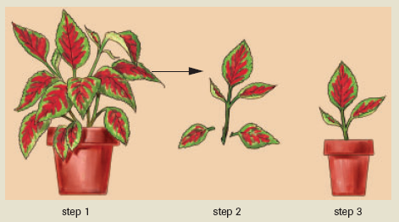
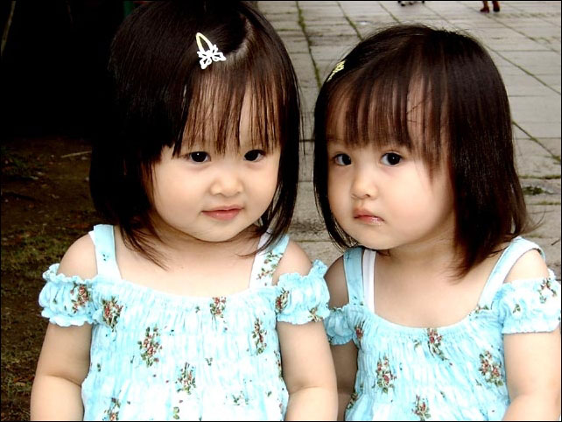
Natural Clones

Slide 6
Plant Cloning Technology
Since the 1950’s scientists have been able to produce adult plants from a single cell.
It has become useful in commercial industries such as flower shops, farms and orchards.
Cloning allows the plants to be identical to their parents, so these businesses choose plants with specific traits that would be beneficial for their industry.
Ex. Largest potatoes

Slide 7
Animal Cloning Technology
Animal cloning technology took much longer to discover because the organisms are much more complex.
The experiments began with frogs.
A nucleus was extracted from an unfertilized frog egg.

Slide 8
Next, the nucleus of a cell from a frog embryo in the blastocyst stage was removed and inserted in the enucleated cell (nucleus removed).
The egg cell with the transplanted nucleus began to divide like a normal fertilized egg.
The cell eventually grew into an adult frog.
The adult frog was identical to the frog who supplied the nucleus.

Slide 9
From frogs they have moved on to adult mammals.
Mammals are much harder to clone because their cells are much more specialized, and once cells become specialized they lose their ability to undergo mitosis.
So the nuclei have to be collected from the parent mammal very early to make sure that the cells have not yet become specialized.

Slide 10
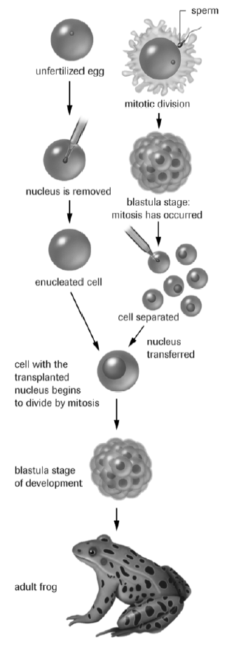
Animal Cloning

Slide 11
Successful Clones
The most famous of the successful clones is “DOLLY” the sheep.
Dr. Ian Wilmut of the Rosalind Institute in Scotland, extracted the nucleus from an udder cell of an adult sheep (Finn Dorsett breed).
The egg was allowed to develop in a Petri dish until an early embryo stage.

Slide 12
Then the embryo was planed into the womb of a third sheep (Scottish Blackface breed).
The adult sheep was identical to the Finn Dorsett breed, proving that Dolly was a clone.
VIDEO:
http://www.youtube.com/watch?v=txr8-0RaD-A

