Slide 1
1.3- Electrons and the Formation of Compounds
Pg. 25-32

Slide 2
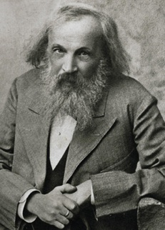
1.3 Electrons and the Formation of Compounds p. 25-37
During the 1800’s, a Russian chemist, Dmetri Mendeleev, examined 62 elements. He developed a table of these elements based upon their repeating properties.
He also predicted the existence and properties of unknown elements and left spaces on the periodic table for them.
Elements are arranged according to increasing atomic number (number of protons in the nucleus)

Slide 3
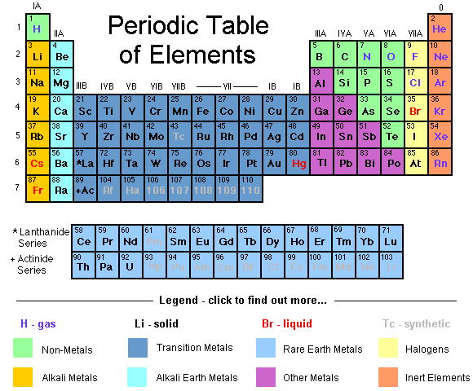
Examine our modern periodic table on p482. It displays the known elements in a format that follows various patterns and trends:

Slide 4
Patterns in the Periodic Table
Left of the staircase line are metals: mostly solids, these elements are shiny, malleable, ductile, and conduct electricity.
To the right are non-metals: these elements are either solid, liquid or gas. They are dull, brittle and do not conduct electricity.
Surrounding this line are the metalloids: these elements display both metal and non-metal properties.

Slide 6
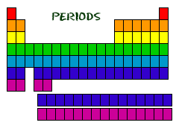
Periods (rows)
The period number tells you how many energy levels you have.
Properties change in 2 ways as you move from left to right across a period:
The elements change from metal to non-metal
The elements become less reactive.

Slide 7
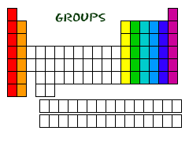
Groups
Elements in the same group have very similar properties.

Slide 8
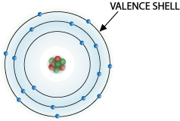
Group number tells us how many electrons are in the valence shell.
for groups 13 – 18, we use the last number to designate the number of valence electrons
(eg. elements in group 16 have 6 valence electrons)
electrons fill the first orbital before they can occupy the second, and fill the second before they can occupy the third
when the valence level is full, it is referred to as a stable octet since there are 8 electrons occupying the orbital (unless it is the first level)

Slide 9
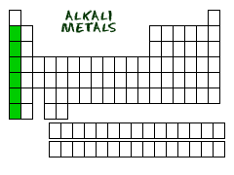
Group 1 – hydrogen and the alkali metals.
The most reactive metals and react violently in air or water. Reactivity increases as you move down the group
alkali metals and water
Brainiacs show alkali reactions
francium in water

Slide 10
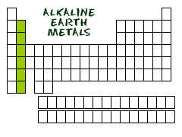
Group 2 –the alkaline-earth metals.
very reactive with oxygen, but less reactive than the alkali metals.

Slide 11
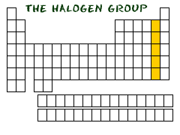
Group 17 –the halogens
The most reactive of the non-metals. They tend to combine with other elements to make compounds.

Slide 12
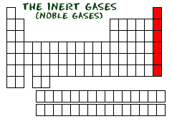
Group 18 – the noble gases
The most stable and unreactive of the elements.

Slide 13
Inner-transitional elements
top period = lanthanoids (fits in period 6)
bottom period = actinoids (fits in period 7)

Slide 14
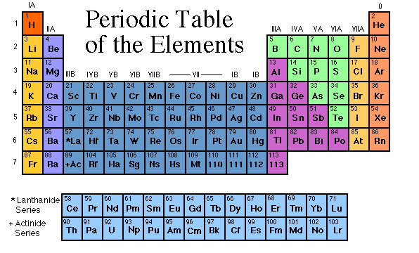

Slide 15
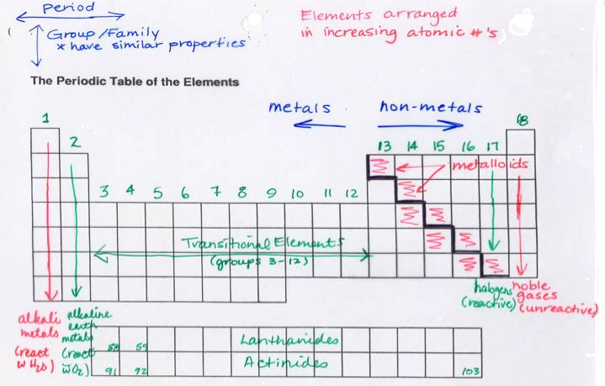

Slide 16
Now here’s a little song about the elements.
http://www.youtube.com/watch?v=zUDDiWtFtEM Enjoy!

Slide 17
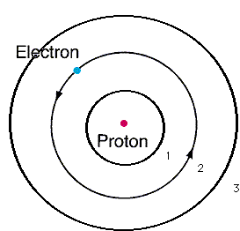
Energy Level Diagrams
Recall that Bohr inferred that electrons orbit the nucleus in fixed energy levels.
Each level can only hold a certain maximum number of electrons.
The first can hold 2 electrons, the second can hold 8, and the third can hold 8.

Slide 18
Electron energy level diagrams show us the number of electrons in each energy level, the number of protons, and the charge on the atom or ion.
Ex. The energy level diagram for Mg
2e-
8e-
2e-
12p⁺
Mg

Slide 19
period number shows the number of orbitals used in each element (eg. period 2 elements have 2 orbitals)
group number describes how many electrons are found in the valence or outermost energy level (eg. lithium is in group 1 and has 1 valence electron)
for groups 13 – 18, we use the last number to designate the number of valence electrons (eg. elements in group 16 have 6 valence electrons)
electrons fill the first orbital before they can occupy the second, and fill the second before they can occupy the third
when the valence level is full, it is referred to as a stable octet since there are 8 electrons occupying the orbital (unless it is the first level)

Slide 20
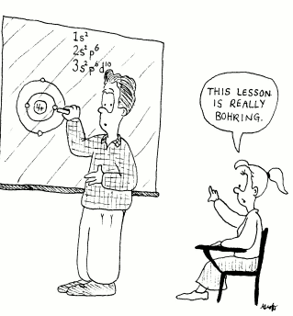
The diagram representing the element beryllium looks like this:
2e-
2e-
4p+
4 nº
- Draw the energy level diagram for fluorine atom and a fluoride ion.

Slide 21
Metals will give away electrons and become positive ions called cations
Non-metals will take electrons and become negative ion called anions
When non-metals become ions you add an –ide at the end of their name

Slide 22
Fluorine Fluoride Ion

Slide 23
http://www.youtube.com/watch?v=zUDDiWtFtEM

Slide 24
See figure 1.22B on P. 26
Do Practice Problems p. 27 #9-12
and BLM 1-4 “Periodic Table Scavenger Hunt”.

