Slide 1
DNA Replication 20.1 part 2

Slide 2
DNA replication
Earlier on in this unit we learned about mitosis or cell division.
In order for mitosis to occur and chromosomes to duplicate themselves, the DNA must copy itself exactly.
This is known as DNA replication – the process whereby DNA makes exact copies of itself.

Slide 3
DNA replication cont’d
DNA replicates itself in a semiconservative manner.
When DNA replicates, it divides the two parent (original) strands and makes a new complementary strand for each parent strand.
Thus the resulting replica of DNA consists of half the parent strand and have the new strand.

Slide 4
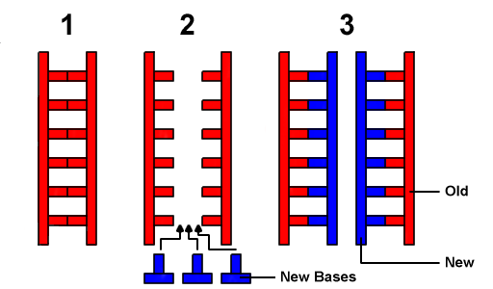
DNA replication cont’d
This is known as semiconservative replication – the process by which each DNA molecule is composed of one parent strand and one newly synthesized strand.

Slide 5
DNA replication Cont’d
DNA replication can be split into three main sections:
Separating the DNA Strands
Building Complementary Strands
DNA Repair

Slide 6
Separating the DNA strands
For replication to occur the two strands of DNA must be unwound and pulled apart (unzipped).
It requires an enzyme to break the bonds between the nitrogenous bases.
The enzyme responsible for unwinding the helix and breaking the bonds is known as DNA helicase.
Once DNA helicase has unzipped the two strands, proteins can bind to the strands to help keep them apart during replication.

Slide 7
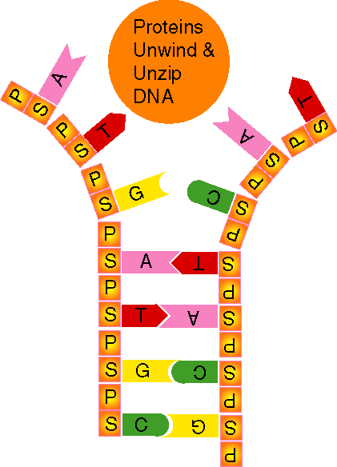
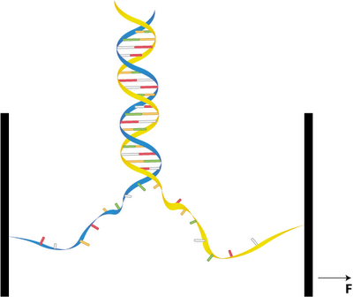
Separating the dna strands
The point at which the two parent strands are separating is called the replication fork.

Slide 8
Building the complementary strands
After the DNA has been separated an enzyme called DNA polymerase III builds new strands on each of the parent strands.
The new strands are built through complementary base pairing.
But before new nucleotides can be attached, a short piece of a single stranded ribonucleic acid, called an RNA primer is attached to each parent strand.

Slide 9
Building the complementary strands
The RNA primer acts as a starting point for building the new DNA strands.
DNA polymerase III then adds nucleotides one by one to the parent strand.
The nucleotides can only be added in a single direction, from the 5’ carbon to the 3’ carbon.

Slide 10
Building the complementary strands
One of the strands will be synthesized in the same direction as the ‘unzipping’ so the nucleotides can be added continuously.
This strand is called the leading strand.
The other strand will be synthesized in the opposite direction of the ‘unzipping’ and therefore nucleotides can only be added a few at a time.
This strand is called the lagging strand.

Slide 11
Building the complementary strands
Because the lagging strand requires a new starting point every few nucleotides, many more RNA primers are used.
Once all the nucleotides have been added one by one, the final step is to remove the RNA primers from the strand and replace them with the correct nucleotides.
The RNA is cut out and replaced with nucleotides by an enzyme called DNA polymerase I.

Slide 12
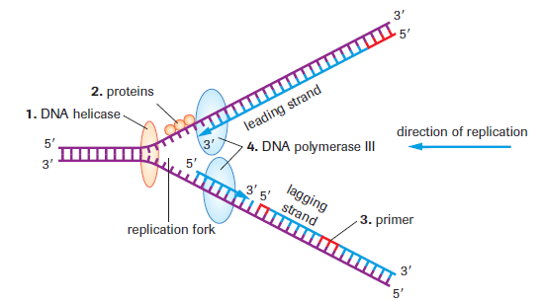
Building the complementary strands
Once the RNA primers have been removed, the enzyme DNA ligase joins the DNA strands back together.

Slide 13
DNA repair
As complementary strands of DNA are built or synthesized, both DNA polymerase I and III act as proofreaders.
They check the strands for mistakes.
When a mistake occurs, the DNA polymerases backtrack to the incorrect nucleotide, cut it out, and continue the replication.

Slide 14
Crash course
Cartoon model: https://www.youtube.com/watch?v=27TxKoFU2Nw
3-D: https://www.youtube.com/watch?v=dKubyIRiN84 (start at 1:30)
Crash course: https://www.youtube.com/watch?v=JIPw-Bd0WGg

