Slide 1
Chapter 20
Section 20.2
Gene Expression

Slide 2
Gene Expression
Specific segments of DNA on a chromosome are called genes.
Genes determine the outward, physical traits of an organism.
The way the information in the DNA sequence for a specific gene gets expressed is through the production of a polypeptide.
This process is known as .

Slide 3
Gene Expression Cont’d
Polypeptides are
More than one polypeptide makes up a .
The proteins produced from the DNA sequences are used to form most structures in an organism, such as skin, muscle and organs, therefore expressing the phenotype of the gene.

Slide 4
Role of RNA
Ribonucleic acid or RNA is a nucleic acid involved in
RNA is different from DNA in 3 ways:
1. The sugar in RNA has an extra hydroxyl (OH) group and is called a

Slide 5
1. Extra Hydroxyl

Slide 6
Role of RNA Cont’d
2. Instead of the nitrogenous base thymine, RNA contains the base Uracil forms a complementary base pair with adenine, like thymine.

Slide 7
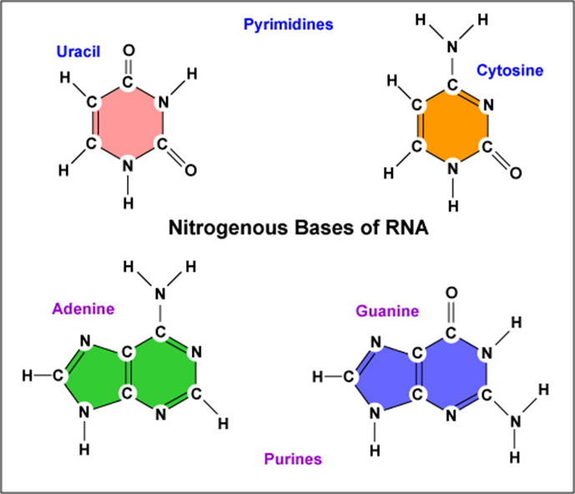
2. Uracil instead of Thymine

Slide 8
3. RNA is a .

Slide 9
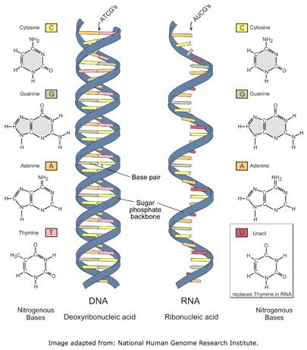
3. Single Strand

Slide 10
3 Types of RNA
There are 3 types of RNA that are needed to convert genes into proteins:
Messenger RNA (mRNA)
Transfer RNA (tRNA)
Ribosomal RNA (rRNA)

Slide 11
Stages of Gene Expression
There are two main stages of gene expression:
Transcription – the process of converting DNA into messenger RNA.
Translation – the process of converting the messenger RNA into a polypeptide and eventually a protein.

Slide 12
Transcription
During transcription, the DNA sequence of a gene is copied (transcribed) into the sequence of a single stranded
Transcription can be divided into 3 processes:
Initiation
Elongation
Termination

Slide 13
Transcription - Initiation
Transcription starts when an enzyme called binds to the DNA in front of the gene that is about to be copied or transcribed.
This region of initial binding is called the .

Slide 14
Transcription - Elongation
Once the RNA polymerase binds to the promoter it opens up the double helix.
Once the helix is open, it builds the single stranded mRNA one nucleotide at a time by copying the nucleotides from the DNA.
It copies in the same direction that DNA is replicated, 5’ to 3’.
The DNA strand that is being copied is called the .

Slide 15
Transcription - Termination
Synthesis of the mRNA continues until RNA polymerase reaches the end of a gene.
RNA polymerase recognizes the end of a gene when it comes to a stop signal called a termination sequence.
A – is a specific sequence of nitrogenous bases that indicates the end of a gene.
Once the termination sequence is reached the mRNA is released from the template strand of DNA.

Slide 16
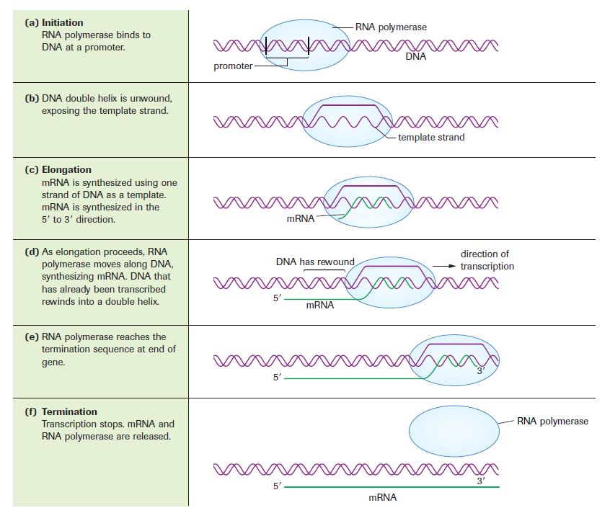

Slide 17
BREAK

Slide 18
Translation
Once the sequence of nucleotides is copied to the mRNA, converts the sequence of bases from the mRNA into a chain of amino acids, making a polypeptide and eventually a protein.
Translation is essentially protein synthesis.

Slide 19
Amino Acids
There are only 20 different amino acids found in human proteins.
Because of the few number of amino acids compared to the many combinations of sequences of nitrogenous bases that can be formed, a few different nitrogenous base sequences code for the same amino acid.
DNA code is read is groups of 3 nucleotides, called a .
Each codon or group of 3 nucleotides calls for a specific amino acid.

Slide 20
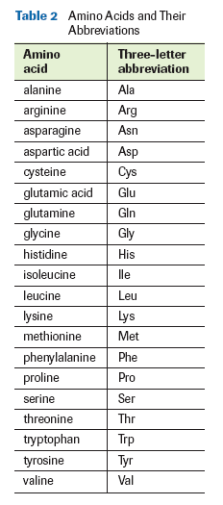
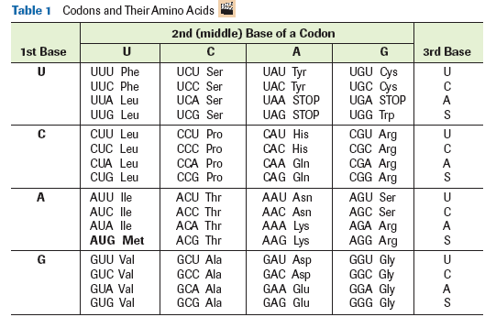

Slide 21
Special Codons
Out of the many DNA codons there are two very special ones:
Start codon – a specific codon that signals the start of translation. The specific codon is AUG.
Stop codons – specific codons that signal the end of translation. The specific codons are UAA, UAG and UGA.

Slide 22
Translation Cont’d
Translation can also be divided into the same 3 processes as transcription:
Initiation
Elongation
Termination

Slide 23
Translation - Initiation
Initiation of translation occurs when a ribosome recognizes a start codon on the mRNA and binds to that site.
The of ribosomes in eukaryotes, consist of two subunits, a large and small subunit. The two subunits of rRNA bind to the mRNA, clamping it between them.
The ribosome then moves along the mRNA in the 5’ to 3’ direction, adding a new amino acid to the polypeptide chain each time it reads a codon.

Slide 24
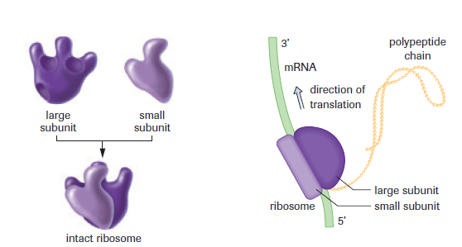

Slide 25
Translation – Initiation Cont’d
The correct amino acids for each codon or sequence are brought to the ribosome by a third type of RNA called tRNA or transfer RNA.
At one end of the tRNA molecule is a sequence of three bases that compliments the codons on the mRNA, called an anticodon.
Ex. mRNA codon = UAU
tRNA codon = AUA

Slide 26
Translation – Initiation Cont’d
At the other end of the tRNA molecule carries the corresponding amino acid for the mRNA codon.
Ex. mRNA codon = UAU
tRNA codon = AUA
Then amino acid on tRNA is tyrosine because UAU codes for tyrosine.

Slide 27
Translation - Elongation
The first codon that is recognized is always AUG, the start codon.
AUG corresponds to the methionine amino acid, so every protein in our bodies starts with methionine.
The ribosome has two sites for tRNA to attach: the A (aminoacyl) site and the P (peptidyl) site.

Slide 28
Translation - Elongation
The tRNA with the anticodon complimentary to the start codon enters the P site.
The next tRNA molecule with the anticodon complimentary to the next codon enters the A site.
When both are present in the different sites a peptide bond forms between the two amino acids at the ends of the tRNA molecules.

Slide 29
Translation - Elongation
Once the bond has formed, the ribosome boots out the tRNA from the P site, moves the second tRNA into the P site, leaving the A site open for the next tRNA molecule.
This action continues adding on each new amino acid depending on each codon of the mRNA.
The tRNAs that have been released are recycled back by having new amino acids attached to them.
The process continues until the entire code from the mRNA has been translated into a polypeptide chain.

Slide 30
Translation - Termination
Eventually, the ribosome reaches one of the three stop codons: UGA, UAG or UAA.
This stops the translation of the mRNA into amino acids.
At this point a release factor recognizes that the ribosome has stalled and helps release the polypeptide chain from the ribosome.
We have now made a protein from a sequence of DNA. These proteins make up our body structures, expressing our genes physically.

Slide 31
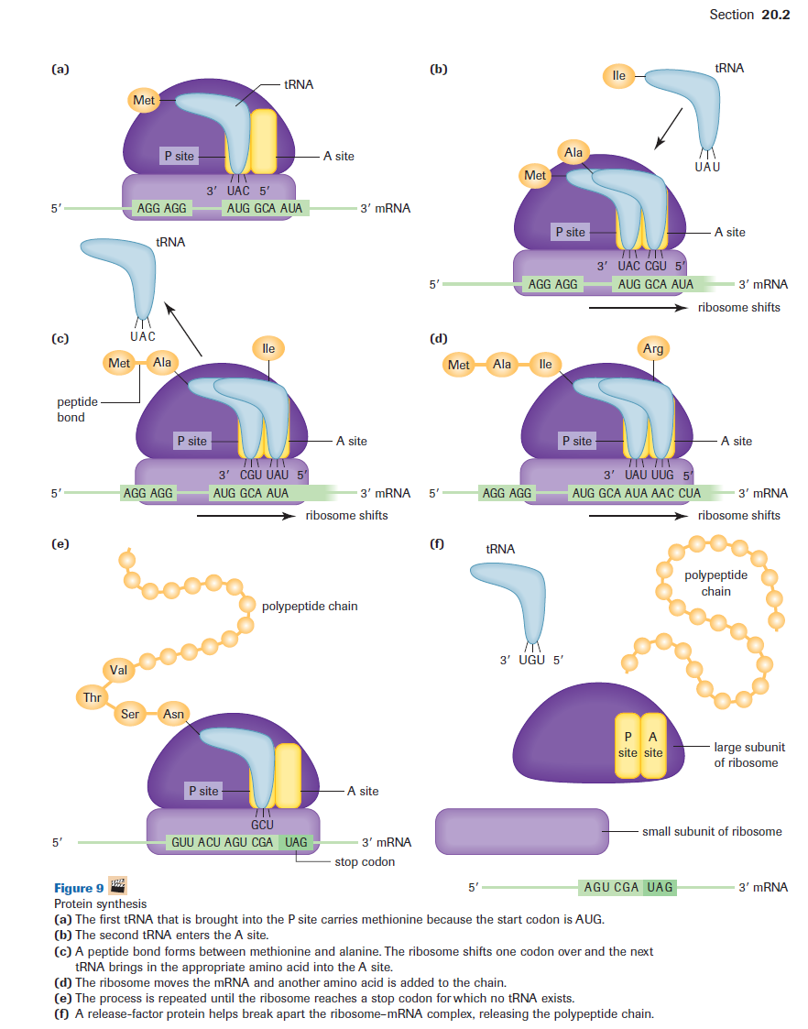

Slide 32
