Slide 1
MORE ON RESPIRATION!!!

Slide 2
External Respiration
External respiration or breathing is a process of inhaling the air into the lungs and expelling the air that contains more carbon-dioxide from the lungs to the outer environment.
External respiration is a physical process in which oxygen is taken up by capillaries of lung alveoli and carbon-dioxide is released from blood.

Slide 3
Internal respiration
Internal respiration or cellular respiration/tissue respiration is a metabolic process during which oxygen is used in tissue cells to make energy in the form of ATP (adenosine triphosphate).
Where did that oxygen come from???

Slide 4
Gas Diffusion
Gas exchange only occurs in the alveoli within the Respiratory System
Alveoli have very thin membranes that are covered in capillaries
Gas diffuses across the
Alveoli-Capillary membrane

Slide 5
Oxygen is not very soluble in blood- 0.3mL of oxygen per 100mL of blood
BUT… we require about 10 times that amount

Slide 6
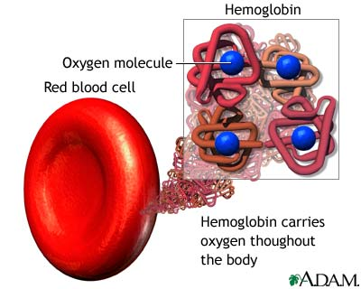
Hemoglobin
Hemoglobin greatly increases the oxygen carrying capacity of the blood

Slide 7
Red blood cells are composed of hemoglobin (heme+globin) which can attach oxygen
Each heme contains an iron atom that can bind an oxygen molecule.
Bond between oxygen and hemoglobin= oxyhemoglobin

Slide 8
The amount of oxygen that combines with hemoglobin is dependent on partial pressure

Slide 9
How do we get oxygen?
When we inhale air:
Oxygen moves from the atmosphere, the area of highest partial pressure, into our lungs and down into the alveoli
Oxygen moves from the alveoli into the blood and attaches to hemoglobin

Slide 10
OXYGEN DIFFUSION
The partial pressure in the lungs is approximately 13.3kPa so blood leaving the lungs is saturated with oxygen

Slide 11
OXYGEN DIFFUSION
When the blood transports through the body and to your body tissues and into the capillaries the partial pressure drops to 5.3kPa.
This causes the dissociation of oxygen from hemoglobin and oxygen diffuses into the tissues

Slide 13
NOW… the body cells are able to undergo: Cellular Respiration
The chemical formula for this is:
C₆H₁₂O₆ + O₂ CO₂ + H₂O
Where does all that CO₂ go? It will start to build up in the body cells and it needs to get out of the body!!! Too much CO₂ is toxic.

Slide 14
Where does the CO2 go?
Carbon dioxide is 20 X more soluble than oxygen
9% of the carbon dioxide waste from the body cells is transported in the plasma liquid
27% combines with hemoglobin to form= carbaminohemoglobin
64% combines with water to form carbonic acid
CO₂ + H₂0 H₂CO₃ _{(aq)}

Slide 15
Carbonic anhydrase
Carbonic anhydrase= an enzyme that speeds up this chemical reaction 250 times faster!
CO₂ + H₂0 H₂CO₃ _{(aq)}

Slide 16
Carbonic acid
This is GOOD because:
making more carbonic acid decreases the partial pressure of CO₂
making it easier to get CO₂ out of our body

Slide 17
Carbonic Acid
But it is also BAD because:
Now we have lots of acid in our blood
TOO much ACID= ouch!

Slide 18
Carbonic acid buffered
The acid ionizes making:
H₂CO_{3(aq)} H⁺_{(aq)} + HCO₃⁻_{(aq)}
H⁺_{(aq)} will combine with hemoglobin and stabilizes the H⁺_{(aq)}
Since hemoglobin stabilizes H⁺_{(aq)} we say that hemoglobin acts a BUFFER

Slide 19
The leftovers will undergo the following reaction:
H⁺_{(aq)} + HCO₃⁻_{(aq)} H₂O + CO₂
Then all of the CO₂ will leave the body through external respiration (we breathe it out!)

