Slide 1
Alkanes, Alkenes, Alkynes

Slide 2
Straight chain alkanes will have symmetrical electronegativities so they will behave as non-polar molecules
Since ‘like dissolves like’ the alkanes will all be soluble in eachother
However… since water is polar; alkanes will NOT dissolve in water… think of pouring oil on water.

Slide 3
Review Alkanes
Pattern:
# of branch- (numerical prefix of branch amounts)( branch name) (parent name)
If there are multiple branches:
start numbering the parent branch so that the closest branch has the smallest number
Name the branches in numerical and alphabetical order

Slide 4
Ways to represent hydrocarbon compounds:
Structural formula: include all hydrogen and carbons and their respective bonds
Condensed structural formula: Simplify the hydrogen attached to the carbons as such: CH₂ or CH₃
Even simpler condensed structural formula: If there are long chains with say 6 - CH₂ in the chain they can be represented as (CH₂)₆
Mrs. Aitken’s shortcut: Only draw the carbons and use a line to represent bonds to hydrogen
Line structural formula: Use lines to represent the molecule, each corner is a carbon

Slide 5
Draw: 2-ethyl 4,4- dimethyl- hexane

Slide 6
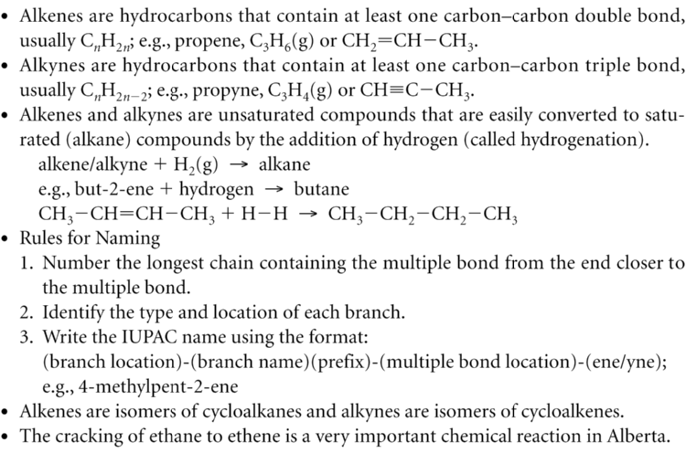

Slide 7
Examples
Notes:
Pg. 375,.376

Slide 8
Hydrogenation
Hydrogenation is the addition of hydrogen to an alkene or an alkyne to produce
Example:

Slide 9
Natural Gas Refining
Natural gas is composed of several hydrocarbons but mostly methane
Raw Natural Gas is made of many impurities that make it “sour”.
It contains H₂S_{(g)} that has the “rotten-egg smell” and it can form acidic solutions with water.

Slide 10
Refining –piped from well site to gas treatment plant
1. Water and hydrocarbons are removed.
2. chemically refined in absorber tower
it reacts with an amine such as ‘diethanolamine’ under high pressure and low temp to make it sweet removing the H₂S_{(g)} and CO_{2(g)}
H₂S_{(g} then reacts with O_{2(g)} and makes SO_{2(g)}
This is then sent to a recovery unit, Claus converter to get the sulfur out.
H₂S_{(g)} + SO_{2(g)} → S_{8(s)} + H₂O_{(g)}
Natural Gas can be 0-80% hydrogen sulfide

Slide 11
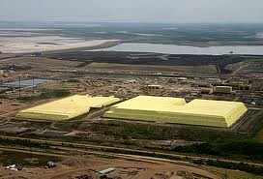
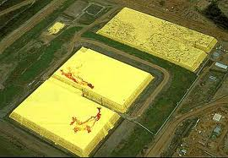
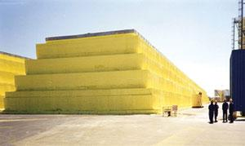

Slide 12
Now we have Sweet Gas…
it has all of the components listed on p. 363 Table 1
Most natural gas is further refined into these components but it could be burned at this point.
Fractional Distillation would be the process used to separate these components and then they can be used for the uses list on Table 2 on page 363.

Slide 13
Fractional Distillation
Natural gas is cooled under high pressure to condense all the components except the methane gas
The condensed liquid is then slowly distilled to separate out the different hydrocarbons

Slide 14
Ethane Cracking
Purpose: produce ethene from ethane
Ethane Cracking= Dehydrogenation
Ethane is one component of natural gas and can be used.
Cracking is an industrial process in which larger hydrocarbon molecules are broken down at high temperatures with or without catalysts to produce smaller hydrocarbon molecules.

Slide 15
Cracking usually refers to breaking a large molecules down into a smaller molecule.
Ethane is ‘cracked’ or dehydrogenated by adding heat and the products are: ethene and hydrogen
Example:

Slide 16
Pg. 377 #1-5
Pg.380 #6,7,11

