Slide 1
Chapter 13
Section 13.2 -1 Electrochemical Impulse

Slide 2
Introduction
Prisoners have often been isolated and placed in dark rooms as a means of punishment. Imagine how you would be affected if you didn’t know whether it was day or night, or if you couldn’t hear a sound for days.
Even in these extreme conditions, however, your nervous system remains active. Information about your depth of breathing, the physical condition of the breathing muscles, and the amount of water contained in the respiratory tract is continually relayed to the brain for processing and storage. Other nerve cells detect air temperature, light intensity, and odours. Pressure receptors in the skin—known as baroreceptors—inform you of the fit of your clothes and can detect an insect scurrying across your leg. Blinking your eyes or scratching your nose requires coordinated nerve impulses. Memories of happy times and hopes for your future reside in the nervous system.
The nervous system is an elaborate communication system that contains more than 100 billion nerve cells in the brain alone. That number exceeds the number of visible stars in the Milky Way galaxy.

Slide 3
Reflect:
What is a cell membrane made out of?
What is semi-permeable?
What is concentration gradient?

Slide 4
How does the nervous system communicate?
The nervous system communicates by sending nerve impulses along neurons between the two different nervous systems (CNS and PNS).
Neurons send messages electrochemically. This means that the chemicals within our body create an electrical signal.
Chemicals in the body are "electrically-charged" -- when they have an electrical charge, they are called "ions."

Slide 5
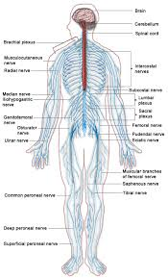

Slide 6
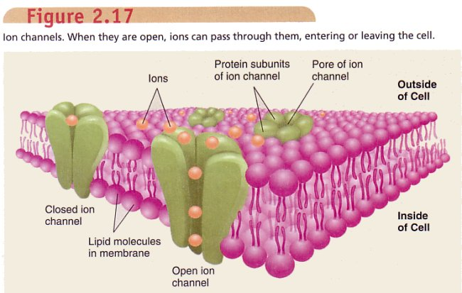

Slide 7
The important ions in the nervous system are sodium and potassium (both have 1 positive charge, Na⁺ and K⁺), calcium (has 2 positive charges, Ca ²⁺) and chloride (has 1 negative charge, Cl⁻).
It is also important to remember that nerve cells are surrounded by a semi-permeable membrane that allows some ions to pass through and blocks the passage of other ions.

Slide 8
Action and Resting Potentials
Our neurons can either be in the action of sending a nerve impulse or they can be at rest.
When our nervous system is sending a message in the form of a nerve impulse our neurons are said to reach an action potential.
When our nervous system is not sending a message or is at rest our neurons are said to be at resting potential.

Slide 9
What is a ‘potential’?
An electrical potential is a difference in electrical charge across a membrane.
Ex. If there are more negative ions on the outside of a membrane and more positive ions on the inside of a membrane, there is a difference in charge across the membrane and therefore an electrical potential is created.
Electrical potentials can be compared to concentration gradients, when there is a difference in concentration across the membrane a concentration gradient is created.

Slide 10
resting potential
When a neuron is not sending a signal, it is "at rest." When a neuron is at rest, the inside of the neuron is negative and the outside is positive.
This negative charge on the inside is created by the movement of ions across the membrane.
Although the concentrations of the different ions attempt to balance out on both sides of the membrane, they cannot because the cell membrane allows only some ions to pass through channels (ion channels).

Slide 11
At rest, membrane is slightly permeable to potassium (K+) and the membrane is impermeable to sodium ions (Na+) and chlorine ions (Cl-)
K is Ok… Na is No way
There is a Sodium-Potassium Pump which puts more Na+ outside of the neuron than putting K+ inside of the neuron… resulting in a build up of positive charge in the EXTRACELLULAR FLUID (ECF)
Sodium potassium pump moves ions via Active Transport

Slide 12
The negatively charged Cl- ions are trapped inside the neuron.
Therefore, a charge difference or an electrical potential is created across the membrane. Because the resting membrane is said to be charged it is also called a polarized membrane.
When the outside of the membrane is positive and the inside of the membrane is negative to a certain degree, the resting potential of the membrane is reached.
The charge difference of a resting membrane is -70 mV (millivolts).

Slide 13
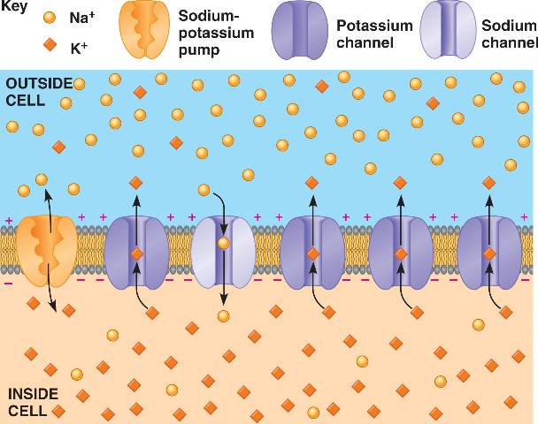

Slide 14
Action potential
When a nerve impulse is being sent an action potential is created.
When a neuron receives a message to be sent, the cell membrane becomes more permeable to sodium than it does potassium.
Na+ channels are opened and K+ channels are closed.
The positively charged Na+ ions rush into the neuron, causing the inside to now become more positive than the outside.

Slide 15
The charge difference across the membrane has become reversed from the resting potential. This reversal in charge is known as depolarization.
When a charge of +40 mV occurs the action potential has been reached and the message has been sent.
Once the voltage on the inside becomes +40 mV and the action potential has been reached, the Na+ channels slam closed, stopping the inflow of sodium.

Slide 16
The K+ channels then re-open and K+ ions continue once again to diffuse out of the neuron.
The charge on the outside becomes positive again and the K+ channels close.
The process of restoring the charge reversal to its original state is known as repolarization.
However, the K+ channels close relatively slowly, allowing more K+ ions out of the neuron than is necessary to restore the membrane’s polarization.

Slide 17
This stage of the action potential is known as hyperpolarization, a state in which the outside of the membrane is more positively charged and the inside is more negatively charged than the resting potential.
In order for another nerve impulse to be sent the membrane must reach its resting potential, so the sodium-potassium pump is needed to fix the hyperpolarization.

Slide 18
This pump moves K+ and Na+ ions back across the membrane in the appropriate direction so that the resting potential of -70 mV can be reached.
The time it takes for the membrane to once again reach resting potential following a depolarization is called the refractory period, which lasts between 1 and 10 ms (milliseconds).

Slide 19
http://bio1152.nicerweb.com/Locked/media/ch48/resting_potential.html
Video: http://www.youtube.com/watch?v=YP_P6bYvEjE
Movement of ions: http://www.youtube.com/watch?v=yQ-wQsEK21E
Longer: http://www.youtube.com/watch?v=Iiiz5CpFCQo

Slide 20
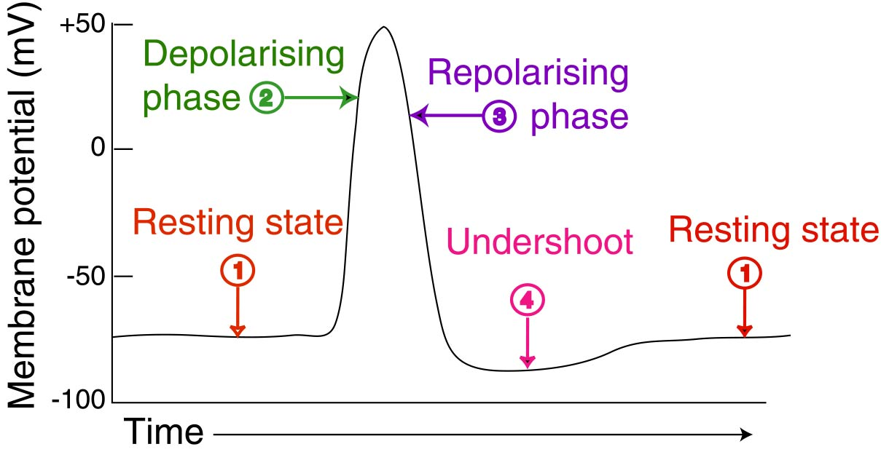
Note: #4 Undershoot = Hyperpolarization

Slide 21
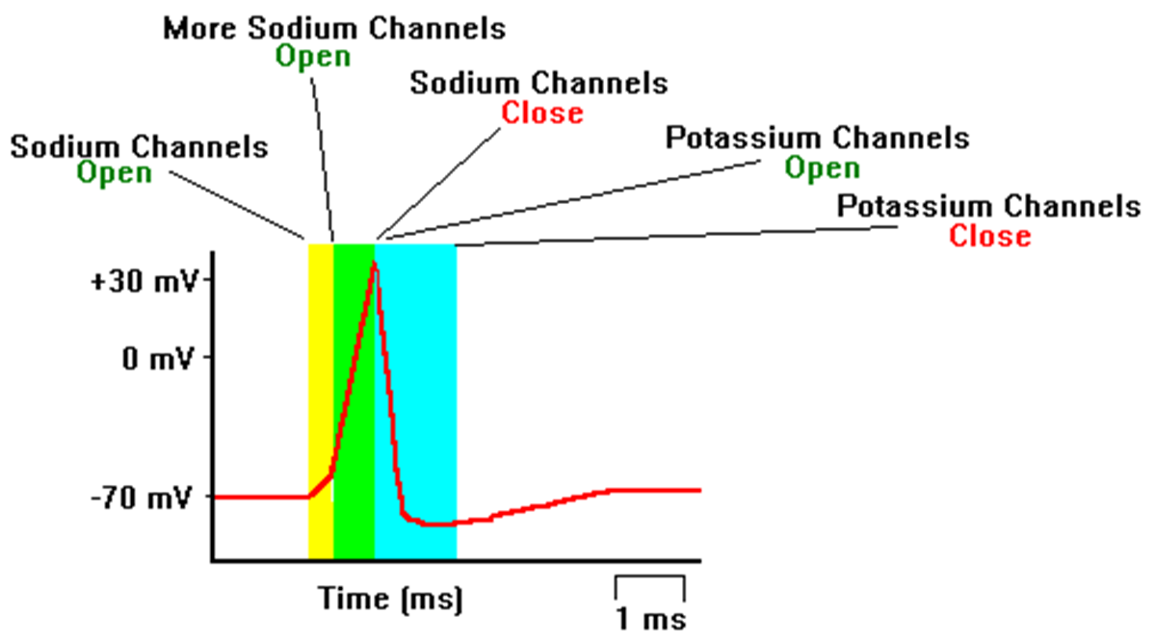

Slide 22
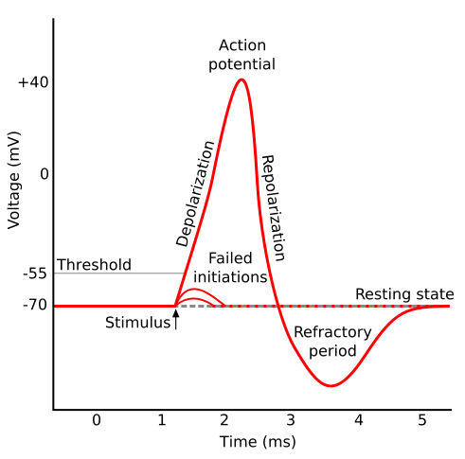
Threshold level
If enough Na+ ions move into the neuron to reach a charge of approx. -55 or -60, an action potential is created and the message will be sent.
-55 or -60 is considered a threshold level. The minimum level that must be reached for an action potential to occur.
- If a charge of -55 or -60 is not reached the action potential will not be created and the message is said to have “failed”.
Stimulus must be strong enough to elicit a response.

