Slide 1
Chem 30 Review

Slide 2
ORGANIC

Slide 3
Organic or Inorganic??
Formula | Organic or Inorganic?
CaCO_{3(s)} | Inorganic (carbonate ion)
C₂₅H_{52(s)} | Organic
Ca₂C_{(s)} | Inorganic (carbide ion)
CCl_{4(l)} | Organic
CH₃COOH_{(l)} | Organic
CO_{2(g)} | Inorganic (oxide)
KCN_{(s)} | Inorganic (cyanide)
C₁₂H₂₂O_{11(s)} | Organic

Slide 4
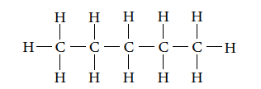
Four Types of Formulas
Molecular Formulas C₅H_{10(g)} Not very useful for organic compounds because so many isomers can exist
Structural Formulas
Condensed Structural Formulas
Line Diagrams
– end of line segment represents carbon
– it is assumed to satisfy each carbon’s octet

Slide 5
Naming Organic Compounds
Aliphatic Hydrocarbons – contains only hydrogen and carbon atoms
Straight line chains of carbon atoms
Alicyclic hydrocarbons have carbon atoms forming a closed ring. Still considered aliphatic
Alkanes | Alkenes | Alkynes
Only single C-C bonds | Double C-C Bond present | Triple C-C bond present
General formula C_{n}H_{2n+2} | General formula: C_{n}H_{2n} | General formula: C_{n}H_{2n-2}
Saturated | Unsaturated | Unsaturated

Slide 6
Summary of Naming Alkanes
Find the parent chain. Use the appropriate root and suffix.
Number the parent chain carbon atoms, starting from the end closest to the branch(es) so that the numbers are the lowest possible
Identify any branches and their location number on the parent chain (us the suffix –yl for branches)
If more than one of the same branch exist, use a multiplier (di, tri) to show this. Remember to include all numbers
If different branches exist, name them in alphabetical order
Separate numbers from numbers using commas, and numbers from words using dashes (no extra spaces)

Slide 7
CYCLOALKANES
Based on evidence, chemists believe that organic carbon compounds sometimes take the form of cyclic hydrocarbons:
Cycloalkanes: Alkanes that form a closed ring
General Formula C_{n}H_{2n}
Two less hydrogens are present than in straight chain alkanes because the two ends of the molecule are joined
Are these considered saturated?? Yes, because they have only single bonds and the max amount of hydrogen's bonded to the carbons
Cyclo-compounds will have a higher boiling point than their straight chain partners (because there is an additional bond present)

Slide 8
Naming Alkenes and Alkynes
Find the parent chain. It MUST contain the multiple bond.
If the bond is a double, the suffix for the parent chain will be -ene
If the bond is a triple, the suffix for the parent chain will be –yne
Count carbon atoms so that the multiple bond will be on the lowest possible number. Indicate the number that the multiple bond falls on directly before the suffix
Name branches as before

Slide 9
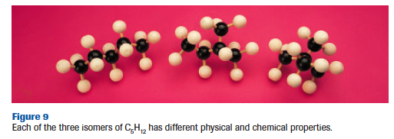
Structural Isomerism
Compound with the same molecular formula but different structures
They will have different chemical and physical properties – based on their different structures

Slide 10
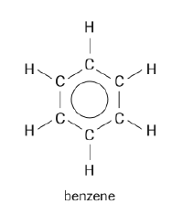
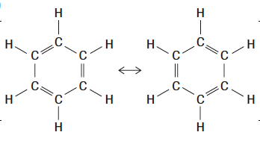
What do we know about benzene?
Formula is C₆H₆ (3D link)
Unreactive – so no true double or triple bonds
Carbon-carbon bonds are the same length and strength
Each carbon is bonded to a hydrogen
So what does benzene look like??
We will use this line structural formula to represent benzene in compounds
The three double bonds resonate resulting in an overall bond length somewhere in between a single and a double bond, explaining benzene’s stability

Slide 11
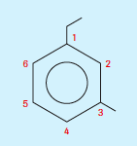
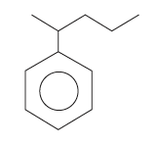
Practice Naming Aromatics
Draw the line structural formula for 1-ethyl-3-methylbenzene
Draw the line structural formula for 2-phenylpentane

Slide 12
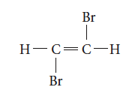
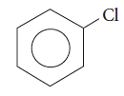
Practice Naming Organic Halides
Name the following:
CH₂Cl₂
1,2-dibromoethene
Bonus: Try 1,2-dibromo-1,2-dichloroethene
chlorobenzene
dichloromethane

Slide 13
Alcohols
An alcohol is an organic compound that contains the –OH functional group (hydroxyl)
General formula is R-OH (R = rest of molecule)
Alcohols are classified as primary, secondary or tertiary depending on the number of carbons bonded to the carbon that contains the hydroxyl group

Slide 14
Naming Alcohols
Locate the longest chain that contains an –OH group attached to one of the carbon atoms. Name the parent alkane
Replace the –e at the end of the name of the parent alkane with –ol (i.e. butane becomes butanol)
Add a position number before the suffix –ol to indicate the location of the –OH group
REMEMBER to number the main chain of the hydrocarbon so that the hydroxyl group has the lowest possible position number
propan-1-ol

Slide 15
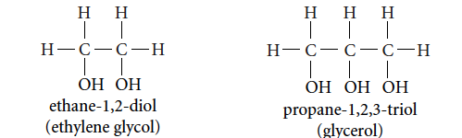
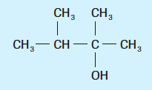
Naming Alcohols
If there is more than one –OH group (called polyalcohols), leave the –e in the name of the parent alkane and put the appropriate prefix before the suffix –ol (i.e. diol, triol, tetraol)
Name and number any branches on the main chain. Add the names of these branches to the prefix.
Draw 2,3-dimethylbutan-2-ol

Slide 16
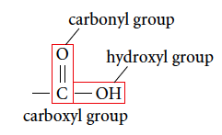
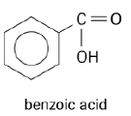
Carboxylic Acids
A carboxyl group is composed of a carbon atom double bonded to an oxygen atom and bonded to a hydroxyl group (-COOH)
Note: Because the carboxyl group involves three of the carbon atom’s four bonds, the carboxyl is always at the end of a carbon chain or branch
Examples:
methanoic acid
Carboxylic acids are weak organic acids
ethanoic acid

Slide 17
Naming Carboxylic Acids
Name the parent alkane
Replace the –e at the end of the name of than parent alkane with –oic acid
The carbon atoms of the carboxyl group is always given position number 1. Name and number the branches that are attached to the compound.
Draw 3-methylbutanoic acid
Remember COOH or HOOC can also represent the carboxyl group
HOOC

Slide 18
Esters
The reaction between a carboxylic acid and an alcohol produces an ester molecule and a molecule of water
This reaction is known as a condensation or esterification reaction
The ester functional group –COO– is similar to that of a carboxylic acid, except that the H atom of the carboxyl group has been replaced by a hydrocarbon branch.
Esters are responsible for natural and artificial fragrance and flavourings in plants and fruits.

Slide 19
Naming Esters
Name the following ester and the acid and alcohol from which it can be prepared.
A strong acid catalyst, such as H₂SO_{4(aq)} is used along with some heating to increase the rate of the organic reaction
butanoic acid
ethanol
ethyl butanoate
water
Tip: The branch attached to the oxygen (of the –COO) comes first in the name, the chain attached to the carbon (of the –COO) comes second

Slide 20
Physical Properties of Simple Hydrocarbons
Alkanes | Non-polar molecules Only intermolecular forces are London Force Boiling point and melting point increase with number of carbons All insoluble in water (like dissolves like) – nonpolar and polar don’t mix 1-4Cs = gas, 5-16Cs = liquid 17 and up = solid at SATP
Alkenes | Non-polar molecules, therefore insoluble in water Boiling points slightly lower than alkanes with the same number of carbons due to less electrons (unsaturated), resulting in lower London Forces
Alkynes | Non-polar molecules, therefore insoluble in water Higher boiling points than alkanes and alkenes with similar C #s Accepted explanation: Linear structure around triple bond allows electrons to come closer together than in alkanes/enes, resulting in greater London Force
Branching | The more branching, the less significant the London Force (~lower b.p.) - more surface area in straight chain hydrocarbons allows more separation of charge, resulting in greater London Force - see Table #3 pg. 378 (i.e. pentane (with 5Cs) has a b.p. of 36ºC which is much higher than dimethylpropane (5Cs) -12ºC) = because branching decreased the strength of the London force

Slide 21
Physical Properties of Hydrocarbon Derivatives
Alcohols | Much higher boiling points than hydrocarbons (1-12Cs are liquids at SATP) due to hydrogen bonding between hydroxyl groups of adjacent molecules Small alcohols are totally miscible in water, but the larger the hydrocarbon part of the alcohol (nonpolar part), the more nonpolar the alcohol is
Carboxylic Acids | Like alcohols they have hydrogen bonding, but is more significant due to the C=O. This means greater bps and solubility than alcohols with same number of Cs. Carboxylic acids with 1-4Cs are completely miscible in water
Esters | Fruity odour in some cases Polar but they lack the –OH bond therefore do not have hydrogen bonding, so lower bps than both alcohols and carboxylic acids Esters with few carbons are polar enough to be soluble in water
Compound | Boiling Point (ºC)
butane | -0.5
butan-1-ol | 117.2
butanoic acid | 165.5

Slide 22
Combustion Reactions
Burning of hydrocarbons in the presence of oxygen
Complete Combustion: abundant supply of oxygen; products are carbon dioxide, water vapour and heat
Ex. C₃H_{8(l)} + 5O_{2(g)} → 3CO_{2(g)} + 4H₂O_{(g)}
Incomplete Combustion: limited supply of oxygen; products are carbon monoxide, soot (pure carbon) or any combination of carbon dioxide, carbon monoxide and soot in addition to water vapour and heat
Ex. 2C₈H_{18(l)} + 17O_{2(g)} → 16CO_{(g)} + 18H₂O_{(g)}
OR 2C₈H_{18(l)} + 9O_{2(g)} → 16C_{(s)} + 18H₂O_{(g)}
** Assume complete combustion unless specified otherwise

Slide 23
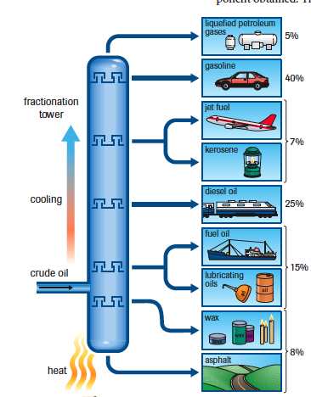
Electronic Visual
A fractional distillation tower contains trays positioned at various levels.
Heated crude oil enters near the bottom of the tower.
The bottom is kept hot, and the temperature gradually decreases toward the top of the tower.
As compounds cool to their boiling point, they condense in the cooler trays. The streams of liquid (called fractions) are withdrawn from the tower at various heights along the tower.

Slide 24
Addition Reactions: reaction of alkenes and alkynes with hydrogen gas, a halogen compound, or a hydrogen halide compound.
Addition reactions usually occur in the presence of a catalyst
Addition with H_{2(g)} (also called hydrogenation)

Slide 25
Substitution Reactions – breaking of a C-H bond in an alkane or an aromatic ring and replacing it with another atom or group of atoms
Usually occur slowly at room temperature, so light may be necessary as a catalyst
Often substitutes a halogen for a hydrogen
No change in saturation
Propane contains hydrogen atoms bonded to end carbons and the middle carbon atom, so two different products (isomers) are formed, in unequal proportions

Slide 26
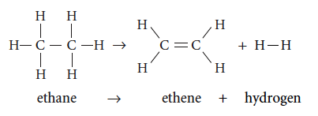
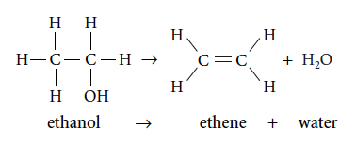
Elimination Reactions – involves eliminating atoms or groups of atoms from adjacent carbon atoms; decreases the level of saturation
Alkane cracked into an alkene (uses high temperatures)
Alcohol is reacted with a catalyst to produce an alkene and water (dehydration – removes a water molecule from the alcohol)
Alkyl halide reacts with a hydroxide ion (OH⁻) to produce an alkene (dehydrohalogenation – removes a hydrogen and halogen atom)

Slide 27
Addition Polymerization always results in one product, the polymer
Requires unsaturated hydrocarbon monomers and bond saturation occurs when the polymer is made
Common polymers produced by addition polymerization:

Slide 28
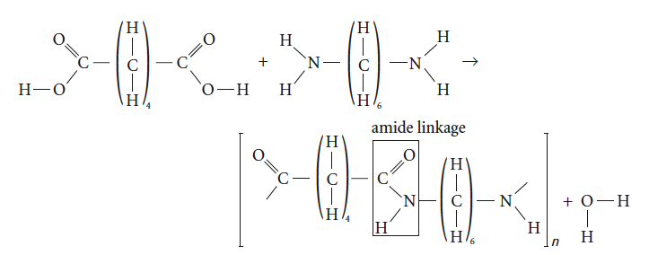
Condensation Polymerization
Monomers combine to form a polymer and a bi-product. Each time a bond forms between monomers, small molecules, such as water, ammonia, or HCl are “condensed” out.
The polymerization of nylon:
For condensation polymerization to occur, monomers must be bifunctional, meaning they have at least two functional groups.
If they only had one functional group, then only one bond would form.

Slide 29
Polyester
When a carboxylic acid reacts with an alcohol in an esterification reaction, a water molecule is eliminated and a single ester molecule is formed.
This esterification reaction can be repeated so many esters are joined in a long chain… a polyester
This is created using a dicarboxylic acid (an acid with a carboxyl group at each end) and a diol (an alcohol with a hydroxyl group at each end)
The ester linkages are formed end to end between alternating acid and alcohol molecules

Slide 30
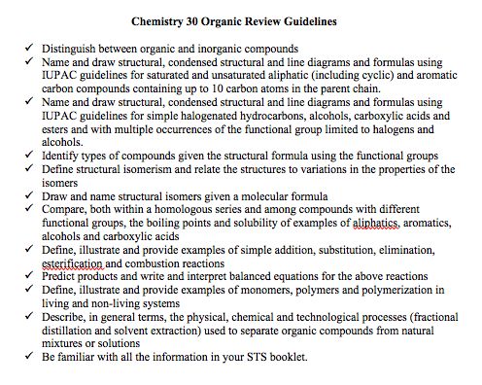
Chemistry 30 Organic Review

Slide 31
REDOX

Slide 32
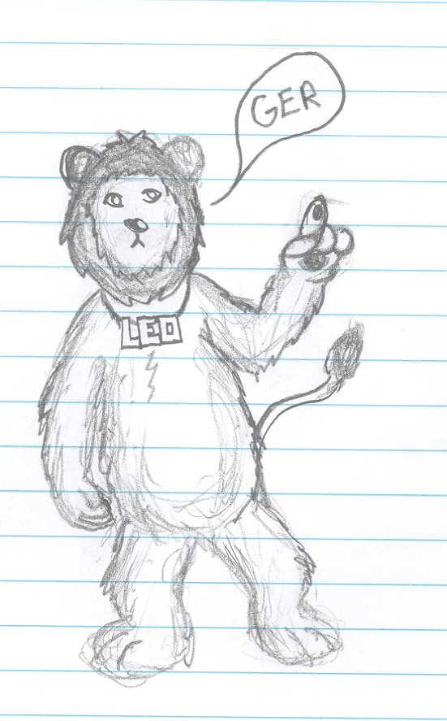
Reduction – Oxidation Reactions “REDOX”
Is a chemical reaction in which electrons are transferred
Must have both reduction and oxidation happening for the reaction to occur
REDUCTION – a process in which electrons are gained by an entity
OXIDATION – a process in which electrons are lost by an entity
How can you remember this?
“LEO the lion says GER”
LEO = Losing Electrons = Oxidation
GER = Gaining Electrons = Reduction
Other memory devices:
OIL RIG (Oxidation Is Losing electrons, Reduction Is Gaining electrons)
ELMO (Electron Loss Means Oxidation)

Slide 33
Redox Terms
Review: “LEO the lion says GER”
Loss of electrons = entity being oxidized
Gain of electrons = entity being reduced
BUT…. Chemists don’t say “the reactant being oxidized” or “the reactant being reduced”
Rather, they use the terms OXIDIZING AGENT (OA) and REDUCING AGENT (RA)
OXIDIZING AGENT: causes oxidation by removing (gaining) electrons from another substance in a redox reaction
REDUCING AGENT: causes reduction by donating (losing) electrons to another substance in a redox reaction
What does this mean? Let’s revisit our first example when zinc and hydrochloric acid reacted.
Which reactant was reduced? Which was oxidized?
So…. Which is the Oxidizing Agent (OA)? Which is the Reducing Agent (RA)
LEO = Oxidized
Zn_{(s)} → Zn ²⁺ _{(aq)} + 2 e⁻
2 H⁺_{(aq)} + 2 e⁻ → H_{2 (g)}
Reducing Agent
GER = Reduced
Oxidizing Agent

Slide 34
Building Redox Tables #1
Check page 7 of your data booklet. Does our ranking order match up with theirs?
Au³⁺_{(aq)} + 3 e⁻ → Au_{(s)}
Hg²⁺_{(aq)} + 2 e⁻ → Hg_{(s)}
Ag⁺_{(aq)} + 1 e⁻ → Ag_{(s)}
Cu²⁺_{(aq)} + 2 e⁻ → Cu_{(s)}
Zn²⁺_{(aq)} + 2 e⁻ → Zn_{(s)}
Mg²⁺_{(aq)} + 2 e⁻ → Mg_{(s)}
YES! Because of the spontaneity rule!
A reaction will be spontaneous if on a redox table:
OA RA
above = Spontaneous below = Non-spontaneous
RA Reaction OA Reaction
SOA
SRA

Slide 35
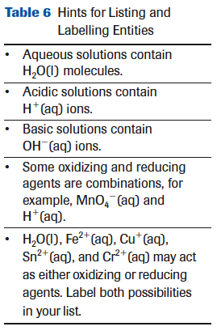
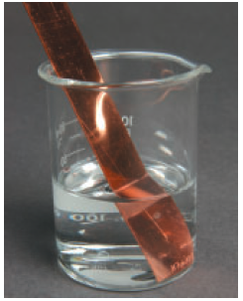
Predicting Redox Reactions
Could copper pipe be used to transport a hydrochloric acid solution?
List all entities
Identify all possible OA’s and RA’s
Identify the SOA and SRA
Show ½ reactions and balance
Predict spontaneity
Since the reaction is nonspontaneous, it should be possible to use a copper pipe to carry hydrochloric acid

Slide 36
Redox Stoichiometry
Example #2
Nickel metal is oxidized to Ni²⁺_{(aq)} ions by an acidified potassium dichromate solution. If 2.50g of metal is oxidizes by 50.0 mL of solution, what is the concentration of the K₂Cr₂O_{7(aq)} solution?
List entities present, identify SOA and SRA: Ni_{(s)} H⁺_{(aq)} K⁺_{(aq)} Cr₂O₇²⁻_{(aq)} H₂O_{(l)}
Write oxidation and reduction half reactions. Balance the number of electrons gained and lost and add the reactions
3 [Ni_{(s)} → Ni²⁺_{(aq)} + 2e- ]
Cr₂O₇²⁻_{(aq)} + 14 H⁺_{(aq)}+ 6 e⁻ → 2Cr³⁺_{(aq)} + 7H₂O_{(l)}
3Ni_{(s)} + Cr₂O₇²⁻_{(aq)} + 14 H⁺_{(aq)} → 3Ni²⁺_{(aq} + 2Cr³⁺_{(aq)} + 7H₂O_{(l)}
_{2.50} _{g} _{50.0mL}
? _{mol/L}
2.50 g x mol Ni_{(s)} x 1 mol Cr₂O₇²⁻_{(aq)} x __1__= 0.284 mol/L Cr₂O₇²⁻_{(aq)} 58.69 g 3 mol Ni_{(s)} 0.0500L
SRA
SOA

Slide 37
Practicing Half-Reactions
Copper metal can be oxidized in a solution to form copper(I) oxide. What is the half-reaction for this process?
Cu_{(s)} → Cu₂O_{(s)}
Balance all atoms except H and O 2Cu_{(s)} → Cu₂O_{(s)}
Balance oxygen by adding water 2Cu_{(s)} +H₂O_{(l)} → Cu₂O_{(s)}
Balance hydrogen by adding H⁺_{(aq)} 2Cu_{(s)} +H₂O_{(l)} → Cu₂O_{(s)} + 2H⁺_{(aq)}
Balance charge by adding electrons 2Cu_{(s)} +H₂O_{(l)} → Cu₂O_{(s)} + 2H⁺_{(aq)} + 2 e⁻

Slide 38
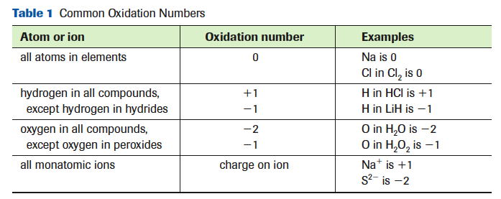
Oxidation States
Tip:
The sum of the oxidation numbers for a neutral compound = 0
The sum of the oxidation numbers for a polyatomic ion = ion charge
** This method only works if there is only one unknown after referring to the above table

Slide 39
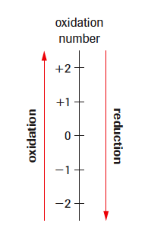
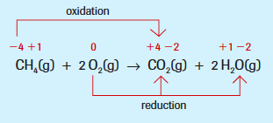
Oxidation Numbers and Redox
Example: When natural gas burns in a furnace, carbon dioxide and water form. Identify oxidation and reduction in this reaction.
First write the chemical equation (as it is not provided)
Determine all of the oxidation numbers
Now look for the oxidation number of an atom/ion that increases as a result of the reaction and label the change as oxidation. There must also be an atom/ion whose oxidation number decreases. Label this change as reduction.

Slide 40
Balancing Redox Equations using Oxidation Numbers #2
Example: Chlorate ions and iodine react in an acidic solution to produce chloride ions and iodate ions. Balance the equation for this reactions. ClO₃⁻_{(aq)} + I_{2(aq)} → Cl⁻_{(aq)} + IO₃⁻_{(aq)}
Assign oxidation numbers to all atoms/ions and look for the numbers that change. Highlight these.
Remember to record the change in the number of electrons per atom and per molecule or polyatomic ion.
The next step is to determine the simplest whole numbers that will balance the number of electrons transferred for each reactant. The numbers become the coefficients of the reactants. The coefficients for the products can be obtained by balancing the atoms whose oxidation numbers have changed and then any other atoms.
Although Cl and I atoms are balanced, oxygen is not. Add H₂O_{(l)} molecules to balance the O atoms.
Add H⁺_{(aq)} to balance the hydrogen. The redox equation should now be completely balanced. Check your work by checking the total numbers of each atom/ion on each side and checking the total electric charge, which should also be balanced.

Slide 41
Disproportionation
Example #2: Will a spontaneous reaction occur as a result of an electron transfer from one copper(I) ion to another copper (I) ion?
Cu⁺_{(aq)} + 1 e⁻ → Cu_{(s)}
Cu⁺_{(aq)} → Cu²⁺_{(aq)} + 1 e⁻
2 Cu⁺_{(aq)} → Cu²⁺_{(aq)} + Cu_{(s)}
YES! Using the redox table and spontaneity rule, we see that copper(I) as an oxidizing agent is above copper(I) as a reducing agent. Therefore, an aqueous solution of copper(I) ions will spontaneously, but slowly, disproportionate into copper(II) ions and copper metal.
See pg. 578 Ex.2 for more another example

Slide 42
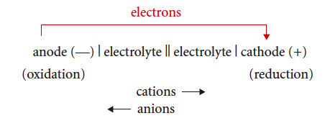
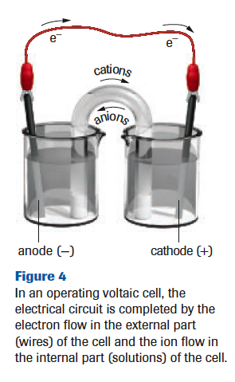
Voltaic Cell Summary
A voltaic cell consists of two-half cells separated by a porous boundary with solid electrodes connected by an external circuit
SOA undergoes reduction at the cathode (+ electrode) – cathode increases in mass
SRA undergoes oxidation at the anode (- electrode) – anode decreases in mass
Electrons always travel in the external circuit from anode to cathode
Internally, cations move toward the cathode, anions move toward the anode, keeping the solution neutral

Slide 43
Standard Cells and Cell Potentials
A standard cell is a voltaic cell where each ½ cell contains all entities necessary at SATP conditions and all aqueous solutions have a concentration of 1.0 mol/L
Standardizing makes comparisons and scientific study easier
Standard Cell Potential, E⁰ cell = the electric potential difference of the cell (voltage)
E⁰ cell = E⁰_{r} cathode – E⁰_{r} anode
Where E⁰_{r} is the standard reduction potential, and is a measure of a standard ½ cell’s ability to attract electrons.
The higher the E⁰_{r} , the stronger the OA
All standard reduction potentials are based on the standard hydrogen ½ cell being 0.00V. This means that all standard reduction potentials that are positive are stronger OA’s than hydrogen ions and all standard reduction potentials that are negative are weaker.
If the E⁰ cell is positive, the reaction occurring is spontaneous.
If the E⁰ cell is negative, the reaction occurring is non-spontaneous

Slide 44
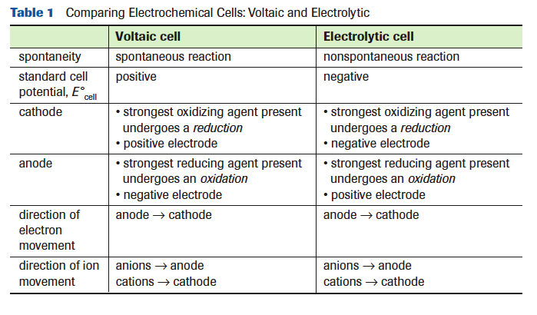
Comparing Electrochemical Cells: Voltaic and Electrolytic
It is best to think of “positive” and “negative” for electrodes as labels, not charges.

Slide 45
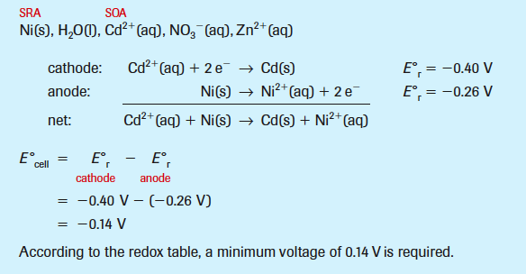
Analyzing Electrolytic Cells #3
Example: An electrolytic cell is set up with a power supply connected to two nickel electrodes immersed in an aqueous solution containing cadmium nitrate and zinc nitrate.
Predict the equations for the initial reaction at each electrode and the net cell reaction. Calculate the minimum voltage that must be applied to make the reaction occur.

Slide 46
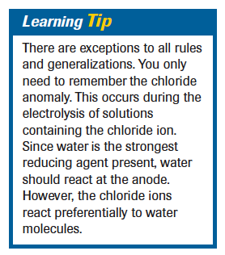
The Chloride Anomaly (*****Diploma)
Some redox reactions predicted using the SOA and SRA from a redox table do not always occur in an electrolytic cell.
The actual reduction potential required for a particular half-reaction and the reported half-reaction reduction potential may be quite different (depending on the conditions or half-reactions)
This difference is known as the half-cell overvoltage.
“As an empirical rule, you should recognize that chlorine gas is produced instead of oxygen gas in situations where chloride and water are the only reducing agents present.”

Slide 47
Practice: Half-Cell Calculations #1
What is the mass of copper deposited at the cathode of a copper electrorefining cell operated at 12.0 A for 40.0 min?
Yes, we can solve for the number of moles, and then use the mole ratio to convert from a chemical amount of one substance to another.
The last step is to convert to the quantity requested in the question, in this case the mass of the copper metal
Could we do this as one equation instead?

Slide 48
Practice: Half-Cell Calculations #2
Silver is deposited on objects in a silver electroplating cell. If 0.175 g of silver is to be deposited from a silver cyanide solution in a time of 10.0 min, predict the current required.
Write the balanced equation for the half-cell reaction, list the measurements and conversion factors.
Convert to moles, use the mole ratio, convert to the current (C/s)

Slide 49
THERMOCHEMISTRY

Slide 50
Energy from the Sun
Stored energy in the chemical bonds of hydrocarbons originated from the sun
Remember:
Photosynthesis:
Liquid H₂O and CO₂ gas → glucose and O_{2(g)}
Hydrocarbon combustion:
Fuel + O_{2(g)} → water vapour and CO₂ gas

Slide 51
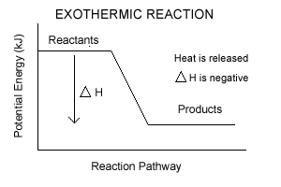
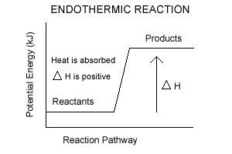
DO YOU REMEMBER??
Exothermic
Endothermic
A change in a chemical energy where energy/heat EXITS the chemical system
Results in a decrease in chemical potential energy
A change in chemical energy where energy/heat ENTERS the chemical system
Results in an increase in chemical potential energy

Slide 52
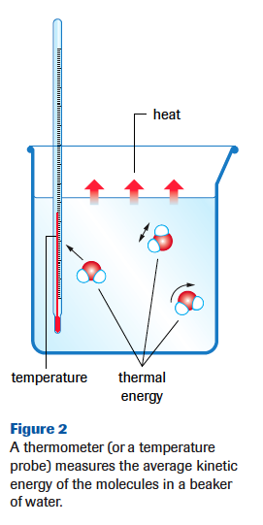
An Introduction to Energetics
Kinetic Energy (E_{k}) is related to the motion of an entity
Molecular motion can by translational (straight-line), rotational and vibrational
Chemical Potential Energy (E_{p}) is energy stored in the bonds of a substance and relative intermolecular forces
Thermal Energy is the total kinetic energy of all of the particles of a system. Increases with temperature.
Symbol (Q), Units (J), Formula used (Q=mcΔT)
Temperature is a measure of the average kinetic energy of the particles in a system
Heat is a transfer of thermal energy. Heat is not possessed by a system. Heat is energy flowing between systems.

Slide 53
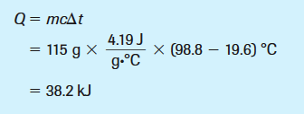
Thermal Energy Calculations
Example: Determine the change in thermal energy when 115 mL of water is heated from 19.6ºC to 98.8ºC?
Mass = density x volume
Show how L = kg and mL = g
The density of a dilute aqueous solution is the same as that of water; that is, 1.00g/mL or 1.00kg/L
c _{water} = 4.19J/g •°C or 4.19 kJ/kg •°C or 4.19 kJ/L •°C

Slide 54
Comparing Q’s
Negative Q value
An exothermic change
Heat is lost by the system
The temperature of the surroundings increases and the temperature of the system decreases
Example: Hot Pack
Question Tips: “How much energy is released?”
Positive Q value
An endothermic change
Heat is gained by the system
The temperature of the system increases and the temperature of the surroundings decreases
Example: Cold Pack
Question Tips: “What heat is required?”

Slide 55
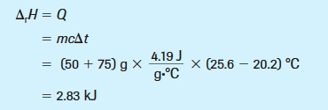
ENTHALPY CHANGES
When 50 mL of 1.0 mol/L hydrochloric acid is neutralized completely by 75 mL of 1.0 mol/L sodium hydroxide in a polystyrene cup calorimeter, the temperature of the total solution changes from 20.2°C to 25.6°C. Determine the enthalpy change that occurs in the chemical system.
Based upon the evidence available, the enthalpy change for the neutralization of hydrochloric acid in this context is recorded as -2.83 kJ.
Is this an Endothermic or Exothermic reaction??

Slide 56
Molar Enthalpy and Calorimetry
Can we measure the molar enthalpy of reaction using calorimetry?
Yes, but indirectly. We can measure a change in temperature, we can then calculate the change in thermal energy (Q=mct). Then, using the law of conservation of energy we can infer the molar enthalpy.
In doing so, we must assume that the change in enthalpy of the chemicals involved in a reaction is equal to the change in thermal energy of the surroundings.
From this equation, any one of the five variables can be determined as an unknown.

Slide 57
Communicating Enthalpy
We will be learning how to communicate enthalpy changes in four ways:
By stating the molar enthalpy of a specific reactant in a reaction
By stating the enthalpy change for a balanced reaction equation
By including an energy value as a term in a balanced reaction equation
By drawing a chemical potential energy diagram

Slide 58
COMMUNICATING ENTHALPY #3
By including an energy value as a term in a balanced reaction equation
If a reaction is endothermic, it requires additional energy to react, so is listed along with the reactants
If a reaction is exothermic, energy is released as the reaction proceeds, and is listed along with the products
In order to specify the initial and final conditions for measuring the enthalpy change of the reaction, the temperature and pressure may be specified at the end of the equation

Slide 59
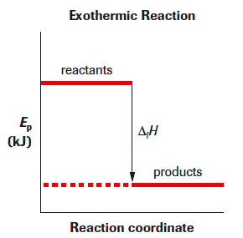
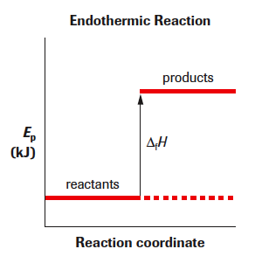
COMMUNICATING ENTHALPY #4
During an exothermic reaction, the enthalpy of the system decreases and heat flows into the surroundings. We observe a temperature increase in the surroundings.
During an endothermic reaction, heat flows from the surroundings into the chemical system. We observe a temperature decrease in the surroundings.

Slide 60
Hess’ Law #4
Example: What is the standard enthalpy of formation of butane? Δ_{f}H_{m}° = ???
First, we need to be able to write this balanced formation equation.
4C_{(s)} + 5H_{2(g)} → C₄H_{10(g)}
The following values were determined by calorimetry:
What will we need to do to get our net equation?
Δ_{f}H_{m}° = -125.6 kJ/1 mol = -125.6 kJ/mol
^{C4H10}
Reverse equation (1) and change the ΔH sign
Multiply equation (2) and its ΔH by 4
Multiply equation (3) and its ΔH by 5/2

Slide 61
Molar Enthalpy of Formation
Methane is burned in furnaces and in some power plants. What is the standard molar enthalpy of combustion of methane? Assume that water vapour is a product.
Need a balanced chemical equation: CH_{4(g)} + O_{2(g)} → CO_{2(g)} + 2H₂O_{(g)}
Use the formula and the data booklet to calculate the Δ_{c}H°
We found all of the Δ_{f} H_{m} for the compounds two slides ago
Are we finished with -802.5 kJ?? NO!

Slide 62
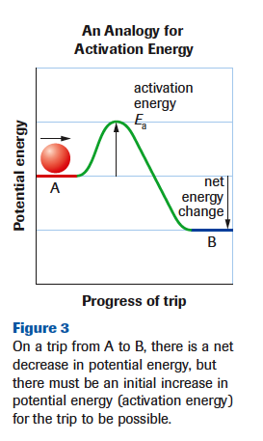
ACTIVATION ENERGY OF A REACTION
Activation Energy – (E_{A})
The minimum collision energy required for effective collision
Dependant on the kinetic energy of the particles (depend on T)
Analogy: If the ball does not have enough kinetic energy to make it over the hill – the trip will not happen. Same idea, if molecules collide without enough energy to rearrange their bonds, the reaction will not occur. (ineffective collision)

Slide 63
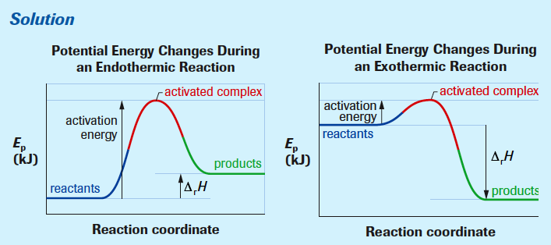
LET’S SEE IF YOU GET IT
Draw energy pathway diagrams for general endothermic and a general exothermic reaction. Label the reactants, products, enthalpy change, activation energy, and activated complex.

Slide 64
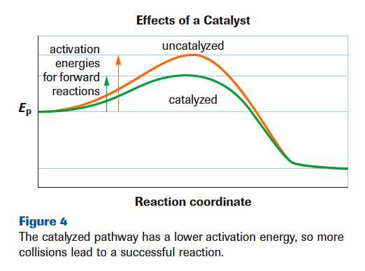
CATALYSTS AND REACTION RATE
A catalyst is a substance that increases the rate of a chemical reaction without being consumed itself in the overall process.
A catalyst reduces the quantity of energy required to start the reaction, and results in a catalyzed reaction producing a greater yield in the same period of time than an uncatalyzed reaction.
It does not alter the net enthalpy change for a chemical reaction
Catalysts lower the activation energy, so a larger portion of particles have the necessary energy to react = greater yield

Slide 65
EQUILIBRIUM

Slide 66
4 Conditions of Dynamic Equilibrium*
Can be achieved in all reversible reactions when the rates of the forward and reverse reaction become equal
Represented by rather than by →
All observable properties appear constant (colour, pH, etc)
Can only be achieved in a closed system (no exchange of matter and must have a constant temperature)
Equilibrium can be approached from either direction. This means that the equilibrium concentrations will be the same regardless if you started with all reactants, all products, or a mixture of the two

Slide 67
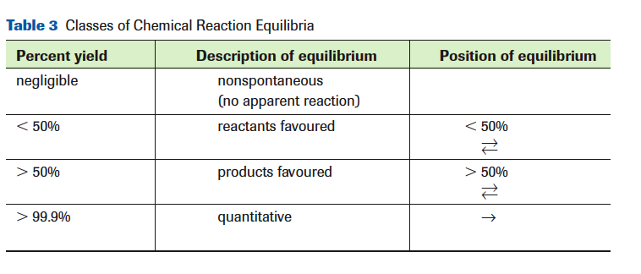
Describing the Position of Equilibrium
Percent Yield- the yield of product measured at equilibrium compared with the maximum possible yield of product.
% yield = product eq’m x 100 %
product max
The equilibrium concentration is determined experimentally, the maximum concentration is determined with stoichiometry

Slide 68
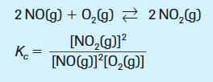
Describing the Position of Equilibrium
Using an Equilibrium Constant, (K_{c})
Example #1: Write the equilibrium law expression for the reaction of nitrogen monoxide gas with oxygen gas to form nitrogen dioxide gas.

Slide 69
Describing the Position of Equilibrium
Using an Equilibrium Constant, (K_{c})
Note: The Kc value describes the extent of the forward reaction.
K_{c reverse} = 1 . = The reciprocal value
K_{c forward}
Example #2: The value of K_{c} for the formation of HI_{(g)} from H_{2(g)} and I_{2(g)} is 40, at a given temperature. What is the value of K_{c} for the decomposition of HI_{(g)} at the same temperature.
K_{c reverse} = 1 . = 1 = 0.025
K_{c forward} 40

Slide 70
ICE Charts and Equilibrium Calculations
Example #1: Consider the following equilibrium at 100 ºC:
N₂O_{4(g)} ↔ 2 NO_{2(g)}
2.0 mol of N₂O_{4(g)} was introduced into an empty 2.0 L bulb. After equilibrium was established, only 1.6 mol of N₂O_{4(g)} remained. What is the value of K_{c}?
E: 1.0 – x = 0.80 solve for x x = 0.20 2x = 0.40
Solve for K_{c} = (0.40)² = 0.20
(0.80)
2.0 mol = 1.0 mol/L (I)
2.0L
N₂O_{4(g)} | 2NO_{2(g)}
I: 1.0 mol/L | 0
C: - x | + 2x
E: 1.0 – x = 0.80 | 2x
1.6 mol = 0.8 mol/L (E)
2.0L

Slide 71
ICE Charts and Equilibrium Calculations
Example #3: Using a perfect square
Given the following reaction:
N_{2(g)} + O_{2(g)} ↔ 2NO_{(g)} K_{c} = 0.00250
Determine the equilibrium concentrations for all species present given that the initial concentration of each reactant is 0.200 mol/L.
0.00250 = (2x)² square root both sides 0.005 = 2x = 0.01 – 0.05x = 2x
(0.200-x)2 0.200 – x
= 0.01 = 2.05x = 0.00488
N_{2(g)} | O_{2(g)} | 2NO_{(g)}
I: 0.200 | 0.200 | 0
C: - x | - x | + 2x
E: 0.200 - x | 0.200 - x | 2x
E: 0.195mol/L | 0.195mol/L | 0.00976mol/L

Slide 72
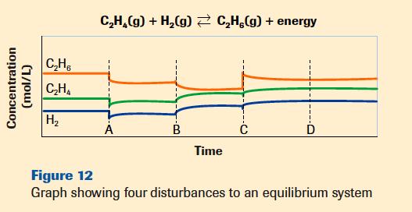
Identify the nature of the changes imposed on the following equilibrium system at the four times indicated by coordinates A, B, C and D
At A, the concentration (or pressure) of every chemical in the system is decreased by increasing the container volume. Then the equilibrium shifts to the left (the side with more moles of gas)
At B, the temperature is increased. Then the equilibrium shifts to left.
At C, C₂H_{6(g)} is added to the system. Then the equilibrium shifts to the left.
At D, no shift in equilibrium position is apparent; the change imposed must be addition of a catalyst, or of a substance that is not involved in the equilibrium reaction.

Slide 73
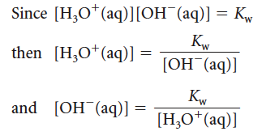
The Water Ionization Constant, K_{w}
Since the mathematical relationship is simple, we can easily use K_{w} to calculate either the hydronium or hydroxide ion concentration, if the other concentration is know.
The presence of substances other than water decreases the certainty of the Kw value to two significant digits;
1.0 x 10 ⁻¹⁴

Slide 74
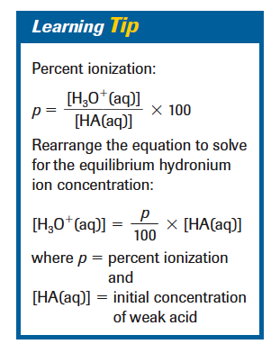
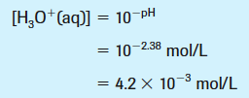
% Ionization
The pH of 0.10 mol/L methanoic acid solution is 2.38. Calculate the percent reaction for ionization of methanoic acid.

Slide 75
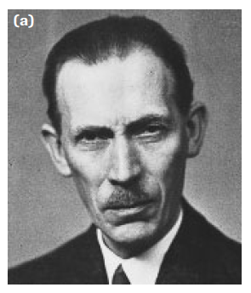
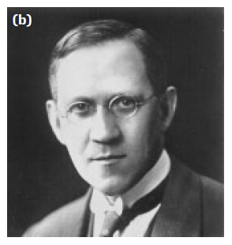
Bronsted-Lowry Acid-Base Concept
Focuses on the role of the chemical species in a reaction rather than on the acidic or basic properties of their aqueous solutions.
Bronsted Lowry Definition for an Acid: proton donor
Bronsted Lowry Definition for an Base: proton acceptor

Slide 76
Bronsted-Lowry Acid-Base Concept
Protons may be gained in a reaction with one entity, but lost in a reaction with another entity.
The empirical term, amphoteric, refers to a chemical substance with the ability to react as either an acid or base.
The theoritical term, amphiprotic, describes an entity (ion or molecule) having the ability to either accept or donate a proton.

Slide 77
Conjugate Acids and Bases
RULE: The stronger the base, the more it attracts a proton (proton acceptor). The stronger the acid, the less it attracts its own proton (proton donor)
What does this mean about their conjugate pair??
The stronger an acid, the weaker is its conjugate base.
If you are good at donating a proton, this means the conjugate base is not good at competing for it (weak attraction for protons)
The stronger a base, the weaker is its conjugate acid.
If you are good at accepting a proton, this means the conjugate acid is not good at giving it up (strong attraction for protons).

Slide 78
Predicting Acid-Base Reactions
5) Predict the approximate position of equilibrium
Example: What will be the predominant reaction if spilled drain cleaner (sodium hydroxide) solution is neutralized by vinegar?
Na⁺_{(aq)} OH⁻_{(aq)} CH₃COOH_{(aq)} H₂O_{(l)}
SA
SB
The reaction of H₃O⁺_{(aq)} and OH⁻_{(aq)} is always quantitative (100%) so a single arrow is used

Slide 79
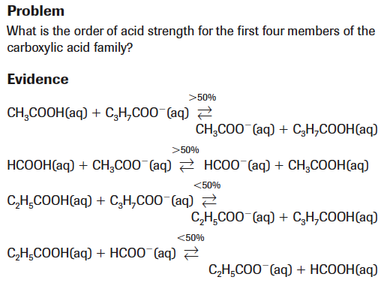
Table Building
Lab Exercise 16.D

Slide 80
K_{a} Calculations
Example #1: The pH of a 1.00 mol/L solution of acetic acid is carefully measured to be 2.38 at SATP. What is the value of Ka for acetic acid?
1.00mol/L – 0.0042 mol/L = 0.9958 (rounds to 1.00 – precision rule)
Change in concentration is negligible in this case – but not always
Regardless of size, Ka values are usually expressed in scientific notation = 1.7 x 10⁻⁵

Slide 81
K_{a} Calculations
Example #4: Predict the hydronium ion concentration and pH for a 0.200 mol/L aqueous solution of methanoic acid.
1.8 x 10⁻⁴ = x ² x = 0.006 = H₃O⁺_{(aq)} concentration
(0.200)
Approximation Rule:
0.200 = >1000
1.8 x 10 ⁻⁴
So (0.200-x) = 0.200

Slide 82
K_{b} Calculations
We will use the same method as Ka calculations, but there is usually one extra step because pH values need to be converted to find hydroxide ion concentrations
Example #1: A student measures the pH of a 0.250 mol/L solution of aqueous ammonia and finds it to 11.32. Calculate the Kb for ammonia
14 = pH + pOH
pOH = 2.68
10^{-2.68} = 0.0021 = OH⁻_{(aq)}
Remember K_{b} has only 2 sig digs
K_{b} for ammonia is 1.8 x 10⁻⁵

Slide 83
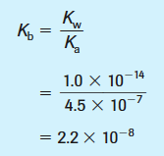
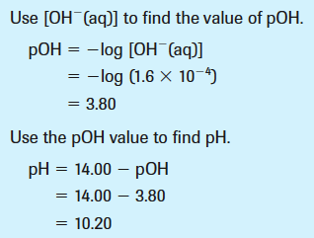
Calculating OH⁻ from K_{b}
Example #2: Find the hydroxide ion amount concentration, pOH, pH and the percent reaction (ionization) of a 1.20 mol/L solution of baking soda.
Baking soda = NaHCO_{3(s)} → Na⁺_{(aq)} + HCO₃⁻_{(aq)}
For HCO₃⁻_{(aq)}, the conjugate acid is H₂CO_{3(aq)} whose K_{a} is = 4.5 x 10⁻⁷
Approximation Rule:
1.20 = >1000
2.2 x 10 ⁻⁸
So (1.20-x) = 01.20
2.2 x 10⁻⁸ = x^{2 .} x = 1.6 x 10⁻⁴ = OH⁻_{(aq)}
2.2x 10⁻⁸

Slide 84
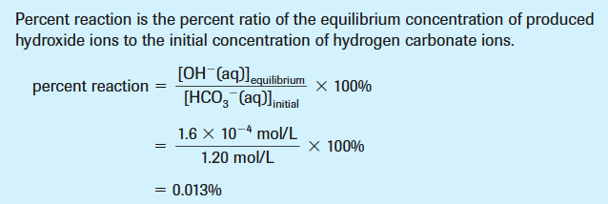
Calculating OH⁻ from K_{b}
Example #2: Find the hydroxide ion amount concentration, pOH, pH and the percent reaction (ionization) of a 1.20 mol/L solution of baking soda.
2.2 x 10⁻⁸ = x^{2 .} x = 1.6 x 10⁻⁴ = OH⁻_{(aq)}
2.2x 10⁻⁸

Slide 85
Polyprotic Entities
Chem 20 Review:
Polyprotic acids – can lose more than one proton
Polyprotic bases – can gain more than one proton
If more than one proton transfer occurs in a titration, chemists believe the process occurs as a series of single-proton transfer reactions.
On a graph, this means there will be more than one equivalence point
First proton transfer = 100%
Second proton transfer = 100%
Carbonate ion is a diprotic base

Slide 87
Buffering Capacity
The limit of the ability of a buffer to maintain a pH level.
When one of the entities of the conjugate acid-base pair reacts with an added reagent and is completely consumed, the buffering fails and the pH changes dramatically.
All of the CH₃COOH_{(aq)} is used up, OH⁻ additions will now cause the pH to drastically increase
All of the CH₃COO⁻_{(aq)} is used up, H₃O⁺ additions will now cause the pH to drastically decrease

