Slide 1
Genetic applications

Slide 2
Crossing over
What is crossing over?
Is there an advantage to this?

Slide 3
Telomeres
What are they?
Caps at the ends of chromosomes
Scientists have determined that telomeres reduce in length each time a cell goes through the cell cycle and divides
How is this related to stress?
http://www.iflscience.com/health-and-medicine/stress-can-alter-your-genome

Slide 4
Dolly
Dolly developed arthritis and died at the age of six
How do telomeres help explain this? (pg. 570)
Perhaps since Dolly was cloned from already aged cells the telomeres were shorter in length

Slide 5
Cancer
What is cancer anyway?
Uncontrolled cell divisions= called metastasis
This is why there is no ‘cure’ or ‘vaccine’ because the cells are your own
How does it relate to telomeres?
they do not lose their ability to divide and their telomere length is also maintained

Slide 6
Abnormal Meiosis
Nondisjunction
Polyploidy
Trisomy
Monosomy

Slide 7
Disorders
Klinefelter
Down Syndrome (Trisomy 21)
Turner
Trisomic female

Slide 8
Identification
Karyotype chart: map of homologous chromosomes in order; contains 23 sets
#23 are the sex chromsomes

Slide 9
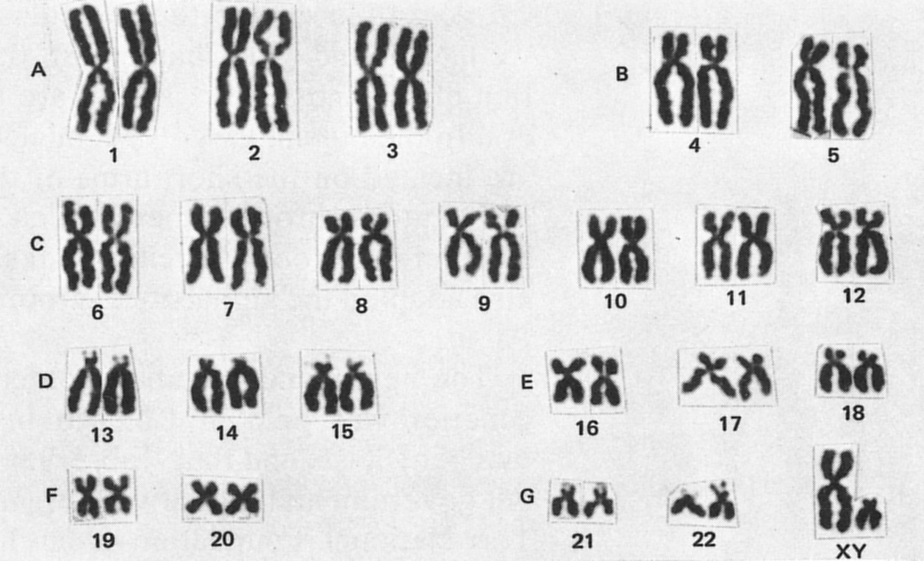
Karotyping

Slide 10
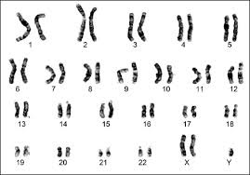
Problem?

Slide 11
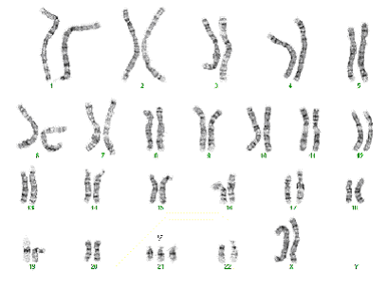
Problem?

Slide 12
You try
Pg. 585 Exercise 1 and Practice #1 on pg. 586

Slide 13
Tomorrow- possibilities
Microscopes
DNA extraction
Review

