Slide 1
Chapter 16
Section 16.2-1
The Female Reproductive Anatomy

Slide 2
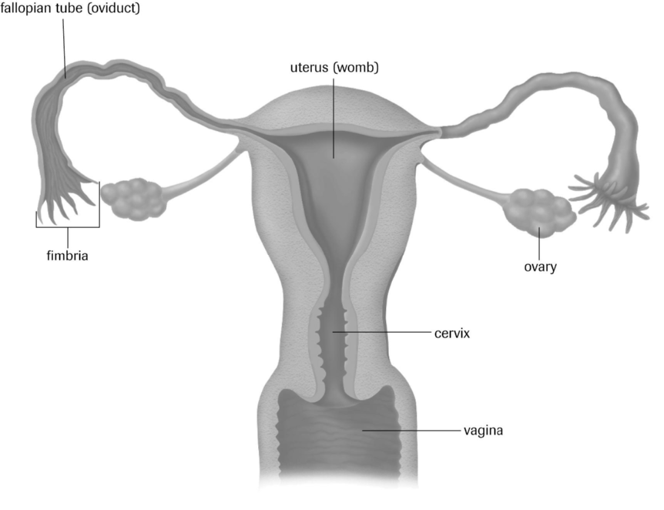
Female Reproductive Structures

Slide 3
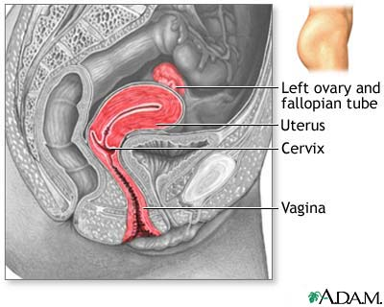
Side View of Female Reproductive System

Slide 4
Functions of Structures
Uterus or Womb
largest organ in the female reproductive system
muscular, hollow pear shaped chamber
where embryo and fetus development occurs
made of two major tissues:
1. A muscular outer lining.
2. Glandular inner lining called the endometrium.

Slide 5
Ovaries
female gonads, or primary reproductive organs
production of female sex hormones
production of egg cells
Fallopian Tubes (oviducts)
connect the ovaries to the uterus

Slide 6
Fimbria (s. fibrium)
finger like projections at the ends of each Fallopian tube
connect the Fallopian tubes with the ovaries during ovulation
Cervix
a band of muscle that separates the vagina from the uterus

Slide 7
Vagina
the muscular canal extending from the cervix to the outer environment
the birth canal

Slide 8
Oogenesis and Ovulation
Oogenesis – the formation and development of mature ova.
Ova (s. ovum) – female egg cell.
Oocyte – an immature ovum or egg cell.
At birth, oocytes are already present within the ovary.

Slide 9
Oogenesis occurs in specialized cells in the ovaries called follicles.
A follicle contains two types of cells: a primary oocyte and cells of the granulosa.
The granulosa is the layer of cells that forms the follicle wall and provides nutrients for the developing oocytes.

Slide 10
Oogenesis begins when nutrient follicle cells surrounding the primary oocyte begin to divide.
As the primary oocyte undergoes cell division, the majority of cytoplasm and nutrients move to one end of the cell called a pole and forms a secondary oocyte.
The secondary oocyte contains 23 chromosomes.
The remaining cell, referred to as the first polar body, receives little cytoplasm and dies.

Slide 11
As the follicle cells surrounding the secondary oocyte multiply, a fluid filled cavity forms.
Eventually, the dominant follicle pushes outward, ballooning the outer wall of the ovary.
Constriction of blood vessels and enzymes act to weaken the ovarian wall above the follicle.

Slide 12
The outer surface of the ovary wall bursts and the secondary oocyte is released, in a process called ovulation.
The remaining follicle cells remain within the ovary and are transformed into the corpus luteum.
The corpus luteum is a mass of follicle cells that secrete estrogen and progesterone, pregnancy hormones.

Slide 13
Formation of Ova
primary follicle containing
primary oocyte
follicle with early
fluid-filled cavity
granulosa
cells
mature
follicle
ruptured
follicle
fully formed
corpus luteum
developing
corpus luteum
secondary oocyte

Slide 14
If pregnancy does not occur, the corpus luteum degenerates after about 10 days.
After it’s release from the ovary, the secondary oocyte is swept into the funnel shaped end of the Fallopian tube by the fimbria.
The secondary oocyte is moved along the Fallopian tube by cilia.
If sperm is present, fertilization will occur.

Slide 15
Once fertilized, the secondary oocyte then undergoes another unequal division of cytoplasm and nutrients to develop the ovum.
The part with the majority of the cytoplasm becomes the ovum, the other part becomes the second polar body and deteriorates.
If the secondary oocyte is not fertilized, it will deteriorate with 24 hours and die. When this occurs, the woman will undergo a menstrual cycle.

