Slide 1
Chapter 16
Section 16.3-3
Birth and Lactation

Slide 2
Birth
Approximately 266 days/nine months after implantation, uterine contractions signal the beginning of parturition.
Parturition – the act of giving birth; labour.

Slide 3
Stages of Parturition
The cervix thins and begins to dilate.
Amnion is forced into the birth canal.
Amnion bursts to lubricate the canal.
Water breaks
As the cervix dilates, uterine contractions move the baby through the birth canal.
Following the birth of the baby, the placenta is shed.

Slide 4
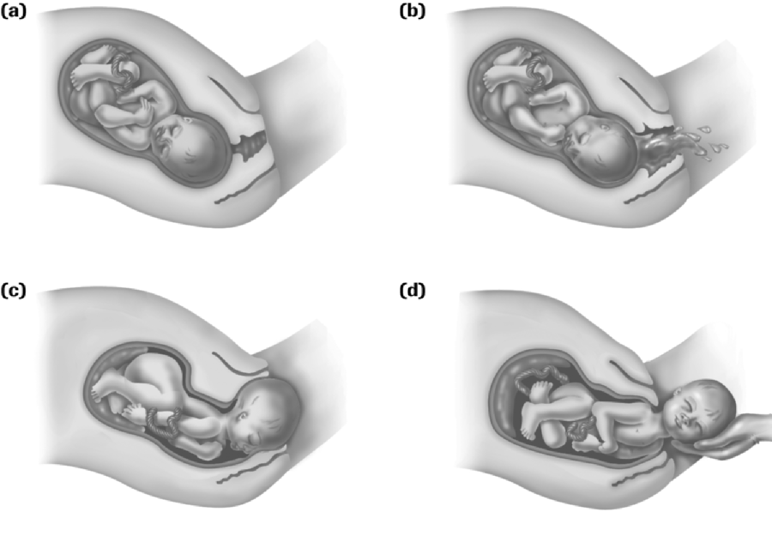
Cervix dilates.
Amnion is forced into birth canal and bursts.
Baby moves through birth canal by uterine contractions.
Baby is delivered, placenta follows.

Slide 5
Hormones and Birth
Hormones play a vital role in the birthing process.
There are 3 major hormones that affect birth:
Relaxin
Oxytocin
Prostoglandins

Slide 6
Relaxin
hormone produced by the placenta before labour
loosens ligaments in the pelvis
softens cervix
creates a more flexible passageway for the baby

Slide 7
Oxytocin
produced by the pituitary
causes uterine contractions

Slide 8
Prostoglandins
a group of hormones that act on the cells that produce them
produced by the uterus
act on the smooth muscle of the uterus
cause very strong uterine contractions
soften the cervix

Slide 9
Lactation
Breast production is stimulated by estrogen and progesterone during puberty.
Elevated levels of estrogen and progesterone during pregnancy prepares the breasts for milk production.
Each breast contains about 20 milk glands.
Each gland is connected to the nipple by milk ducts.

Slide 10
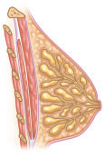
Breast Structure
fat
rib
milk gland
rib muscle
nipple
chest muscle
milk duct

Slide 11
Role of Prolactin in Lactation
Prolactin is a hormone produced by the pituitary gland, that stimulates the milk glands to start producing milk.
Estrogen stimulates the release of prolactin during pregnancy.
Milk production does not occur before birth though because the action of prolactin is inhibited by progesterone.

Slide 12
The drop in estrogen and progesterone after birth signals the prolactin that is already present in the body to produce milk.
The production of prolactin drops because of loss of estrogen, but the action of prolactin increases because of the loss of progesterone.
Prolactin initially causes the production of colostrum, a fluid that resembles breast milk.

Slide 13
Colostrum contains milk sugars and milk proteins, but lacks the fat found in breast milk.
After a few days, prolactin stimulates real breast milk.
Together colostrum and breast milk supply the baby with an important source of nutrients.

Slide 14
Importance of the Baby’s Sucking Motion
Although prolactin produces milk, the milk does not automatically leave the breast.
The sucking action of the baby stimulates nerve endings in the breast.
Sensory nerves carry information to the pituitary gland.

Slide 15
Pituitary gland releases oxytocin.
Oxytocin is carried to the breasts and uterus by the blood stream.
In the breasts it causes weak contractions of the smooth muscle, that forces milk from the glands into the ducts that head to the nipple.
In the uterus, it causes weak contractions of smooth muscle, allowing the uterus to return to its pre-pregnancy size and shape.

Slide 16
