Slide 1
Chapter 19
Section 19.3
DNA is the Hereditary Material

Slide 2
Introductory Video
https://www.youtube.com/watch?v=3-mmjwXT5Dg

Slide 3
DNA
DNA or deoxyribonucleic acid is found in the nucleus of every cell, in all living organisms.
DNA is the only molecule that is capable of replicating itself.
All characteristics of every organism are coded within the chemical messages of DNA.

Slide 4
Continuity of Life
DNA contains instructions that ensure the continuity of life.
The continuity of life refers to the similar structural traits between members of different generations.
DNA also accounts for the diversity of life forms because unless you are an identical twin, your DNA code is one of a kind.

Slide 5
Confirming the Chemical of Heredity
It was not until 1952 that DNA was accepted as the hereditary material.
Before this, it was strongly believed that the material of hereditary was a protein.
DNA was confirmed by the experiments of Alfred D. Hershey and Martha Chase, two American scientists.

Slide 6
Their experiments dealt with a virus that infects bacteria called bacteriophage T2.
Bacteriophages consist of two components: DNA and a protein coat.
Bacteriophage T2 is a virus that attaches itself to the outer surface of a bacteria cell and injects its own hereditary material into it.

Slide 7
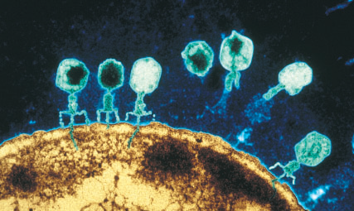
Bacteriophage T2

Slide 8
Once the hereditary material of the bacteriophage T2 is in the bacteria cell, it begins to produce thousands of new viruses, which then burst out of the cell, resulting in its death.
The result of the experiments showed that only the DNA from the bacteriophage T2 was entering the bacteria cell.
Therefore it was the DNA and not the protein that was directing the synthesis of new viruses.

Slide 9
How did Hershey and Chase track the DNA?
Hershey and Chase were able to track the DNA using isotopes of elements found within the protein coat and the DNA.
Isotopes are two or more atoms of the same element containing the same number of protons but a different number of neutrons.

Slide 10
Proteins contain sulphur but no phosphorus.
DNA contains phosphorus but no sulphur.
So they attached an isotope of sulphur, ³⁵S, to the protein and an isotope of phosphorus, ³²P, to the DNA.
³⁵S and ³²P are both radioactive isotopes.

Slide 11
Radioactive isotopes are unstable isotopes that decay spontaneously by emitting radiation.
Because the isotopes that were attached to the protein and the DNA were radioactive, they could track their location by looking at the radiation they left behind.

Slide 12
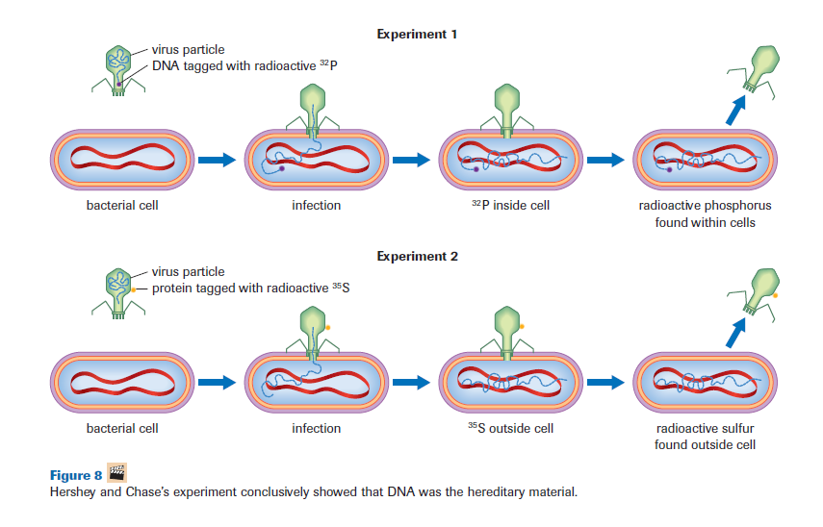
Hershey and Chase’s Experiements

Slide 13
The Race to Reveal the Structure
When scientists confirmed that DNA was the material of heredity, their focus shifted to understanding it’s structure and how it works.
The discovery of the structure was credited to Francis Crick and James Watson.

Slide 14
The Structure of DNA
DNA is made of chains of molecules called nucleotides.
Nucleotides are molecules that contain:
  A 5 carbon sugar called a deoxyribose sugar.
  A nitrogenous base attached to the sugar’s carbon #1 (1’).
  A phosphate group attached to the sugar’s carbon #5 (5’).

Slide 15
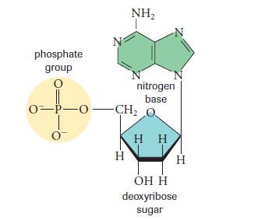
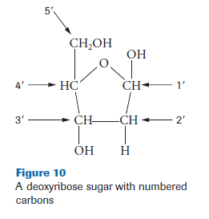
A nitrogenous base – is a basic (alkaline) molecule containing nitrogen.
A phosphate group – is a group of 4 oxygen atoms surrounding a central phosphorus atom.

Slide 16
There are four nitrogenous bases that form DNA:
Adenine (A)
Guanine (G)
Thymine (T)
Cytosine (C)

Slide 17
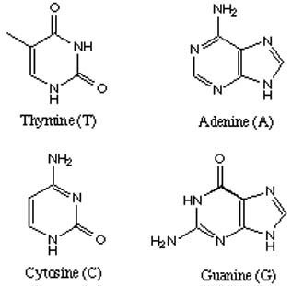
Adenine and Guanine are doubled ringed structures called purines.
Thymine and Cytosine are single ringed structures called pyrimidines.

Slide 18
Research done by the biochemist Erwin Chargaff, helped Watson and Crick to uncover the structure of DNA.
Chargaff discovered two things for any DNA of any species:
The amount of adenine was always equal to the amount of thymine. (A=T)
The amount of guanine was always equal to the amount of cytosine. (G=C)

Slide 19
Another part of their success came from a researcher named Rosalind Franklin, who used a technique called X-ray diffraction to help determine that the structure of DNA is a helix.
A helix – is a spiralling (twisting) structure.
She was not credited with this success until after her death.

Slide 20
Break

Slide 21
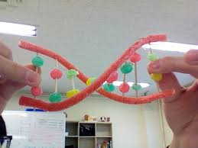
Notes:
Twizzler is the sugar/phosphate backbone. Nucleotide base pairs are jubejubes

Slide 22
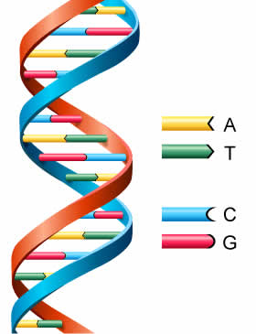
The Structure of DNA
The two twisting strands are held together by the paired nitrogenous bases.
A is always paired with T.
C is always paired with G.

Slide 23
DNA Structure
DNA is made up of millions of nucleotides.
Each nucleotide consists of three molecules:
A deoxyribose 5 carbon sugar.
A phosphate group that is attached to carbon 5’ of the sugar molecule.
One of 4 nitrogenous bases (adenine, guanine, cytosine and thymine) that is attached to carbon 1’ of the sugar molecule.

Slide 24
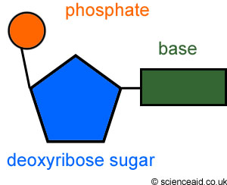
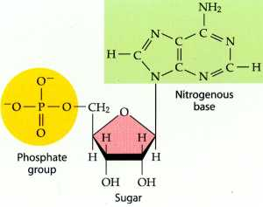
Nucleotide Structure
Adenine
5’
1’

Slide 25
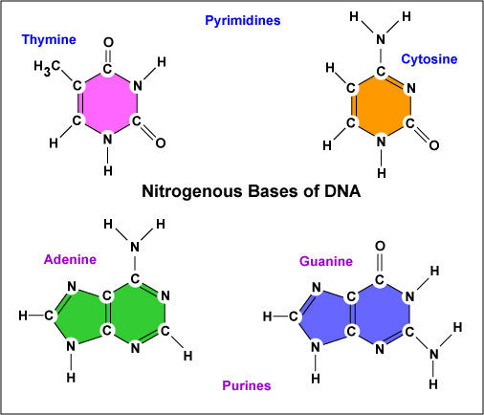
Nitrogenous Bases
Adenine and Guanine are double ringed purines.
Cytosine and Thymine are single ringed pyrimidines.

Slide 26
DNA structure Cont’d
DNA consists of two strands of nucleotides that are held to together by complementary base pairing.
Complementary base pairing – is the pairing of a pyrimidine with a purine.
A (purine) always binds with T (pyrimidine).
G (purine) always binds with C (pyrimidine).

Slide 27
DNA structure cont’d
The two nucleotide strands are antiparallel.
They run parallel of each other but in opposite directions.
One strand will have a 5’carbon and phosphate group at the head and 3’ carbon and a hydroxyl group (OH) of a deoxyribose sugar at the tail.
The other strand will have the 3’ carbon at the head and the 5’ carbon at the tail.

Slide 28
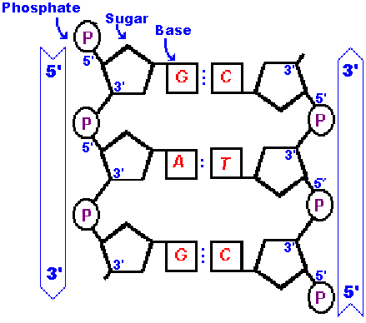
Antiparallel dna strands
5’ carbon with phosphate group.
3’ carbon with hydroxyl or OH group.

Slide 29
DNA structure Cont’d
Having antiparallel strands also helps hold the two strands together.
The phosphate on the 5’ carbon bonds to the hydroxyl (OH) group on the 3’ carbon at the ends to help hold the structure together.

Slide 30
DNA structure Cont’d
Finally once the two nucleotide strands are held together, the entire DNA structure is twisted into a helix.

Slide 31
Crash course: https://www.youtube.com/watch?v=JIPw-Bd0WGg

Slide 32
DNA Candy Model

Slide 33
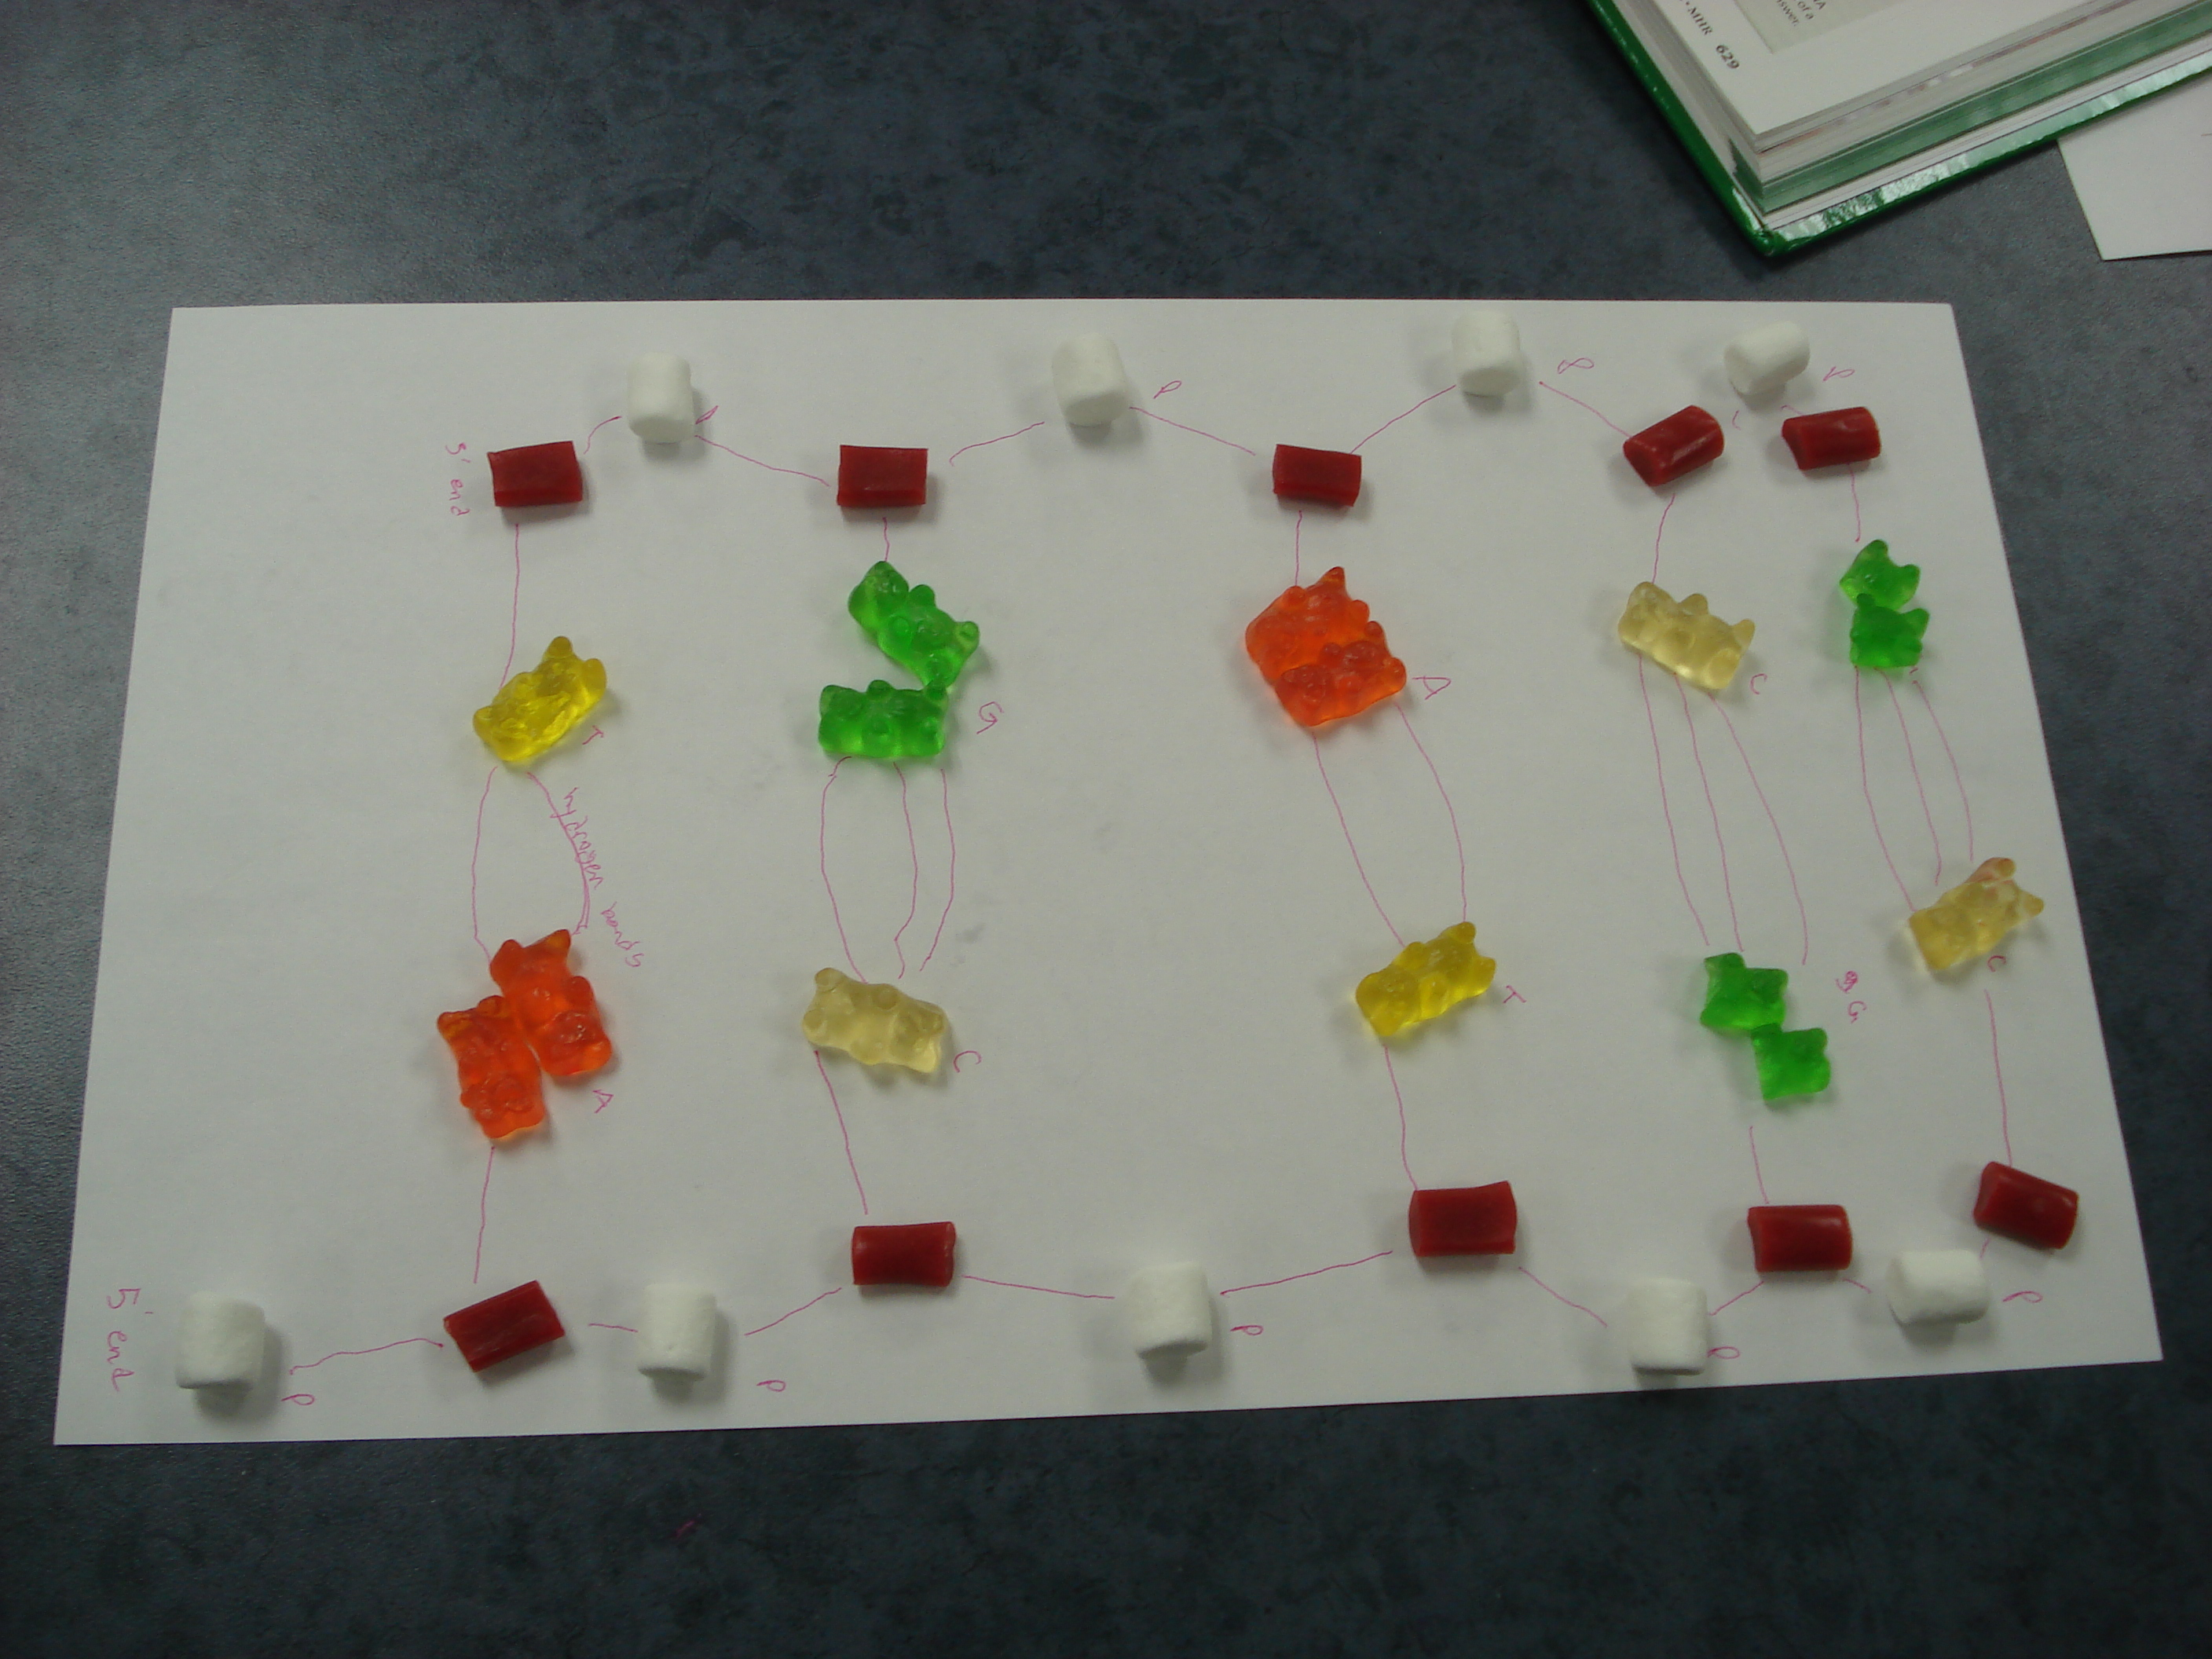
Tricks and Treats of Biology
DNA Model
Notes:
Nitrogen bases: T, C single jube jubes/ gummy bears and A and G are double bears. Phosphate is marshmellow. Sugar group is twizzler/nibs. Draw Hydrogen bonds to connect the base pairs.

Slide 34
DNA Extraction from Fruit

Slide 35
