Slide 1
Chapter 20
Section 20.3 – DNA and Biotechnology

Slide 2
DNA and Biotechnology
Carpenters require tools such as hammers, screwdrivers, and saws, and surgeons require scalpels, forceps, and stitching needles.
The tools of the molecular biologist are living biological organisms or biological molecules, such as bacteria or enzymes.
Using these tools, scientists can take specific DNA sequences and move them from one DNA molecule to another, forming recombinant DNA.
Recombinant DNA – a fragment of DNA composed of sequences originating from at least two different sources.

Slide 3
Research in exploring and using this type of biotechnology has led to exciting new advances in biological, agricultural, and medical technology.
Biotechnology research has also found ways to introduce specific DNA sequences into a living cell. For example, the gene that encodes insulin has been introduced into bacterial cells so that they become living factories producing this vital hormone for Diabetics.
The introduction and expression of foreign DNA into a new an organism is called genetic transformation.
In this section, we will explore some of the key tools used by molecular geneticists in producing recombinant DNA and genetically transformed organisms.

Slide 4
The Human Genome Project
Before scientists could transform or transfer human DNA into another organism for medical advancements, they first needed to determine the entire DNA sequence within a human body.
They had to determine what each sequence of DNA base pairs was responsible for.
This endeavour became known as the HUMAN GENOME PROJECT.

Slide 5
The ultimate goal of the project was to specifically map out each gene in the human body.
There are approximately 30 000 genes, amongst the 23 chromosomes and an estimated 3 billion base pairs.
The project began in 1990 and the human genome was completely mapped by June of 2000.

Slide 6
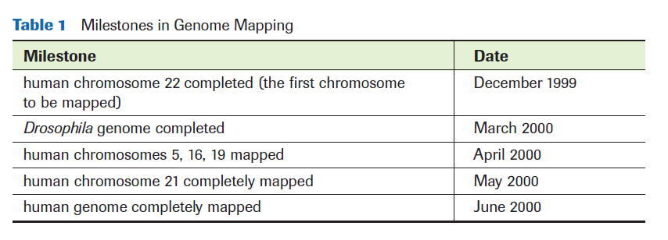
Milestones In Gene Mapping

Slide 7
Enzymes and Recombinant DNA
Once scientists have located a particular segment of DNA they wish to remove, enzymes can be used to isolate it or modify it.
The DNA fragment can then be used to create recombinant DNA or be transferred to another organism.

Slide 8
The Enzymes Involved
There are 3 major enzymes involved in the making of recombinant DNA:
Restriction Endonucleases
AKA Restriction Enzymes
Methylases
DNA Ligase

Slide 9
Restriction Endonucleases
Restriction Endonuclease – an enzyme that cuts double-stranded DNA into fragments at a specific sequence; like molecular scissors.
Each type of restriction enzyme recognizes a particular sequence of nucleotides that is known as a recognition site.
Most recognition sites are four to eight base pairs long and are palindromes.

Slide 10
Palindromes – are sequences of DNA that read the same backwards as forwards when reading in the 5’ to 3’ direction.
EX. GAATTC
CTTAAG

Slide 11
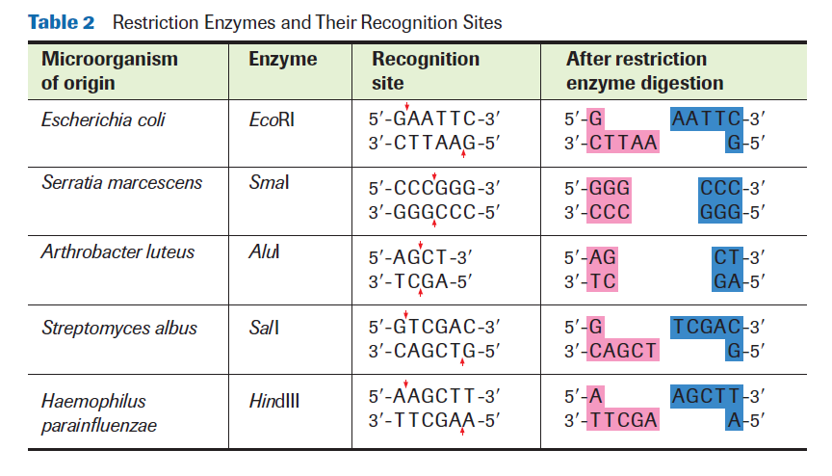

Slide 12
When restriction enzymes make a cut, they can leave two possible ends:
Sticky Ends
Blunt Ends
Sticky Ends - fragment ends of a DNA molecule with overhangs of base pairs, or bases are left unpaired.
Blunt Ends - fragment ends of a DNA molecule that are fully base paired.

Slide 13
Sticky Ends – Not all bases are paired after the cut.
Blunt Ends – All bases are paired after the cut.

Slide 14
Example Question #1
The following sequence of DNA was digested with the restriction endonuclease Smal:
Smal recognizes the sequence CCCGGG and cuts between the C and G.
Identify the location of the cuts on it.
How many fragments will be produced?
What type of ends does Smal produce?

Slide 15
Example Question #2
Hind III recognizes the sequence AAGCTT and cleaves between the two A’s. What type of end is produced by cleavage with Hind III?

Slide 16
Example Question #3
Write out the complementary strand for the DNA sequence below. Clearly identify the palindromic sequences within it by circling them.

Slide 17
Methylases
Methylase - an enzyme that adds a methyl group to one of the nucleotides found in a restriction endonuclease recognition site.
Methyl group = CH₃
Methylases are important tools in recombinant DNA technology because they protect a gene fragment from being cut by the restriction endonuclease.

Slide 18
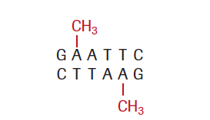
Methylases are important to molecular biologists because they may want to make cuts at certain places in a DNA sequence and not others.
They can use methylases to prevent cutting the DNA in unwanted locations.
A methyl (CH3) group is added to change the sequence slightly, so it is no longer recognized by the restriction endonuclease and is therefore not cut.

Slide 19
DNA Ligase
To create recombinant DNA, pieces of DNA from two sources must be joined together.
Using restriction enzymes and methylases, molecular geneticists can engineer fragments of DNA that contain the specific nucleotide sequences they want.
These segments of DNA are then joined together by DNA ligase.

Slide 20
If two fragments have been generated using the same restriction enzyme, they will be attracted to each other at their complementary sticky ends.
Hydrogen bonds will form between the complementary base pairs.
DNA ligase then joins the strands of DNA together.

Slide 21
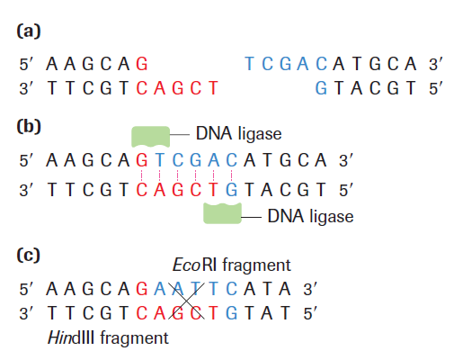
and (b)
Show two ends
formed by the
EcoRI
endonuclease,
fitting together
perfectly.
(c) Shows how when one fragment is cut using the enzyme EcoRI and the other fragment is cut using the enzyme HindIII, the ends will not match up.

Slide 22
Transformation
Once the new sequences of DNA are created using restriction endonucleases, methylases and DNA ligase, the new DNA must be transformed (transferred) into the same organism or a different one.
In transformation, vectors are used as a delivery system to move the foreign DNA into a cell of the organism.

Slide 23
Once the new DNA has been introduced by the vector, the organism is now said to be transgenic.
Transgenic - a cell or an organism that is transformed by DNA from another species.

Slide 24
Transformation of Bacteria
Bacteria are the most common organisms that are transformed by molecular biologists.
Transgenic bacteria may be used to study gene expression or gene function or to synthesize a useful gene product.
For example, some transgenic bacteria have been engineered to produce human growth hormone, used in the treatment of pituitary dwarfism.

Slide 25
The first stage of transformation for any organism is to identify and isolate the DNA fragment that is to be transferred.
The DNA fragment is then introduced into the vector.
Plasmids are commonly used as vectors for bacterial transformation.
Plasmids are small, circular, double-stranded DNA molecules that occur naturally in the cytoplasm of many bacteria.

Slide 26
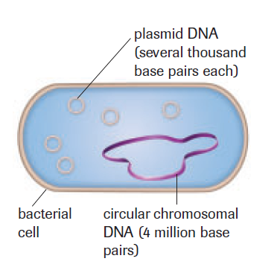

Slide 27
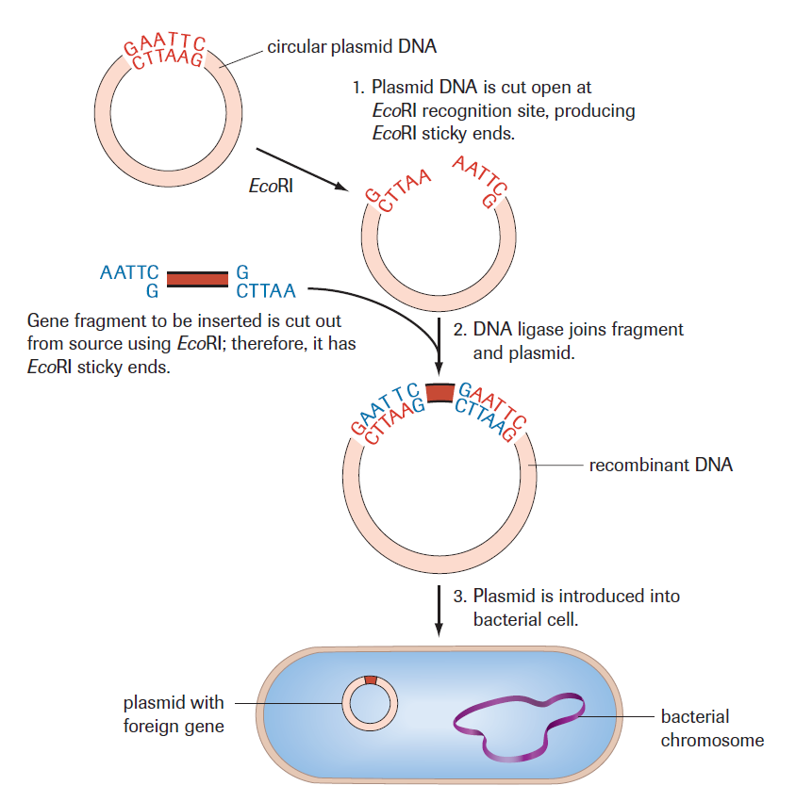
Once the plasmid contains the recombinant DNA, the plasmid is introduced into the same or new bacterial cell.

