Slide 1
TIPS
-read the Summaries at the back of each section (example pg.414)
-read the Summaries in the KEY and do practice questions
-you should read your textbook approx. 4X
1st time as intro
2nd time doing questions
3rd time to study
4th time before the final
-draw out diagrams
-write out definitions
-YouTube lessons
-make up acronyms or songs to memorize
-use cue-cards
-quiz with a partner
-ExamBank / Quest A+

Slide 2
Chapter 13
Section 13.1
The Importance of the Nervous System

Slide 3
Draw Nervous System Outline

Slide 4
Organization of the Nervous System
The nervous system has two main divisions:
Central Nervous System (CNS)
- consists of the nerves of the brain and spinal cord
Peripheral Nervous System (PNS)
- consists of nerves that carry information between the organs of the body and the central nervous system
* Refer to diagram: Divisions of the Nervous System

Slide 5
Peripheral
Somatic:
responds to external environment
voluntary control
movement of skeletal muscle, bones, skin
Autonomic:
involuntary ‘automatic’
controls the internal body organs
Sympathetic: typically functions in actions requiring quick responses
Parasympathetic: functions with actions that do not require immediate reaction (salivating, crying, digestion)

Slide 6
Autonomic Nerves- Involunatary

Slide 7
Anatomy of a Nerve Cell
There are two different types of cells found in the nervous system:
Glial cells – non-conducting cells that are important for structural support and metabolism of the nerve cells.
Neurons – nerve cells that conduct nerve impulses.

Slide 8
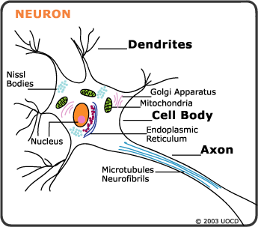
Neuron Structure
All neurons contain 3 main structures:
Dendrites – receive information from the environment or other neurons and carry the nerve impulses toward the cell body.
Cell bodies – contains the nucleus and all other typical cell organelles
Axons – receive the nerve impulses from the cell bodies and carries them away towards other neurons or to effectors.

Slide 9
Pg.409- Draw structure of a neuron

Slide 10
Neuron Structure Continued
- Axons are covered with a glistening white coat of a fatty protein called myelin sheath, which acts as insulation for the axons.
- The myelin sheath acts as insulation by preventing the loss of charged ions from the nerve cell.
Myelin sheath is formed by special glial cells called Schwann cells.

Slide 11
Neuron Structure Continued
The areas between the sections of myelin sheath are known as the nodes of Ranvier.
All nerve fibres found within the peripheral nervous system have a thin outer membrane called the neurilemma, which surrounds the axon.
Neurilemma is formed by the Schwann cells and promotes the regeneration or repair of damaged axons.

Slide 12
Neuron Structure Continued
Not all nerve cells that have a myelin sheath have a neurilemma.
Nerves within the brain that contain myelinated fibres are called white matter because the myelinated axons are whitish in colour.
Other nerve cells within the brain and spinal cord are referred to as grey matter because they lack a myelin sheath.
Cells of both the white and grey matter of the central nervous systems lack neurilemmas.
This is why damage to the central nervous system tends to be permanent.

Slide 13
Types of Neurons
One way to classify neurons is by the direction that they send information. There are 3 main groups:
Sensory (or afferent) neurons: send information from sensory receptors (e.g., in skin, eyes, nose, tongue, ears) TOWARD the central nervous system.
Motor (or efferent) neurons: send information AWAY from the central nervous system to muscles or glands.
Interneurons: send information between sensory neurons and motor neurons. Most interneurons are located in the central nervous system (brain or spinal cord).

Slide 14
The Reflex Arc
The simplest nerve pathway is the reflex arc.
Most reflexes through a reflex arc do not involve coordination by the brain.
Reflex arcs contain 5 essential components:
The sensory receptor
The sensory neuron
The interneuron
The motor neuron
The effector

Slide 15
Example of a Reflex Arc
Finger on a tack.
The reflex arc begins when a touch receptor in the finger senses the tack.
The receptor sends this information to the sensory neuron in the form of a nerve impulse.
From the sensory neuron the nerve impulse is sent to the interneurons located in the spinal cord.
Once received the interneurons send the nerve impulse to the motor neuron.
The motor neuron activates the effector (muscle), causing it to contract and move your hand.
The interneurons also send a nerve impulse to your brain, which registers as pain. (THIS IS NOT PART OF THE REFLEX ARC.)

Slide 16
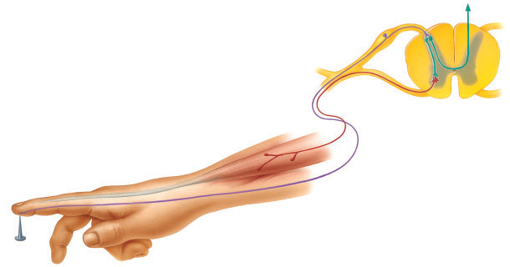
Example of a Reflex Arc
Finger on a tack.
To Brain
Interneuron
Motor Neuron
Sensory Receptor
Spinal Cord
Sensory Neuron

Slide 17
Summary
Structure | Function
Neuron | Nerve cell that conducts nerve impulses.
Sensory Neuron | Carries impulses to the CNS.
Interneuron | Carries impulses within the CNS.
Motor Neuron | Carries impulses from the CNS to effectors.
Dendrite | Projection of cytoplasm that carries impulses toward cell body.
Axon | Extension of cytoplasm that carries impulses away from the cell body.
Myelin Sheath | Insulated covering over axon.
Nodes of Ranvier | Gaps between myelin sheath.
Neurilemma | Membrane surrounding the axons that promote regeneration of nerves.
Reflex Arc | Pathway of nerve impulses through the spinal cord.

Slide 18
New research on interneuron growth- pg. 411 ‘Repairing Damaged Nerves’

Slide 19
Parkinsons- pg. 406: progressive degenerative nerve disorder that affects muscle activity. Particular cells which secrete hormones in the brain die and without them, some muscle movements are limited or completely non-functional
MS- multiple sclerosis (pg. 410 ‘Did you know’)

