Slide 1
Chapter 14
Section 14.2 -2
The Chemistry of Vision

Slide 2
Chemistry of Vision
The rods contain a light-sensitive pigment called rhodopsin.
Rhodopsin is made of 2 components:
Retinene/Retinal – the pigment portion made with Vitamin A
Opsin – the protein portion

Slide 3
When a single photon of light (a package of energy), strikes a rhodopsin molecule it divides into its two components.- OPSIN and RETINAL
** DIAGRAM**
This division alters the cell membrane of the rods and produces an action potential.
Neurotransmitters are released from the end plates of the rods and the nerve impulse is conducted across synapses to the bipolar cells, then to the ganglion and finally to the optic nerve.
vitamin A is needed to restore rhodopsin molecule

Slide 4
Colour Perception
The cones are responsible for colour vision.
Each cone is sensitive to one of the three primary colours of source light:
Red
Blue
Green

Slide 5
Our eyes can also perceive three primary colours of reflected light:
Magenta (Hot pink)
Cyan (Light Tealish Blue)
Yellow
We see the primary colours of reflected light when combinations of cones are stimulated.

Slide 6
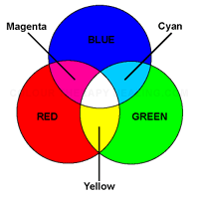
Primary Colours of Light

Slide 7
We see yellow when cones sensitive to both red and green wavelengths are stimulated.
We see cyan when cones sensitive to blue and green wavelengths are stimulated.
We see magenta what cones sensitive to blue and red wavelengths are stimulated.

Slide 8
Colour Blindness
Colour blindness occurs when one or more types of cones are defective.
The most common type is red-green.
Red-green colour blindness occurs when red sensitive cones fail to work properly.
Colour blindness is genetic.
More common in males.

Slide 9
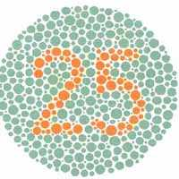
Lets Test Our Colour Blindness
What do you see in each of the following images?

Slide 10
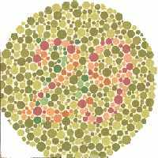
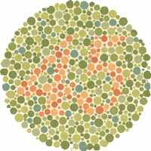

Slide 11
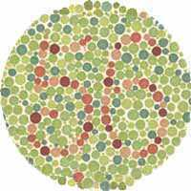
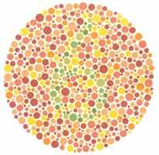

Slide 12
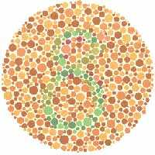

Slide 13
After Images
There are two different types of after images:
Positive – occurs when you look into a bright light, then close your eyes and the image with its original colour can still be seen.
Negative – occurs when the cones become tired or over stimulated, and the opposite colour or the original image is seen.

Slide 14
Focusing the Image
Light enters the eye.
Light travels much slower through dense materials.
The slowing of light causes bending, which is known as refracting.
The cornea refracts light towards pupil and lens.
Once the light hits the lens, it slows down and refracts further.

Slide 15
Light is refracted to a focal point.
The focal point for the human eye is the retina.
The image is focused on the retina upside down.
Once it hits the rods and cones of the retina, the image is passed to the optic nerve and then to the occipital lobe.
In the occipital lobe it is turned right side up and interpreted.

Slide 16
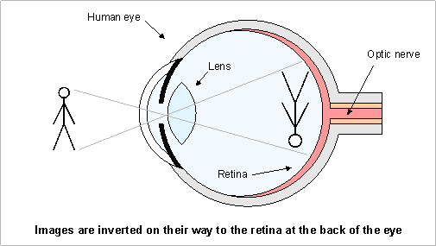

Slide 17
Accommodation
Accommodation - is adjustments made by the lens and pupil of the eye to focus on near and distant objects.
To view close objects the ciliary muscles contract and the lens becomes thicker.
To view distant object the ciliary muscles relax and the lens becomes thinner.
Objects 6 m from the viewer do not require accommodations.

Slide 18
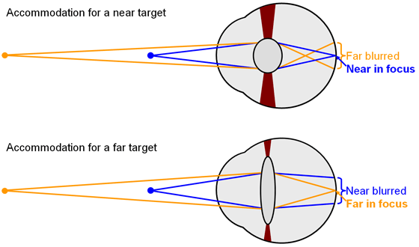

Slide 19
A secondary adjustment also occurs during accommodation.
When objects are viewed from a distance the pupil dilates (gets bigger) to let in as much light as possible.
When objects are viewed close up the pupil constricts.

Slide 20
How eyes work
https://www.youtube.com/watch?v=gvozcv8pS3c
https://www.youtube.com/watch?v=cFVbLnXWn6A

Slide 21
Vision Defects
Glaucoma – disease of the eye caused by a build up of aqueous humour in the eye.
As fluid builds up, the pressure inside the eye increases causing the ganglion cells to die, which leads to loss of vision.

Slide 22
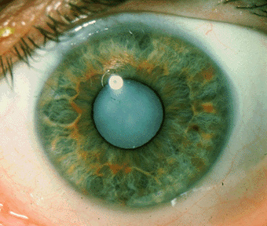
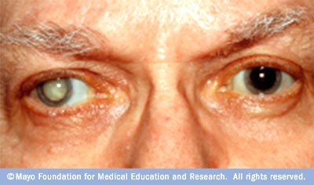
Cataracts – condition that occurs when the lens or cornea becomes opaque, preventing light from passing through.

Slide 23
Astigmatism – vision defect caused by abnormal curvature of the lens or cornea.
Light cannot be refracted properly.
Myopia – nearsightedness; occurs when the image is focused in front of the retina.
Hyperopia – farsightedness; occurs when the image is focused behind the retina.

Slide 24
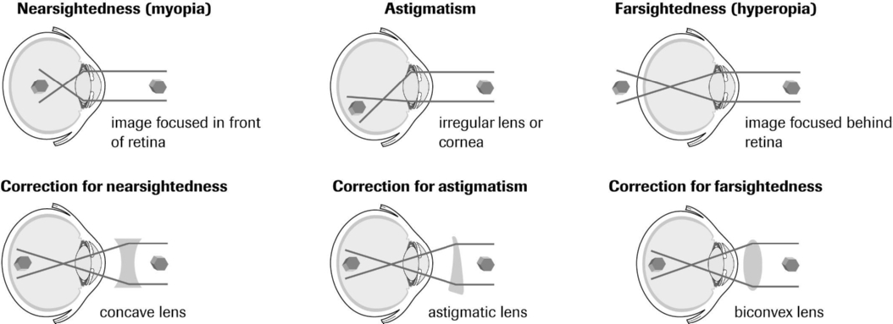
Visual Defects and Their Corrections

