Slide 1
Organic Chemistry
Ch. 9 & 10

Slide 2
What is Organic?
What do we know about carbon?

Slide 3
Organic Chemistry
Major branch of chemistry that deals with compounds of carbon, excluding oxides (such as CO) and ionic compounds of carbon-based ions such as carbonates, cyanide and carbide ions (CaC2)
Major sources of organic compounds: still living or previously living things

Slide 4
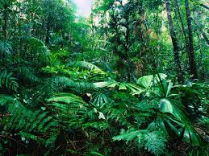
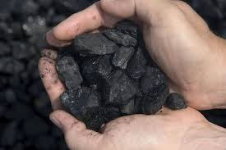
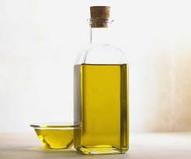
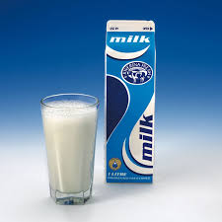
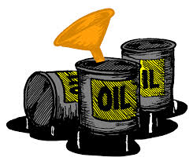
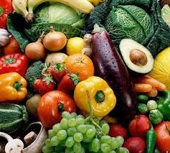
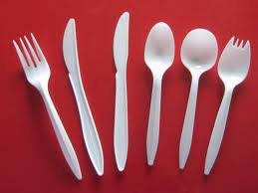
Which ones are NOT ORGANIC

Slide 5
Organics
Still living or PREVIOUSLY living things
Plants
Animals
Fossil fuels

Slide 6
Hydrocarbons
Coil, oil sands, heavy oil, crude oil and natural gas are nonrenewable sources of fossil fuels
Hydrocarbons: compounds containing carbon atoms bonded to hydrogen atoms

Slide 7
Refining
Technology that includes physical and chemical processes for separating complex mixtures into simpler mixtures or near-pure components
Pg. 358 Table 1
Bitumen example

Slide 8
Society, Technology, Society, Environment (STSE)
How has the use of fossil fuels affected technology? Society? Environment?
And how has society affected the science of fossil fuels?
And how has technology affected the science of fossil fuels?
And how has the environment affected the science of fossil fuels?

Slide 9
Case Study
Fossil fuel Industries in Alberta
Pg. 359 and questions #1-4, 6
Pg. 361 # 1-5

