Slide 1
Homework
Course Outline
Case Study
9.1 Questions
* Please hand-in to the hand-in box *
Notes:
Check who has course outlines done, read Case Study for completion, mark #1, 4 on pg. 361

Slide 2
Organic Chemistry – 9.2
Alkanes
Notes:
Have molecular model kits ready for examples

Slide 3
Alkanes
Hydrocarbons which the carbon-carbon bonds are only single bonds
Saturated hydrocarbons
Table 3 on pg. 366 *memorize*

Slide 4
Drawing Alkanes
Draw methane, ethane, propane…. Up to decane

Slide 5
Structural Isomers
Same molecular formula but with different structure
Have different physical and chemical properties
Need to write isomers differently to indicate the shape

Slide 6
Example
C4H10 can be:
Butane
Methylpropane

Slide 7
Naming isomers
The name of the compound indicates whether there are branches on a carbon chain
Branch= any group of atoms that is no part of the main structure of the molecule
A branch with only carbon and hydrogen is known as an alkyl branch
In the names of alkyl branches, the prefixes are followed by a –yl suffix.

Slide 8
Naming Branched Alkane STEPS (pg. 368)
Identify the longest continuous chain of carbon atoms-the parent chain and number the carbon atoms from the end closest to the branches
Identify any branches and their location number on the parent chain
Write the complete IUPAC name following this format:
(number of location)-(branch name)(parent chain)
If the branch is right in the middle, the number is not necessary.

Slide 9
Example
Notes:
2- methlyhexane

Slide 10
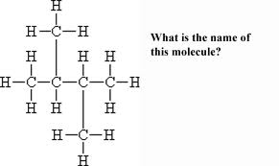
2-methyl, 3-ethylbutane
OR… 2,3 dimethlybutane

Slide 11
Drawing Branched Alkane Structure
Draw a straight chain containing the number of carbon atoms represented by the name of the parent chain and number the carbon atoms from left to right
Attach the branches to their numbered locations on the parent chain
Add enough hydrogen atoms to show that each carbon has four single bonds.

Slide 12
Drawing Isomers
dimethylpropane (2,2-dimethylpropane)
2-methlypentane
2,3-dimethlyhexane
3-ethly-2,4-dimethylpentane
2,3,4-trimethylpentane
tetramethylbutane

Slide 13
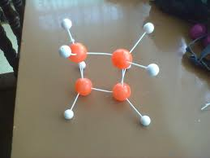
Cycloalkanes
All carbon-carbon bonds in a single bonded cyclic hydrocarbon

Slide 14
Naming cycloalkanes
Named by placing the prefix cyclo in front of the alkane name
If branches are present, treat the cycloalkane as the parent chain and identify the branches

Slide 15
Spangler science
http://www.youtube.com/watch?v=UloIw7dhnlQ

Slide 16
Pg. 370 #7-11
Pg. 373 #6-8
Memorize table #3 pg. 366

