Slide 1
Lake Ecosystems

Slide 2
Aquatic Biomes in Canada
There are 2 aquatic biomes in Canada:
Salt Water
Fresh Water

Slide 3
Fresh Water Biomes
The fresh water biomes in Alberta are made up of lake ecosystems.
Lake ecosystems have 3 main zones:
Littoral zone
Limnetic zone
Profundal zone

Slide 4
Littoral Zones
The area from the shore of the lake or pond to the point where no more plants grow in the lake bottom.
It is warm, shallow and has lots of oxygen.
It has many photosynthetic organisms and is the most productive zone.

Slide 5
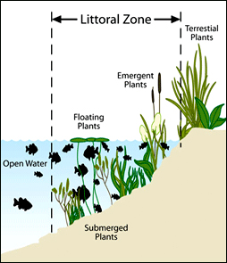

Slide 6
Limnetic Zones
The area of a lake or pond in which there is open water and sufficient light for photosynthesis to occur.
Plankton are autotrophic and heterotrophic microorganisms found in this zone
Contains consumers such as fish, tadpoles, and birds.

Slide 7
Profundal Zones
The region of a lake beneath the limnetic zone, in which there is insufficient light for photosynthesis to occur.
It has cool temperatures and is very dark.
There are few nutrients, low oxygen due to
no photosynthesis and a high number of bacteria.
It contains low oxygen organisms such as carp.

Slide 8
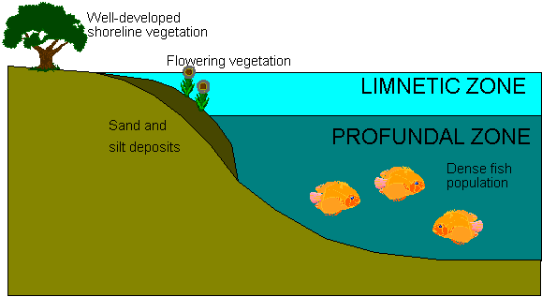
LITTORAL ZONE

