Slide 1
Lake Ecosystems
Part 2: Abiotic Factors affecting Aquatic Ecosystems
Pg. 104-106

Slide 2
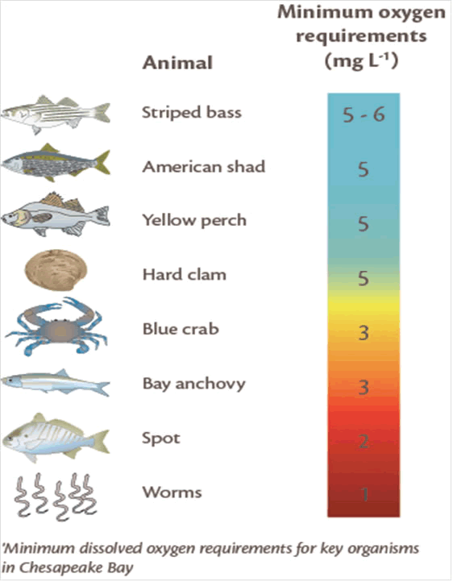
1. Chemical Environment
Type of water: fresh or salt
Dissolved oxygen available
Other dissolved minerals (phosphorus, nitrogen, pollutants)
Notes:
INB 4 flap of each Factor

Slide 3
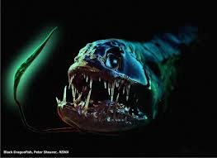
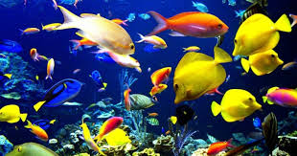
2. Temperature and Sunlight
Varies due to: seasons and water depth
Near surface will have more light and higher temperatures
There are organisms adapted for all types of light and temperature

Slide 4
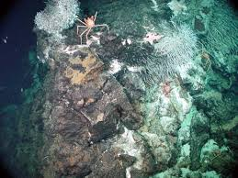
3. Water Pressure
Water is 800 times denser than air making it more difficult to move through
Organisms can be limited with ‘up and down’ movement’ because water pressure changes with water depth
Ocean bottom is crushing pressure; only a few animals live there

Slide 5
4. Seasonal Variations
Temperature layers: epilimnion, hypolimnion, thermocline
Epilimnion: upper level of a lake; warms up in summer
Hypoliminion: lower level of lake; remains at a low temperature
Thermocline: a narrow zone in which the temperature drops rapidly from warm to cold
Notes:
INB pocket of each season

Slide 6
4. Seasonal Variations
Pg. 105
Winter
Spring
Summer
Fall
Notes:
INB pocket of each season

