Slide 1
Lake Ecosystems
Part 3: Changes in Lake Ecosystems
115-119

Slide 2
Lakes defined by nutrients- pg. 115
Aquatic ecosystems are sustained by the dynamic equilibrium among biotic and abiotic factors.
Oligotrophic
Eutrophic
Notes:
INB of compare each

Slide 3
Changes in Lake Ecosystems
Oligotrophic
- deep, cold, clear water
- low nutrient levels
- few producers

Slide 4
Eutrophic
- shallow, warm
- high nutrient levels
- many producers (algae, plants, etc.)
- murky water
In general, oligotrophic lakes gradually become eutrophic over time in a process called eutrophication of a lake.

Slide 5
Water Pollution pg.115-116
Humans speed up eutrophication of lakes by adding in human wastes, fertilizer run off, household or industrial wastes and increasing thermal energy (raising the temperature of the water).
Organic solid waste
Disease causing organisms
Inorganic solid and dissolved minerals
Thermal energy
Organic compounds
Notes:
INB 5 flap

Slide 6
Organic solid waste – sewage and waste from food processing, as this matter is decomposed, oxygen in the water is used up.
2) Disease causing organisms – from animal waste.
Ex. Water borne diseases → typhoid fever
3) Inorganic Solids and Dissolved Minerals – fertilzers, salt from the roads, and mining waste.

Slide 7
4) Thermal Energy – waste heat from industry, which affects the amount of dissolved oxygen the water can hold. (warm water cannot hold as much)
5) Organic compounds – oil, pesticides, detergents.

Slide 8
Indicators of Water Quality pg. 117-118
Bacteria
Dissolved Oxygen
Biological Oxygen Demand
Notes:
Get out testing material

Slide 9
Indicators of Water Quality
There are three main indicators of water quality:
Bacteria Count
- the main bacteria found in water is coliform bacteria
- coliform bacteria occurs naturally in the intestines of humans and other animals
- the presence of coliform bacteria indicates the presence of fecal waste contaminating the water

Slide 10
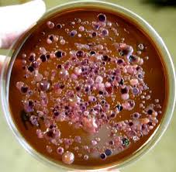
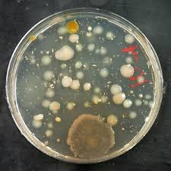
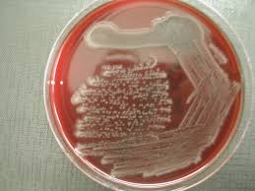

Slide 11
Indicators of Water Quality
2) Dissolved Oxygen
- Chemical reagents change color to indicate the amount of dissolved oxygen present in a water sample
- healthy lakes that are cool and not polluted have levels of dissolved oxygen from 8 -14 mg/L
- the level/amount of dissolved oxygen determines the organisms that live in that lake
- as dissolved oxygen drops, fewer organisms can be supported

Slide 12
3) Biological Oxygen Demand
- the amount of dissolved oxygen needed by decomposers to completely break down the organic matter in a water sample at 20 C over 5 days
- the BOD indicates the amount of available organic matter in a water sample
- if BOD is high, there are many decomposers, and less oxygen is available

Slide 13
Examples: Changes in Alberta lakes pg. 119-120
Salinity
Shorelines
Sewage

Slide 14
Salinity
Increased evaporation rates of water due to climate change
Result: Lake water levels are dropping.
Increased salinity, or changes in salt content of the lake water.

Slide 15
Shorelines
Cottage owners have changed the shorelines causing changes to the water quality.
Removal of plants along the shoreline.

Slide 16
Sewage
Addition of sewage to the lake water.
Addition of water pollution = detergents, gas, oil
Increased erosion and increased nutrients, increases the aging of the lake.

Slide 17
Reminder
Tomorrow: outdoor activity
Friday: morning Lab at Cummings Lake

