Slide 1
Who Eats Who?
Part A: Niches, Habitat, Invasive

Slide 2
Roles in Ecosystems
Each organism has a specific role that it fills in its ecosystem.
These roles are known as ecological niches.
Examples of niches:
It’s place in the food chain
It’s habitat
It’s breeding area
It’s most active time of day
Case Study Pg. 88-89 (#1-15)
Notes:
INB 4 petals

Slide 3
Different species inhabit different ecological niches.
Species will adapt or change so that they do not overlap niches.

Slide 4
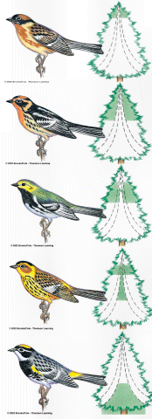
An example of adaption to niches is the warblers.
The Warblers
Competition for food is reduced because each species of warbler prefers to feed in a different section of the tree.
This means that each warbler is filling a different ecological niche within the forest ecosystem.
Notes:
INB 5 flap book

Slide 5
Exotic/Invasive/Introduced Species
The introduction of a new species to an ecosystem by humans is one of the main causes of species depletion and extinction.
These exotic or introduced species invade the ecological niches of native species and compete for food and other resources.
http://www.youtube.com/watch?v=qxxgflwX2Fg
Notes:
Frayer Model

Slide 6
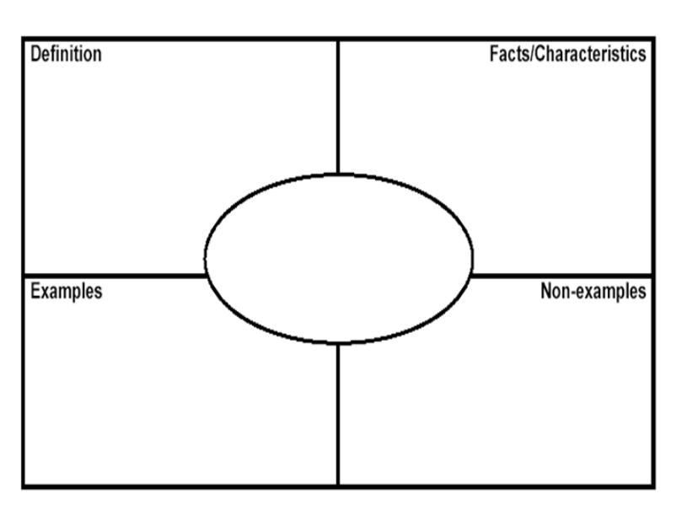

Slide 7
GAME
Invasive species outdoor (dry activity) game

Slide 8
Materials needed
Today: we need pinnies. The class will be divided into 3 equally sized groups except for 3 students.
And 4 hoola hoops

