Slide 1
Who Eats Who?
Part B- At Risk & Indicator Species
Pg. 11-14

Slide 2
Unbalanced = Risk
When an ecosystem becomes unbalanced it usually leads to multiple species being at risk.
At risk species are classified depending on the degree of risk.

Slide 3
Classifying At Risk Species
Threatened – a species that is likely to become endangered if factors that make it vulnerable are not reversed.
Extirpated – a species that no longer exists in one part of the country, but can be found in others.
Special Concern – any species that is at risk because of low or declining numbers in a restricted area.
Endangered – a species that is close to extinction in all parts of the country or in a significantly large location.
Extinct – a species that can no longer exist in any part of the world.
Notes:
5 flap INB

Slide 4
Indicator Species
What is an indicator species?
A species that is sensitive to environmental change.
When change occurs these animals will begin to die off.
When they die off we know that environmental change is occurring.
Notes:
Frayer model INB

Slide 5
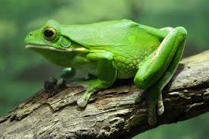
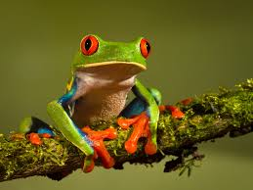
Indicator Species
An example of an indicator species is a frog.
Why do you think they are?

Slide 6
Why Are Frogs Disappearing?
Loss of Habitat
Wetlands and ponds are being filled in or destroyed by humans
Air and Water Quality
pollution is hard on frogs because their skin is very thin and not protected
frogs also breathe through their skin, so pollutants can easily pass into their system
Notes:
5 accordian INB

Slide 7
Climate Change
global warming increases Earth’s temperature
as Earth warms our wetlands will begin to dry up which greatly affects the frog population
Ultraviolet Radiation
- the thin skin of a frog is also susceptible to UV radiation which causes sunburn and cell damage

Slide 8
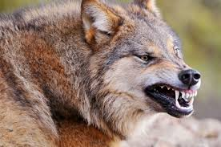
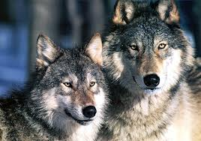
The Big Bad Wolf?

Slide 9
Are wolves good or bad?
What influences your conclusion/opinion?
Notes:
Have students write down their answers and select popsicle sticks for others to share. Perspective and what you value will influence your opinion… short term/long term; farm/ecology; safety/sustainability

Slide 10
Keystone Species
A keystone species is a plant or animal that plays a unique and crucial role in the way an ecosystem functions.
Without keystone species, the ecosystem would be dramatically different or cease to exist altogether.
http://education.nationalgeographic.com/education/encyclopedia/keystone-species/?ar_a=1
Notes:
Frayer model INB

Slide 11
Wolf Killings
In 1818, a "War of Extermination" against wolves and bears was declared in Ohio. Iowa began its own wolf bounty in 1858, with Wisconsin and Colorado following suit in 1865 and 1869. Wolf pelts soon began to increase in demand as American beavers began to become scarce from over-trapping.
Between 1916 and 1926 the National Park Service predator control program resulted in the extermination of sustainable packs of wolves in Yellowstone National Park by 1926.^{[38]} American wolf hunts peaked in the 1920s-1930s, when up to 21,000 were killed annually.^{[2]} After World War II, wolves were seen less as varmints and more as big game trophy animals

Slide 12
Restoration, not extermination
http://www.jyi.org/issue/restoration-or-destruction-the-controversy-over-wolf-reintroduction/
Pg. 15 in textbook

