Slide 1
Who Eats Who: Trophic Levels- pg.22-23
Trophic Levels
Food Chains
Food Webs

Slide 2
Trophic Levels
Trophic Level – a category of living things defined by how it gains its energy.
The first level contains autotrophs, and each higher level contains heterotrophs.

Slide 3
Autotrophs vs. Heterotrophs
Autotrophs – organisms that use the Sun’s energy and inorganic compounds to make its own food OR… just inorganic compounds
Heterotrophs – organisms that are incapable of making their own food, and so must feed on other organisms to gain energy.
Notes:
Compare/contrast flaps

Slide 4
Autotrophs
Food webs/chains/trophic levels always begin with autotrophs.
Remember an autotroph is: an organism that manufactures its own food from inorganic substances
There are two types of autotrophs:
Photosynthetic autotrophs
Chemoautotroph
Notes:
2 flap autotrophs with underlying titles

Slide 5
Photosynthesis
Plants are autotrophs who get their energy through the process of photosynthesis.
Chlorophyll
Light +Water + Carbon Dioxide → Glucose + Oxygen
Chlorophyll
Light +6H₂0_{(l)} + 6CO_{2 (g)} → C₆H₁₂O_{6 (aq)} + 6O_{2 (g)}

Slide 6
Cellular Respiration
All organisms, including plants, undergo cellular respiration in order to use the energy in their food.
Cellular respiration breaks down glucose, releasing the energy stored in its bonds.
Glucose + Oxygen →Carbon Dioxide + Water + Energy
C₆H₁₂O_{6 (aq)} +6O_{2 (g)} →+ 6H₂0_{(l)} + 6CO_{2 (g)} + energy
Notes:
Write equations down below

Slide 7
Chemosynthesis
Not all food webs begin with photosynthetic organisms.
In a few ecosystems, such as caves or deep oceans, producers carry out a process called chemosynthesis instead of photosynthesis.
Chemosynthesis – the process by which non-photosynthetic organisms convert inorganic chemicals to organic compounds with a source of energy other than solar.
Chemoautotroph – an organism that performs chemosynthesis.

Slide 8
Chemosynthesis
inorganic chemicals that are used:
H₂S, NH₃, Fe²⁺, and S₈
Example of Chemosynthesis equation:
This would be of a bacteria using ammonia
Ammonia + carbon dioxide + thermal energy nitrate + carbohydrate

Slide 9
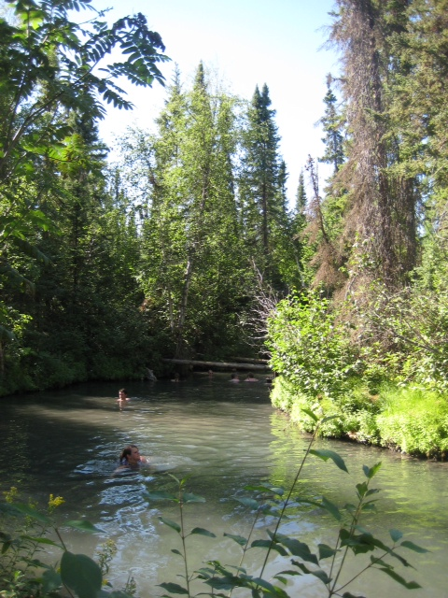

Slide 10
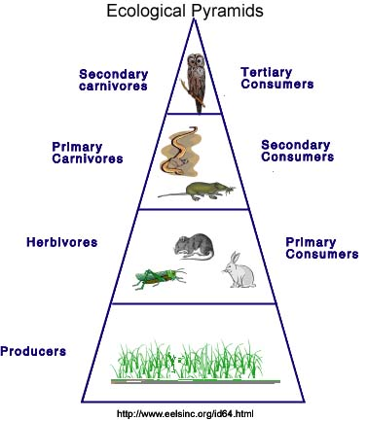
Trophic Levels

Slide 11
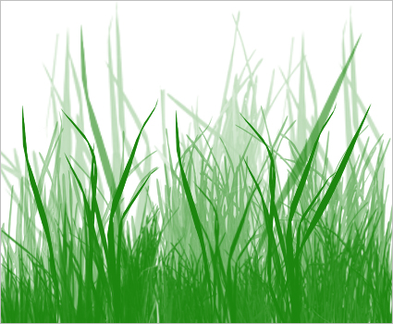
1st Trophic Level
Producers – organisms that make their own food.
Notes:
INB of 4 triangle

Slide 12
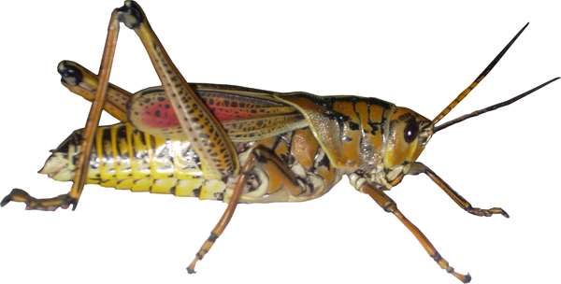
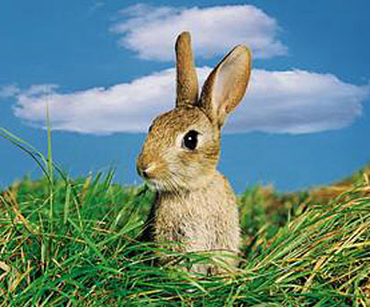
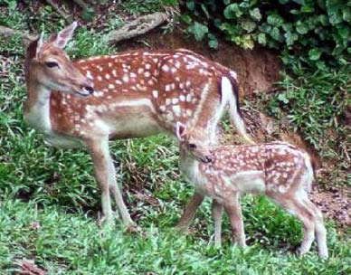
2nd Trophic Level
Primary Consumer – an organism that relies directly on producers (autotrophs) for its source of energy.

Slide 13
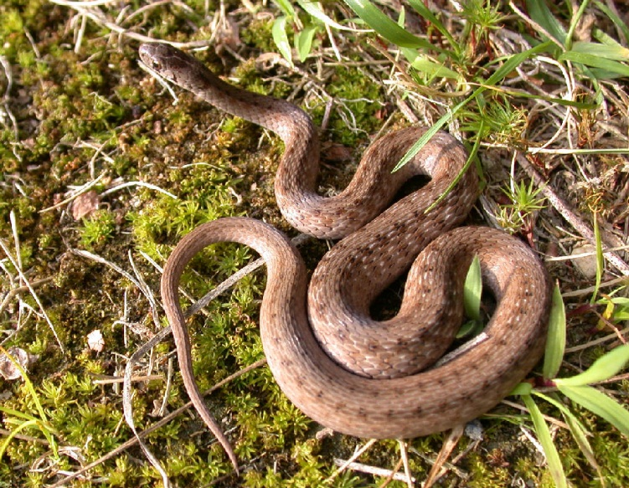
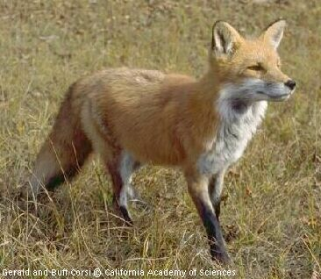
3rd Trophic Level
Secondary Consumer – an organism that relies on primary consumers for its principle source of energy.

Slide 14
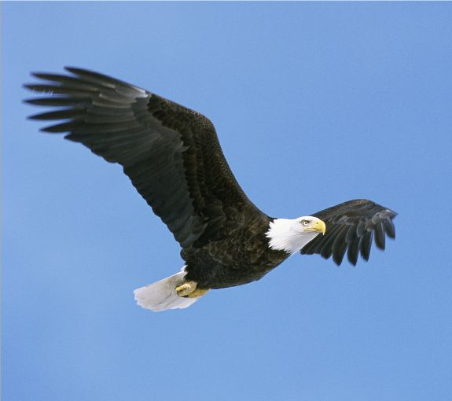
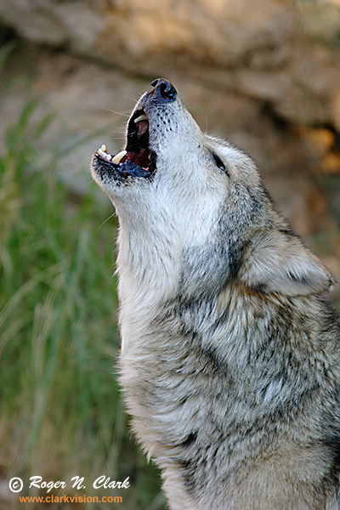
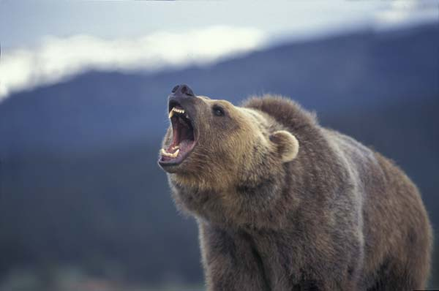
4th Trophic Level
Tertiary Consumer – an organism that relies on secondary consumers for its principle source of energy.

Slide 15
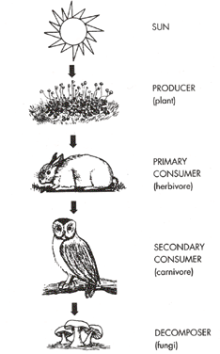
Food Chains
Food Chain – a step by step sequence of who eats whom in an ecosystem.
The final carnivore in any food chain is called a top carnivore.
Top carnivores are not eaten by other animals.
Notes:
INB of food chain and food web

Slide 16
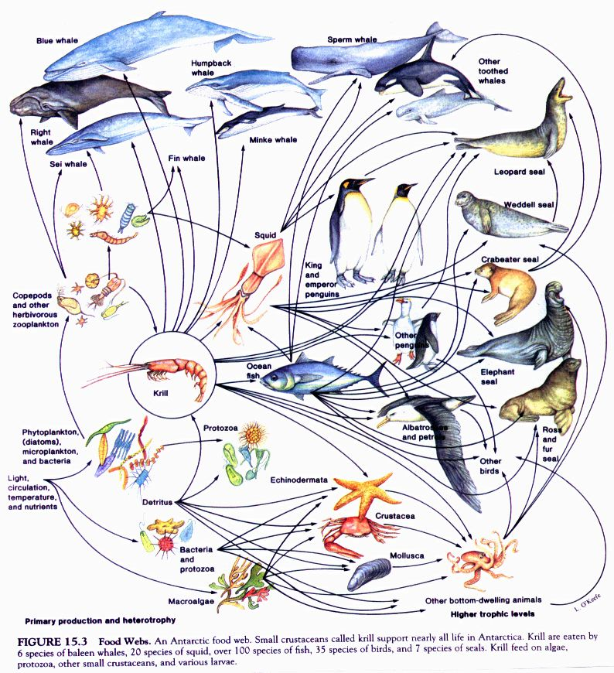
Food Webs
Food Web – a representation of the feeding relationships among all organisms in an ecosystem.

Slide 17
Practice questions

