Slide 1
Plants are multicellular organisms
Tissues – groups of cells performing the same function together
Organs – are tissues contributing to the same function in the organism.
Organs are a part of a system, and plants have 2 organ systems
shoot systems
root systems

Slide 2
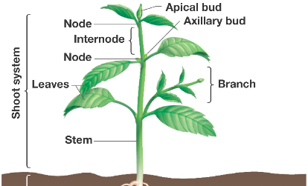
Plants are multicellular organisms
Shoot systems include:
everything that is above ground
stems, leaves, buds, flowers.

Slide 3
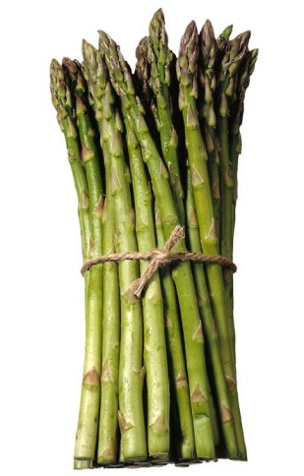
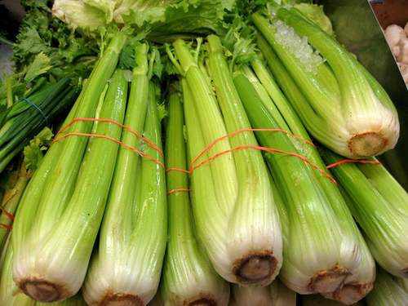
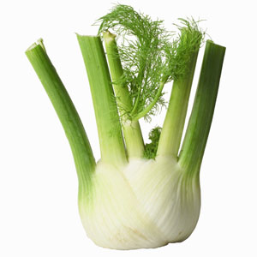
Shoots we like to eat!
3

Slide 4
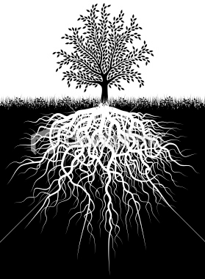
Plants are multicellular organisms
Root systems include:
everything underground
roots, tubers and rhizomes.

Slide 5
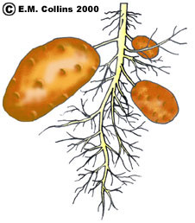
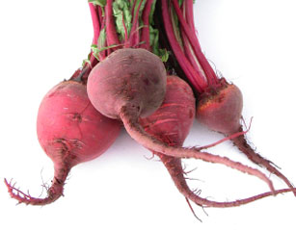
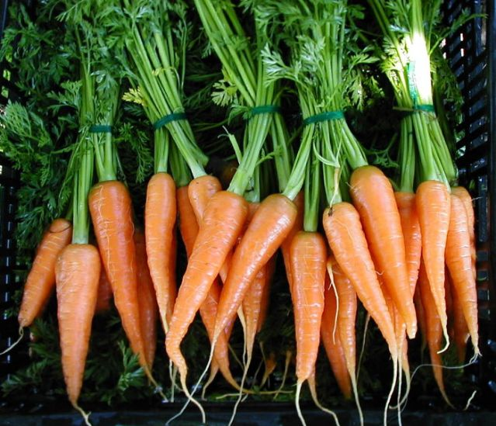
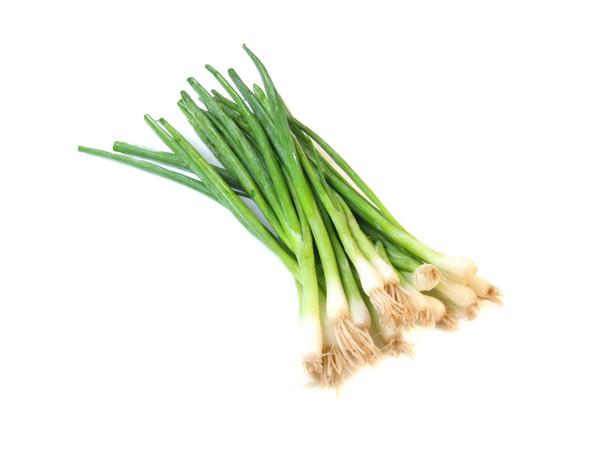
ROOTS WE LIKE TO EAT
5

Slide 6
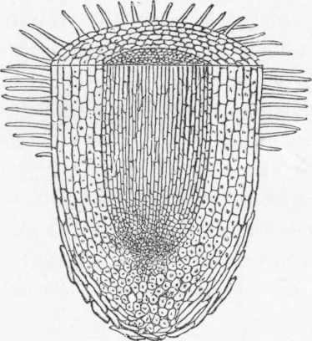
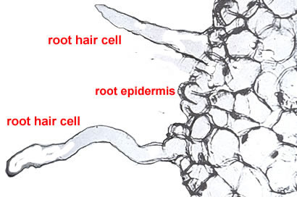
Root Hairs
Root hairs increase the surface area of roots. This allows them to absorb more water and nutrients when needed.
6

Slide 7
Plants are multicellular organisms
Plants grow, or increase in size by cell division

Slide 8
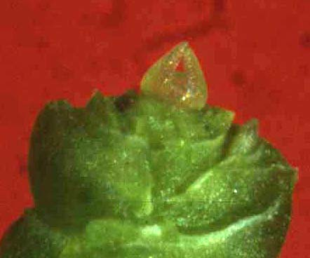
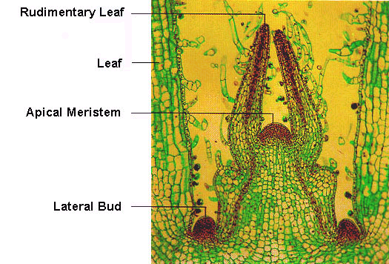
Plants are multicellular organisms
Shoot

Slide 9
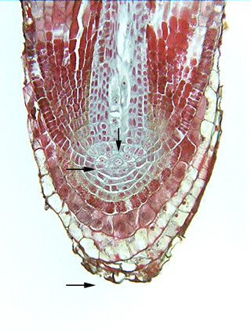
Root apical meristem
9

Slide 10
Plant Tissue
Plants are made of different types of tissues
Each tissue has a specific ‘job’ to do for the plant

Slide 11
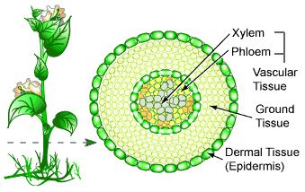
Epidermis
is the outer layer of cells

Slide 12
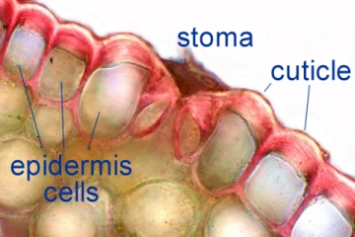
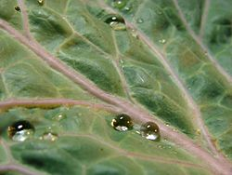
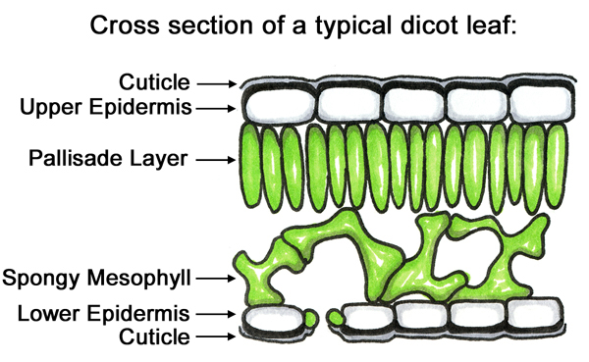
CUTICLE
The dermal tissue can produce a waxy substance to protect the plant called a cuticle.
12

Slide 13
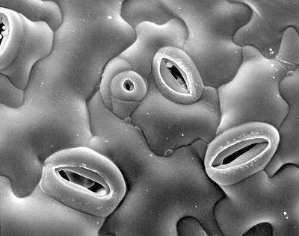
Stomata
The dermal tissue can also have specialized cells called stomata. They allow for gas exchange (in and out of cell to atmosphere)and are very important for photosynthesis. Guard cells open and close the stomata.

Slide 14
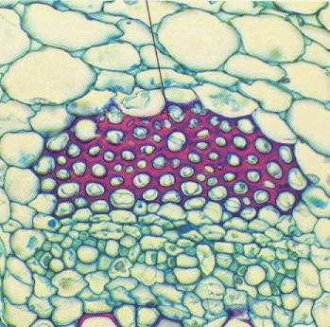
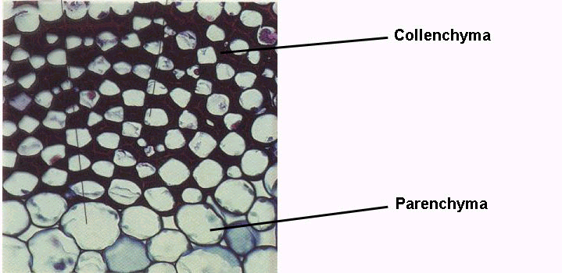
Ground Tissue
Ground tissue is located beneath the epidermis.
In the stem it helps support the plant

Slide 15
Ground Tissue
There are special ground tissue cells in the leaves of plants that help with photosynthesis
15

Slide 16
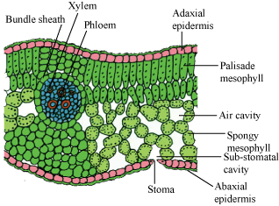
Ground Tissue
16

Slide 17
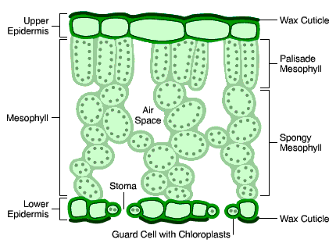
17

Slide 18
What is the formula for photosynthesis?

Slide 19
How do we get the gas?
How does the gas leave?

Slide 20
On your diagram label the movement of gas.

Slide 21
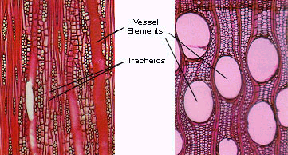
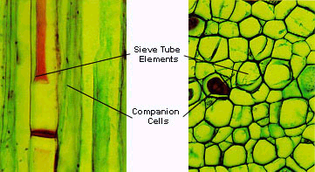
Vascular Tissue
Vascular tissue is responsible for moving materials around the plant.
Xylem primarily transports water
Phloem primarily transports sugar.
xylem

Slide 22
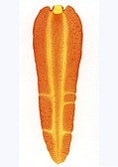
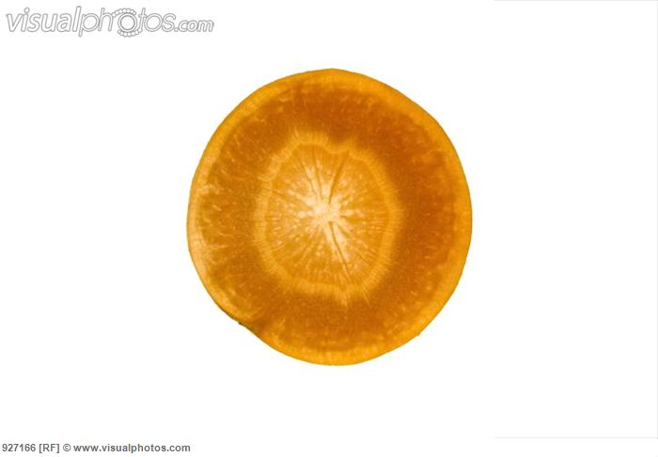
22

Slide 23
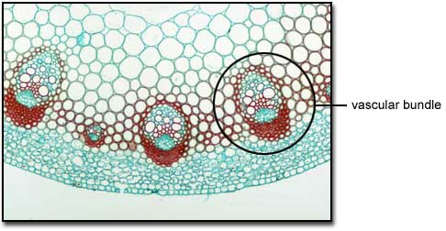
Phloem and xylem are packed together in vascular bundles
23

Slide 24
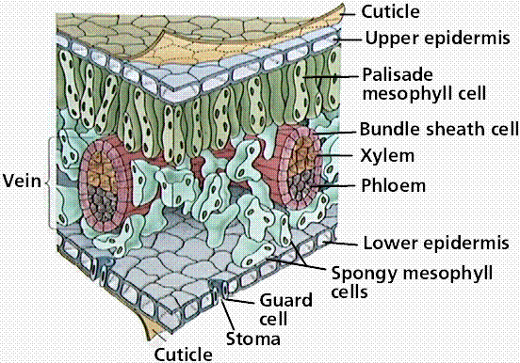
Plants are multicellular organisms
Dermal Tissue
Ground Tissue
Vascular Tissue
Dermal Tissue
Ground Tissue

