Slide 1
HOW IN THE WORLD??? Is there Transport in Plants
Several factors contribute to the plant being able to transport materials.
At the Roots
osmosis
root pressure
In the stem
cohesion/adhesion
At the stomata in the leaves
turgor pressure at stomata
transpiration pull at stomata
Notes:
Organize the slides differently so you just go by ‘the part of the plant’

Slide 2
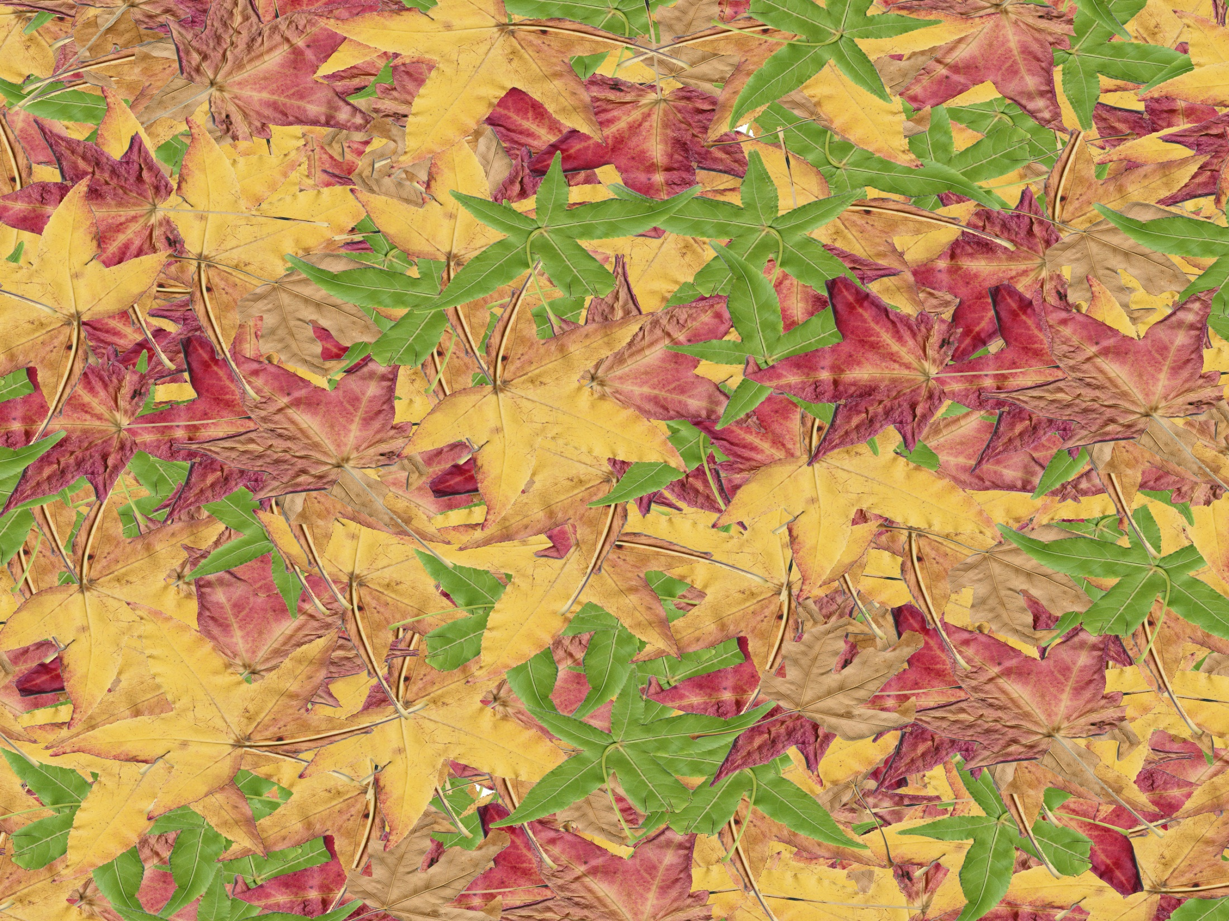
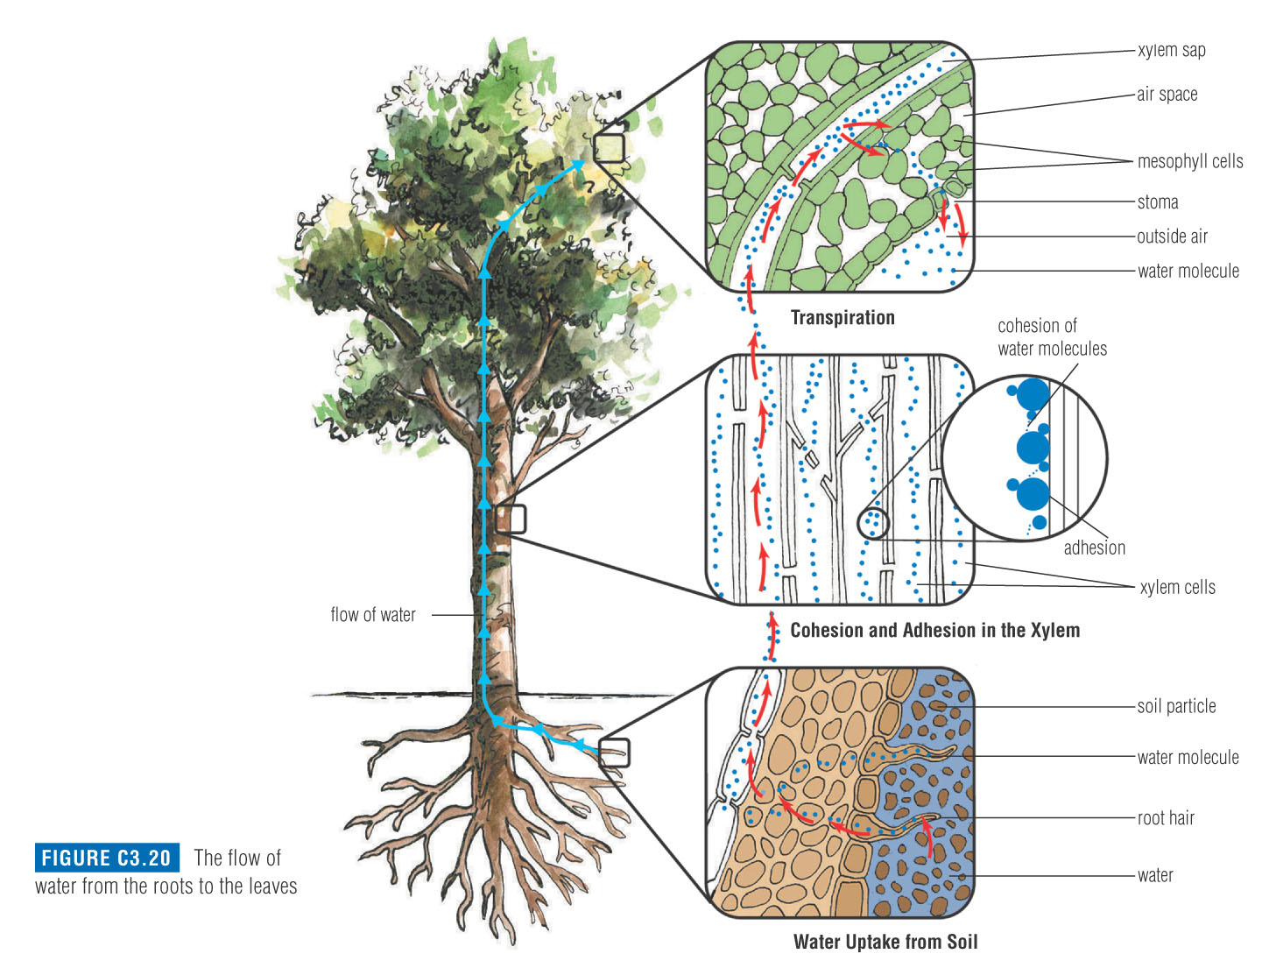
From Root to Leaf: Water Transport in Plants

Slide 3
Roots
osmosis
root pressure

Slide 4
At the Roots: Osmosis
There is higher solute concentration and lower water concentration INSIDE of the roots than outside, therefore water enters the roots through OSMOSIS
50

Slide 5
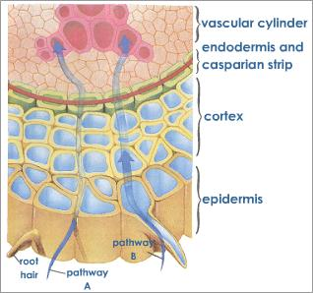
51

Slide 6
At the Roots: Root Pressure
As water continues to move into the roots through osmosis there will be a buildup of water in the roots. There will be so much water that it will increase the pressure in the roots called Root Pressure. The pressure in the roots will help to push the water up. (Like a geyser)

Slide 7
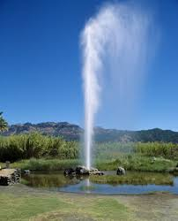

Slide 8
In the Stem
Cohesion
Adhesion

Slide 9
In the Stem: Cohesion & Adhesion
Cohesion= attraction of water molecules to other water molecules
Cohesion will cause the water molecules to stick together so when water is drawn up the molecules will all draw up together
47

Slide 10
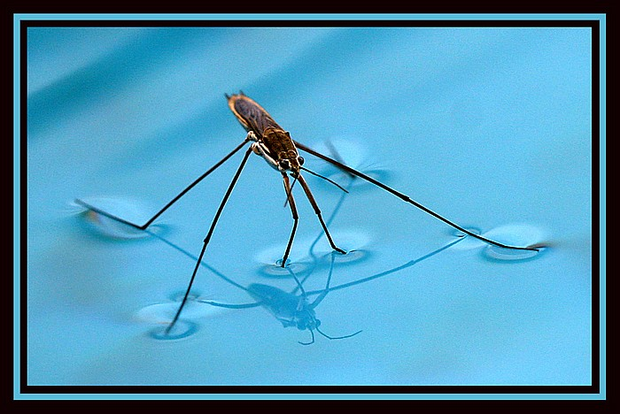
Cohesion makes surface tension
48

Slide 11
Adhesion= attraction of water molecules to other substances
Adhesion will cause the water molecules to stick to the sides of the stem and be drawn up the stem

Slide 12
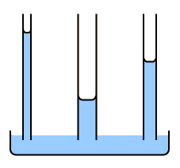
In the Stem: Adhesion
49

Slide 13
At the Leaves
turgor pressure at stomata
transpiration pull at stomata

Slide 14
At the Leaves: Transpiration Pull
Transpiration: the process of water vapor leaving the leaf through the stomata
This process pulls water up the stem. (remember that all the water molecules are connected with cohesion so it is like pulling up a long chain)
When Transpiration causes the water molecules to be pulled up the stem it is called Transpiration Pull
53

Slide 15
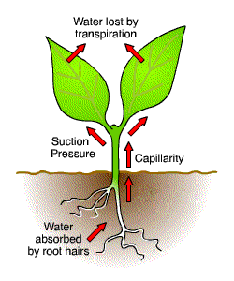
54

Slide 16
BUT… we can’t have the stomata open ALL the time! Why not?

Slide 17
TO SOLVE FOR THIS PROBLEM…..
The guard cells will adjust to either open or close the stomata through turgor pressure.
55

Slide 18
At the Leaves: Turgor pressure
If the guard cells are full of water they are turgid and have a high turgor pressure
When the guard cells are turgid they will be far apart therefore the stomata will be open
56

Slide 19
At the Leaves: Turgor pressure
If the guard cells are low on water they are limp and have low turgor pressure
When the guard cells are limp they will be collapsed therefore the stomata will be closed
56

Slide 20
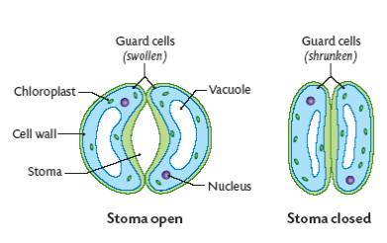
57

Slide 21
Stomata function:
http://www.youtube.com/watch?v=IlmgFYmbAUg
TedEd: https://www.youtube.com/watch?v=ASLUY2U1M-8

Slide 22
From Root to Leaf: Water Transport in Plants

Slide 23
Note: 334-336 in your textbook heading: Properties of Water, Root Pressure Pushes & Transpiration Pulls.
58

Slide 24
The mechanism of phloem transport is a critical process for multicellular plants.
It takes the products of photosynthesis from the place where they are produced, the leaves to places where they will be used or stored.
In other words they are taken from a high concentration (a source) to a low concentration (a sink).

Slide 25
At the leaf, the source of food, the phloem becomes loaded with sugar molecules from the sites of photosynthesis.
Water then moves into the cells by osmosis.
The water and sugar molecules then move into the sieve cells.
The increased water pressure in the sieve cells pushes the water and sugars through the phloem to other parts of the plant.
This movement of water and sugar is called the

Slide 26
Plasmolysis
When a plant cell is put into a HYPERTONIC solution, water will leave the vacuole through osmosis. This results in a ‘shriveled up’ plant cell. This process is called plasmolysis.
When would a plant cell ‘be in’ a hypertonic solution?
59

Slide 27
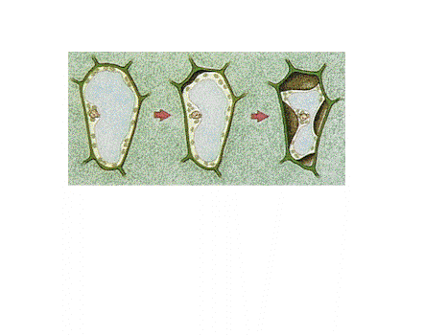
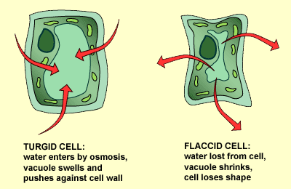
Plasmolysis
60

Slide 28
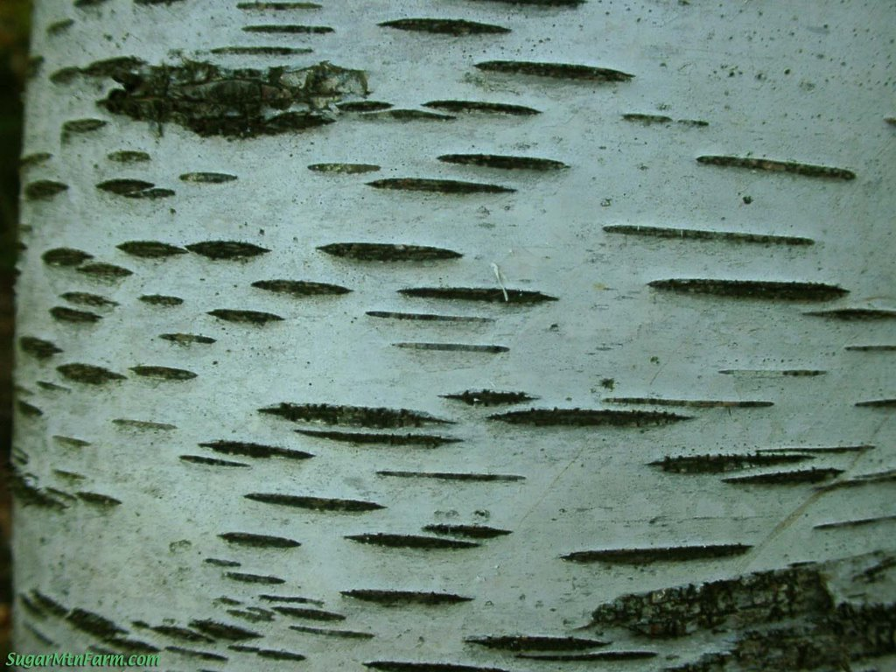
61

Slide 29
Lenticel
A soft opening in the stem allowing gas exchange from atmosphere to plant interior. The bark would otherwise ‘suffocate’ the plant.
62

