Slide 1
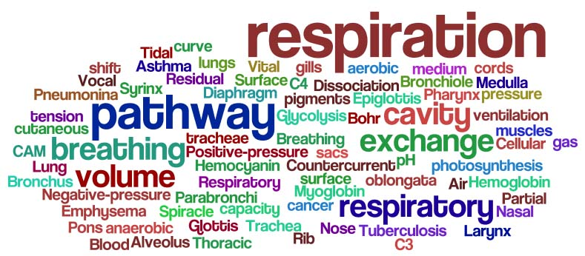

Slide 2
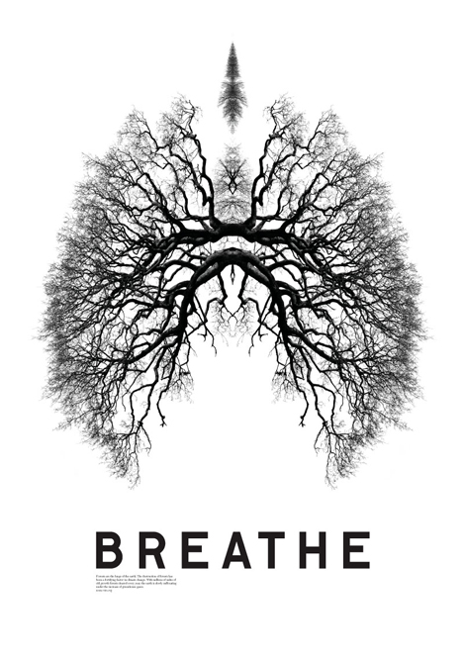
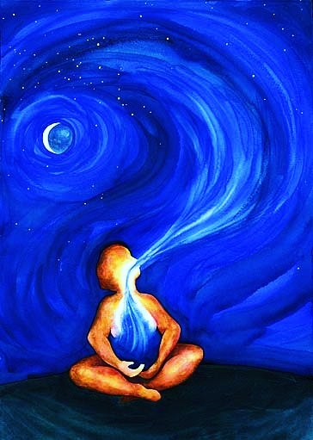
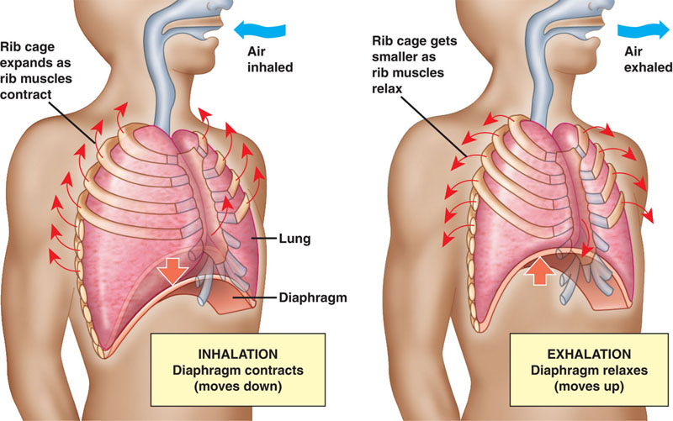
Breathing...
Why do we do it?
What is it for?
Where does oxygen go?
Why is it so crucial?

Slide 3
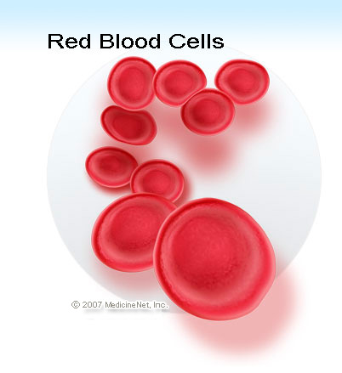
Always keep in mind the “Bigger Picture”
Oxygen is carried away from the lungs through very small blood vessels
Red blood cells transport oxygen to almost every cell in your body
In your cells, nutrients are oxidized to produce ENERGY through a process called METABOLISM
A by-product of this is carbon dioxide, which is transported through blood to lungs and exhaled.

Slide 4
Today: Structures (pg. 282-285) Journey of oxygen
Nasal passage
Pharynx
Larynx
Trachea
Bronchi
Bronchiole
Alveoli

Slide 5
Accessory Respiratory Organs
Epiglottis
Diaphram
Rib muscles (intercostal)

Slide 6
Structure of Respiratory System (think: structure= function)

Slide 7
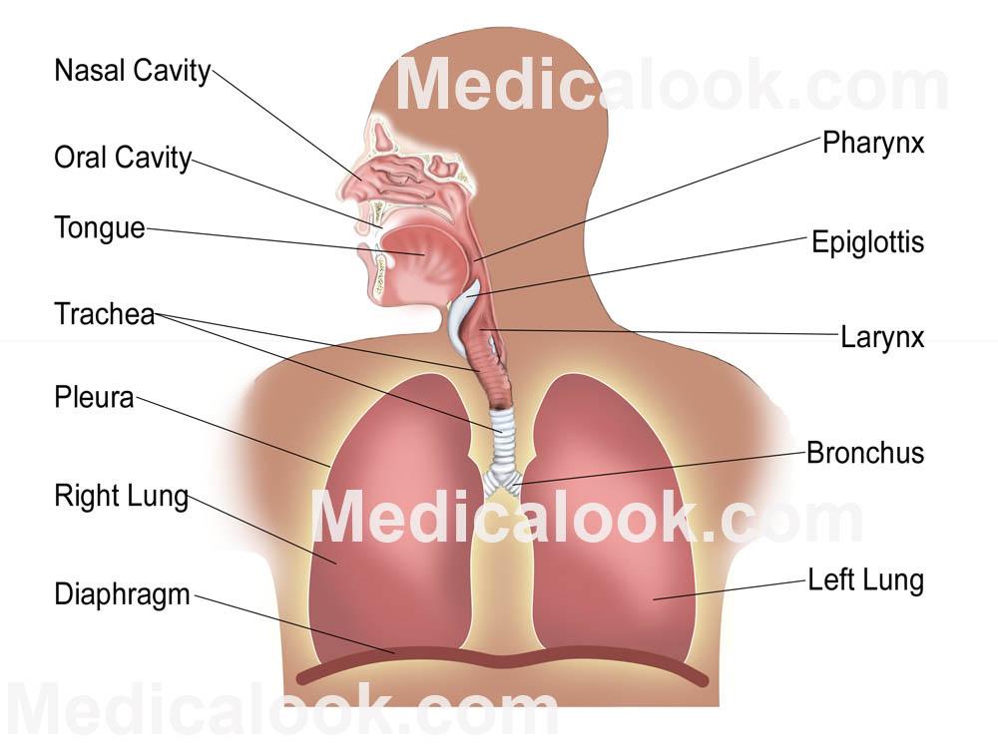

Slide 8
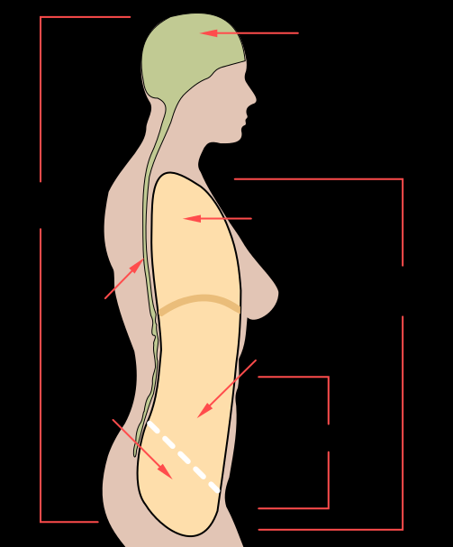
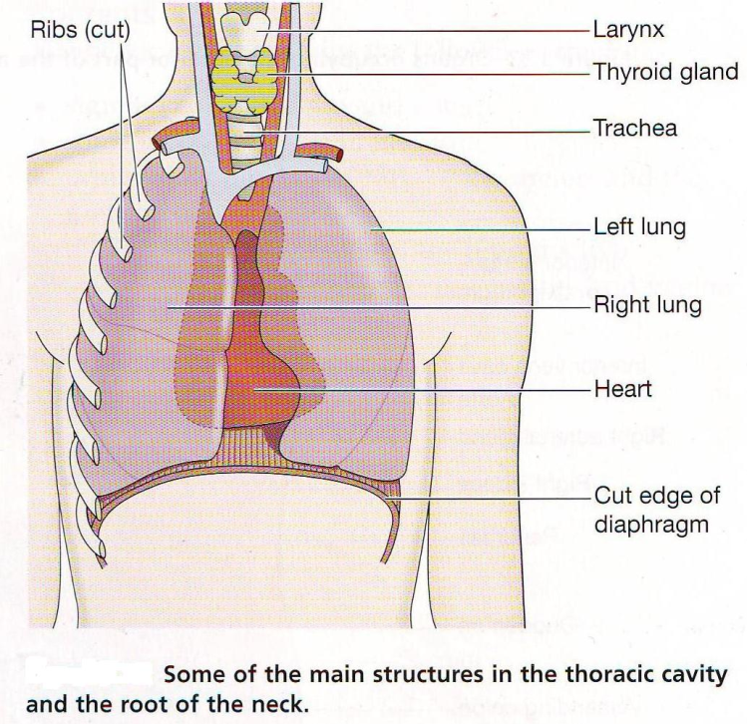
Thoracic Cavity
Contains the lungs, heart
Protected by the Thoracic Cage (ribs, diaphragm, rib muscles)
Thoracic cavity

Slide 9
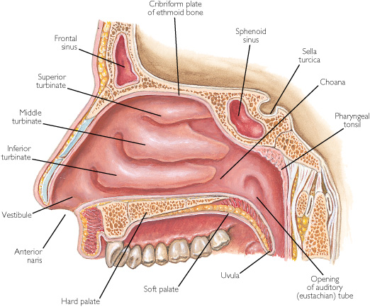
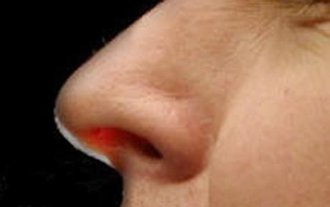
Nasal Passage
Mucous traps unwanted particles
Epithelia warms air
Prepares air for lower respiratory system

Slide 10
Pharynx/ Larnyx
Pharynx is common tube for food, gas, liquid
Pharynx branches into the esophogus and the larnyx
The larnyx is only reserved for gas and connected to the Trachea

Slide 11
Cilia
Cilia are small hair like projections that line the trachea
Some cells in the trachea produce mucus
The mucus traps debris that may have escaped the filters in the nasal passage
The debris is swept by the cilia from the windpipe back into the pharynx

Slide 12
Vocal cords
Vocal cords are located in the larynx
Sound is made when air passes over the larynx
Swelling of vocal cords= lower frequency vibrations (when you are sick your voice goes deeper)

Slide 13
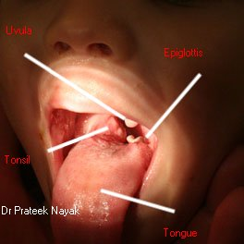
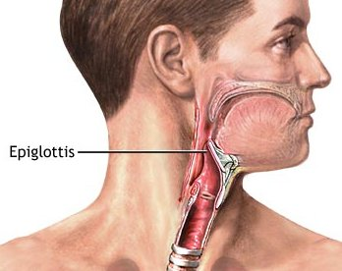
Epiglottis
Elastic cartilage tissue with mucous membrane
Attached to the entrance of the larynx
Covers the glottis which is the opening to trachea
Covers larynx during peristalsis of pharynx muscles (swallowing)

Slide 14
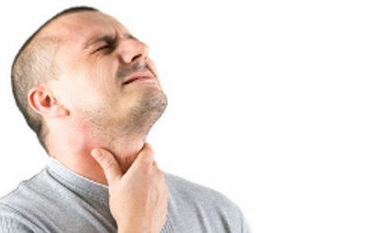
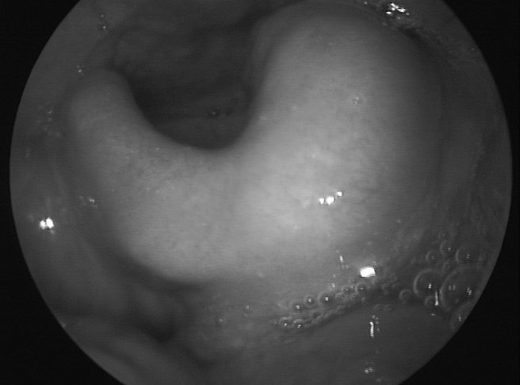
More epiglottis
Now that we know is structure... What would be its function?
What happens when epiglottis malfunctions?
Ex. Epiglotitis= swollen epiglottis from infection from Haemophilus influenzae

Slide 15
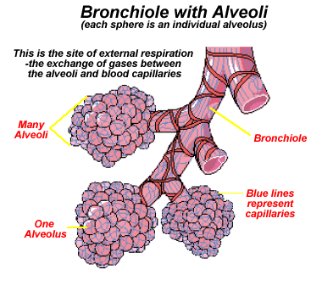
Bronchi/Bronchiole
The trachea connects to the Bronchi
The Bronchi branch off into Bronchioles
Bronchioles branch off into alveoli
The more branching that occurs the thinner the membrane and less muscle tissue

Slide 16
Alveoli
Thin membrane
Surrounded by many capillaries (very thin blood vessels- one cell thick)
Primary exchange for gas
Oxygen and carbon dioxide diffuse across the thin alveoli membrane into capillaries

Slide 17
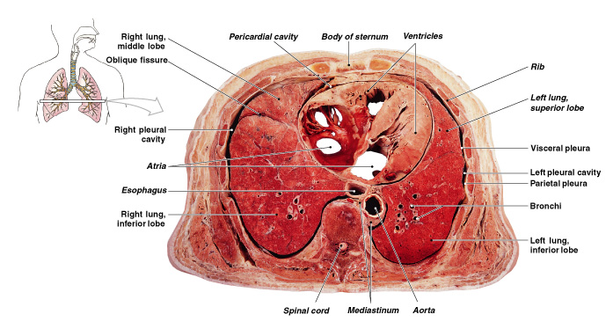
Pleural Membranes
1 Pleural Membrane surrounds 1 lung
Holds and protects the lung
Allows for ventilation

Slide 18
Rib muscles (intercostal muscles)
-elevates or depresses ribs during breathing cycles

Slide 19
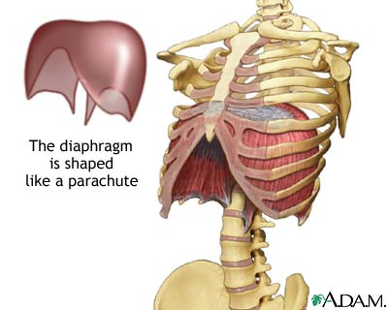
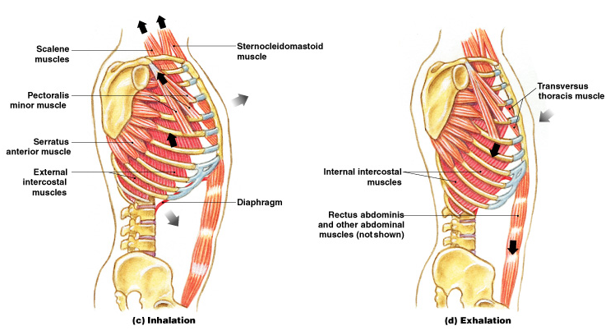
Diaphragm
A muscle that contracts or relaxes to change the shape of the thoracic cavity

Slide 20
questions
pg. 285 #4-5
pg. 287 #1-9

