Slide 1
Breathing Processes
1. Physical ventilation
2. Gas Diffusion
3. Gas Transport

Slide 2
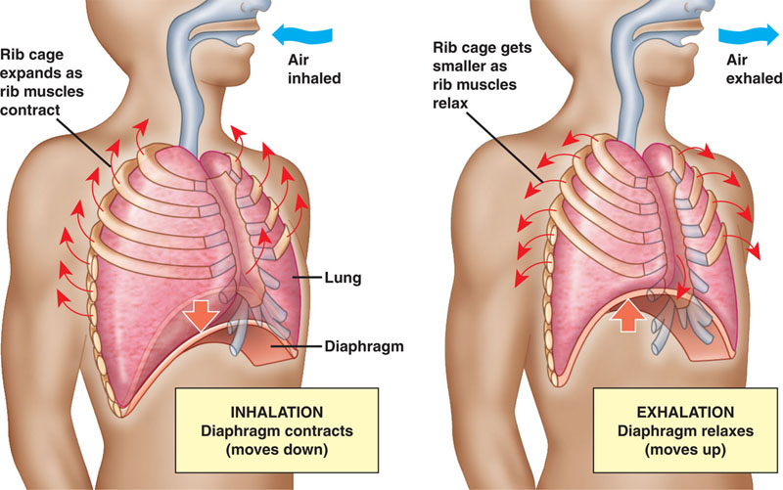
Physical Ventilation

Slide 3
INHALE
-Diaphragm contracts, flattens: thoracic cavity pressure decreases
-Rib muscles contract, expands rib cage: thoracic cavity pressure decreases
-Air moves from high pressure (outside) to low pressure (lungs)= inhalation

Slide 4
EXHALE
-Diaphragm relaxes, moves up: thoracic cavity pressure increases
-Rib muscles relax, reduces rib cage: thoracic cavity pressure increases
-Air moves from high pressure (lungs) to low pressure (outside), ‘deflating’ the lungs= Exhaling

Slide 5
SUMMARY TO REMEMBER
INhale air =CONTRACT (diaphragm + rib muscles)
EXhale air= RELAX (diaphragm + rib muscles)

Slide 6
Pressure Changes
Air will move from areas of high pressure to areas of low pressure
An increase in volume decreases pressure
A decrease in volume increases pressure
If our diaphragm +rib muscles coNtract =more volume in thoracic cavity & low pressure in the lungs then... air moves IN (iNhale)
If our diaphragm+ rib muscles relaX (eXhale)= less volume in thoracic cavity & high pressure in the lungs, air moves OUT

Slide 7
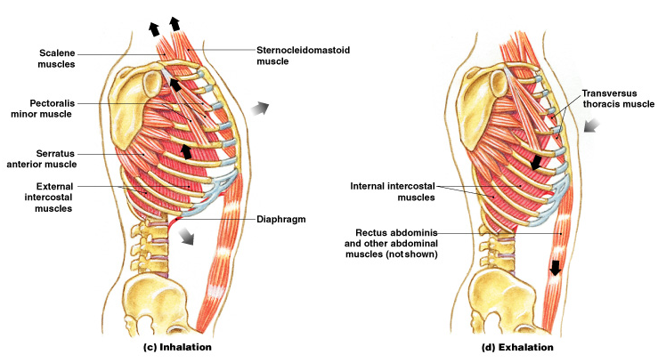
Check it out... Note: you don’t need to know all of the terms in this diagram- just the diaphragm + intercostal muscles and the mechanisms involved with breathing

Slide 8
Temperature Changes
The lungs are a warm, moist environment to allow for efficient gas exchange: the alveoli would not be able to function if their thin membranes weren’t moist (they’d dry up)
Air is warmed through Nasal passage, Trachea, Bronchi, and Bronchioles before arriving at the alveoli
That is the air you exhale is warmed that the air you inhale

Slide 9
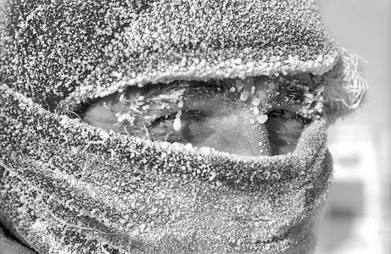
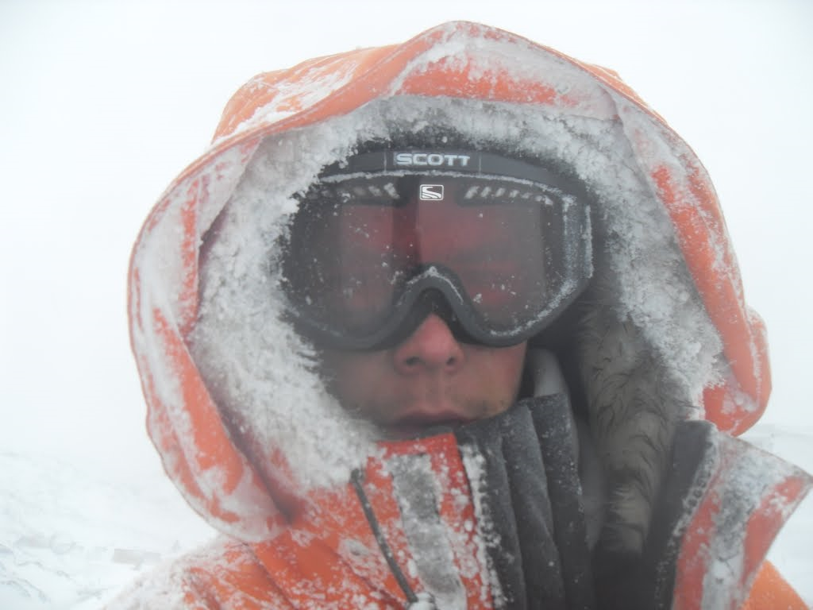
Nasal Passage Warming
What happens on a cold day?

Slide 10
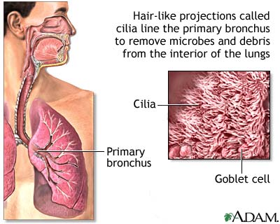
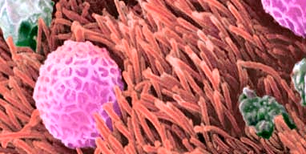
Mucous and Cilia
Mucous keeps the Respiratory system moist and traps unwanted particles.
Cilia sweeps the mucous into the throat (which you either cough up and spit or swallow down esophogus)
What happens when cilia are damaged?
What is smokers cough?

Slide 11
Respiratory Cycle
Respiratory Cycle= complete cycle of inhalation and exhalation
Tidal Volume= amount of air moved both in and out in respiratory cycle

Slide 12
Expiratory Reserve Volume= maximum total air exhaled
Inspiratory Reserve Volume= maximum total air inhaled
Vital Capacity= maximum amount of energy a person can expel following maximum inhalation
Vital capacity= Inspiratory Reserve Volume+ Expiratory Reserve Volume+ Tidal Volume

Slide 13
Application: Controversial Topics
In groups of 2-3 people
Discuss your article and the corresponding questions
Briefly jot your answers down
Be prepared to share with the class
Hand in your answers at end of class

Slide 14
Questions??
What is the main idea/topic or issue in your article?
What is your opinion/reaction to the article?
What are the proposed solutions to the issue or topic?
What sorts of technology do we have to help this issue?
How do you think the problem/issue should be addressed?

Slide 15
Article 1
Smokers occupy one-third of hospital beds: study in Quebec
Researchers found that those who smoke, or used to smoke heavily, occupy 32.6 per cent of hospital beds in the province. The report concludes that caring for smokers in hospital costs Quebec's health-care system $930 million a year.
The Health Ministry is preparing to file a multibillion-dollar class-action lawsuit against the tobacco industry to recuperate some of its losses.Officials are also looking into stronger anti-smoking legislation in the fall, including banning smoking in cars when children are around.

Slide 16
Article 2
World No Tobacco Day
According to the World Health Organization (WHO), tobacco use is the leading cause of preventable death
WNTD) is observed worldwide every year on May 31st to help smokers abstain from consuming tobacco for at least 24 hours, smokers are also encouraged to give up the habit for life.
WHO is persuading more countries to sign a global treaty to ensure public protection from smoking.
In Indonesia there are 21 million child smokers. There is essentially nothing to stop companies promoting cigarettes to youth. In countries such as Brazil and Nigeria tobacco companies sponsor party nights to attract new young users. In Russia, women are persuaded to smoke by selling cigarettes branded by the fashion giant Yves Saint Laurent.

